Slide 1
THE WORLD HERITAGE
Gemstone collection created by Victor Tuzlukov ©

Slide 2
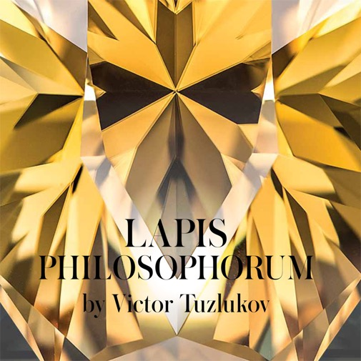
Beginning. “Philosophical stone” collection
2009.
10 stones.
10 philosophical conceptions.

Slide 3
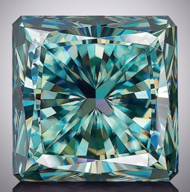
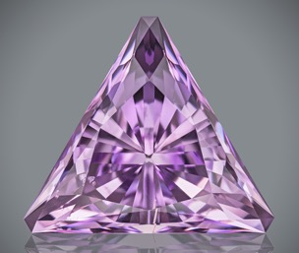
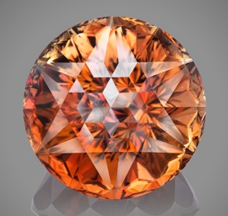
Beginning. “Philosophical stone” collection
Example of multi-layered symbolism:
3 stones (“Birth of Star”, “Great Sacrifice”, “Mystery of Universe”) – 3 stages of spiritual evolution (awakening, renunciation, transformation) – 3 letters of synthetic conception name (D – A – O)

Slide 4
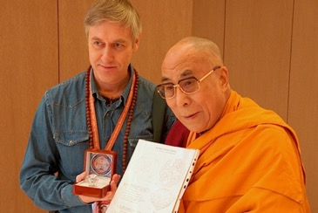

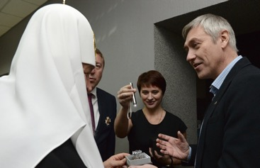
Next step.
7 summits (religions)
Meetings with spiritual Leaders.
Buddhist, Orthodox, Catholic…

Slide 5
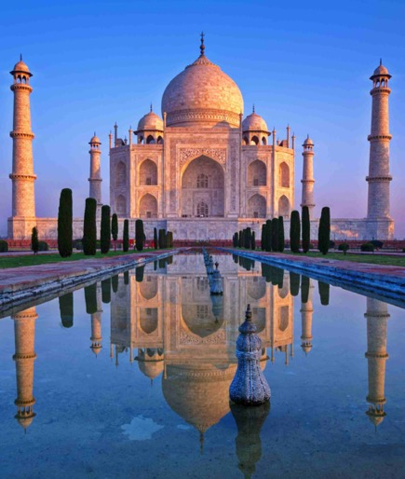
New project.
World heritage
“Please don’t ask me how many stones will be included to this collection. This is project of my life, because it is more than my life. Because the world cultural heritage is really inexhaustible…”

Slide 6
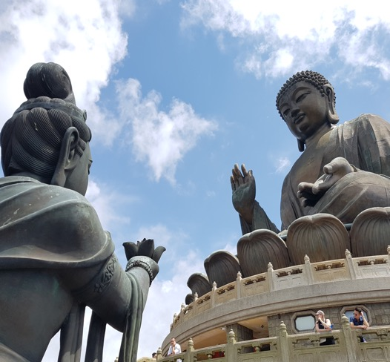
World heritage
Introduction
Initially my goal was to show grains of Wisdom kept in the world cultural heritage…

Slide 7
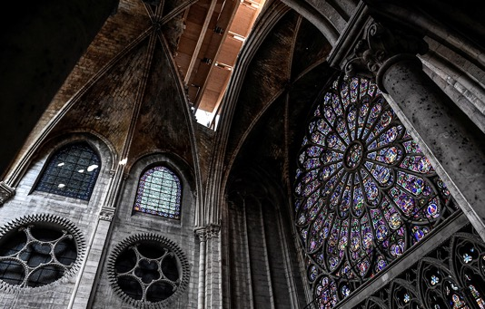
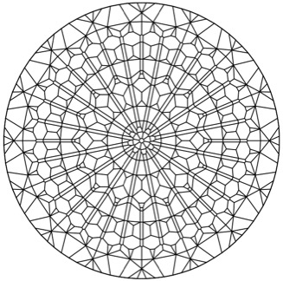
World heritage
Introduction
I feel grateful to my French colleague Lionel Bailey, who gave me the idea to show the stain glass of the cathedral in the faceting diagram.

Slide 8
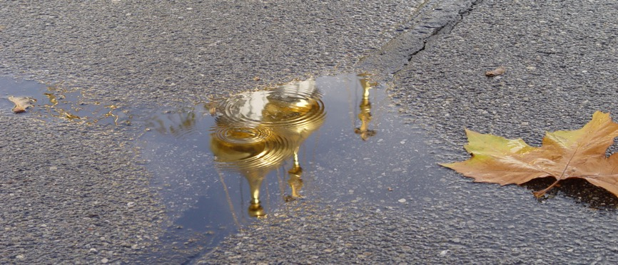
World heritage
Introduction
How do different peoples express Wisdom, Love, Beauty and Harmony? What is the contribution of this or that country to the world cultural treasury?

Slide 9
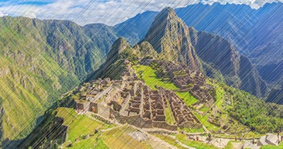
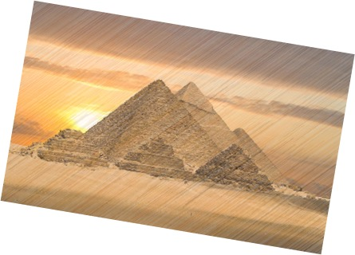
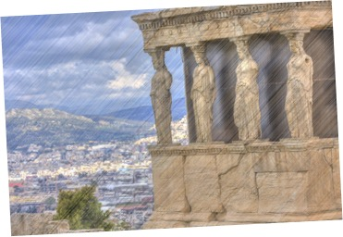
World heritage
Introduction
I want to cover gone civilizations as well, which are the same bricks in the wall of the world heritage.

Slide 10
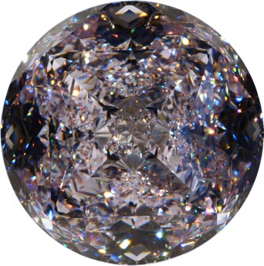
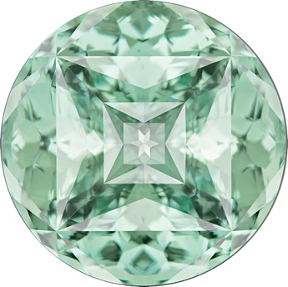
World heritage
Introduction
Sometimes the synthetic rough with its high optical characteristics gives the opportunity to reveal the author's idea more completely.

Slide 11
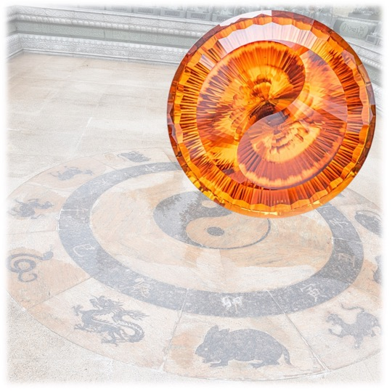
World heritage
1. China
“FROM THE EMPTINESS”
«Ever-dozing Dragon of the Eternity reveals his dual essence from the great Emptiness, forming the Universe. Like a precious flower, the Single Life twinkles inside…»

Slide 12
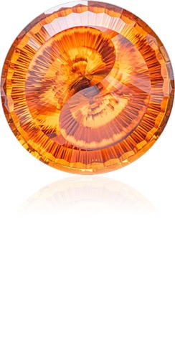
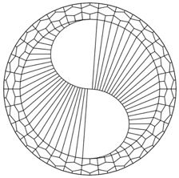
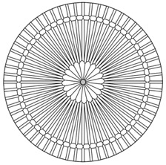
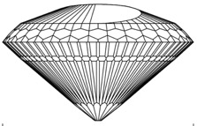
World heritage
1. China
“FROM THE EMPTINESS”
Photo: Dmitry Stolyarevich
Fire Citrine
187 carats
712 facets

Slide 13
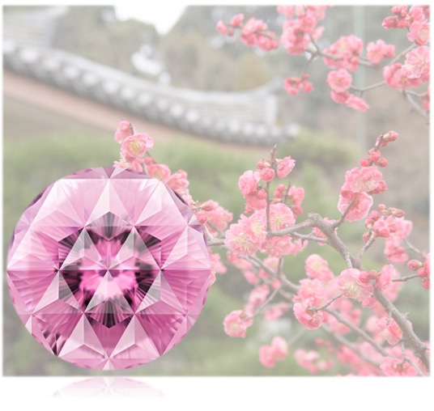
World heritage
2. japan
“FACES OF PERFECTION”
«Sakura finishes blossoming quite fast, and flight of arrow is swift. But the beauty of flower is immortal, as well as the power of flying arrow. Power and Beauty are two faces of the single Perfection… »

Slide 14
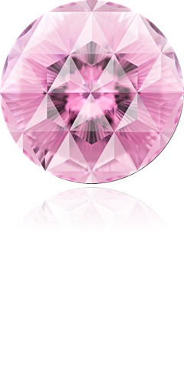
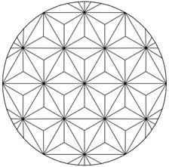
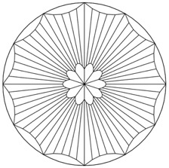
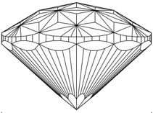
World heritage
2. JAPAN
“FACES OF PERFECTION”
Photo: Arjuna Irsutti
Kunzite
122 carats
250 facets

Slide 15
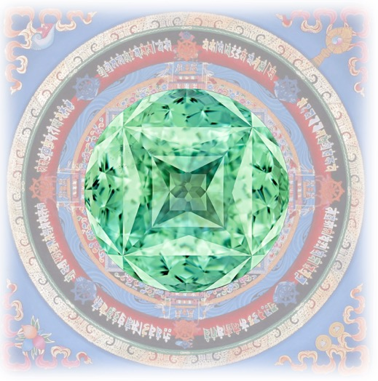
World heritage
3. TIBET
“REFLECTION OF THE GREAT”
«The Great Mandala is shining in the small gemstone. A small man is realizing the great teachings. The tiny may contain the Grand, being the beginning, the end and the evolution itself… »

Slide 16
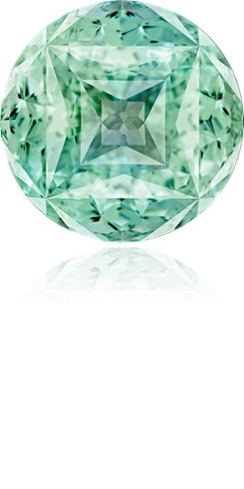
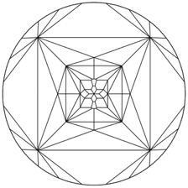
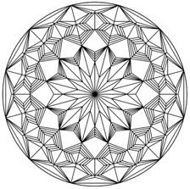
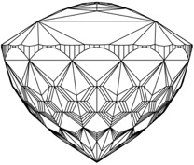
World heritage
3. TIBET
“REFLECTION OF THE GREAT”
Photo: Arjuna Irsutti
Topaz
161 carats
722 facets

Slide 17
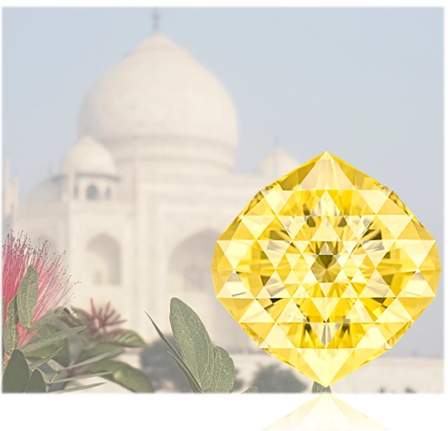
World heritage
4. INDIA
“HEART AND ESSENCE”
«Beauty is the goal and means; Ray of the Middle Way – Ray of Saving – is shining like a treasure in the Lotus flower between the ways of Destroying and Creation, similar to spirit of three-tongued flame, being the heart and the essence of our Universe… »

Slide 18
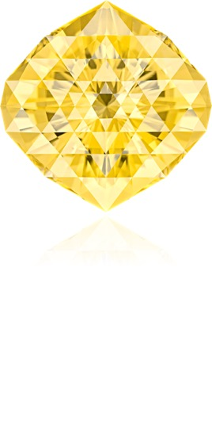
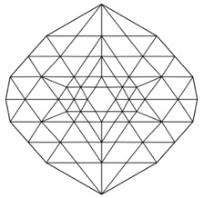
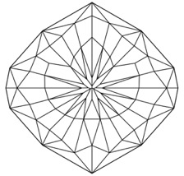
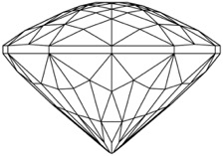
World heritage
4. INDIA
“HEART AND ESSENCE”
Photo: Arjuna Irsutti
Scapolite
199.9 carats
205 facets

Slide 19
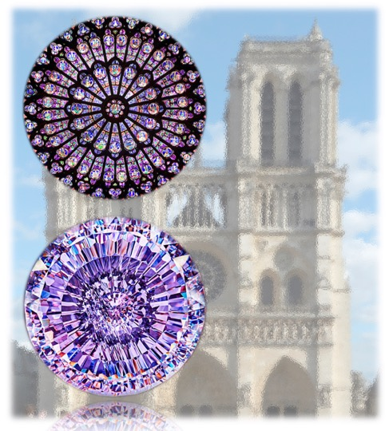
World heritage
5. FRANCE
“FRAGILITY OF THE ETERNAL”
«History teaches us how fragile our heritage could be: what had been created and kept by centuries might be damaged or even destroyed in a matter of hours…»

Slide 20
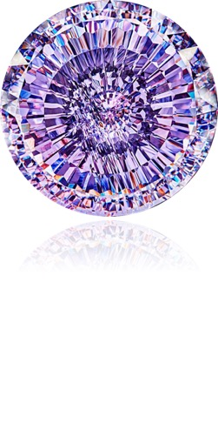

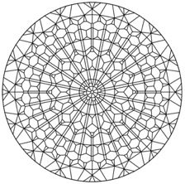
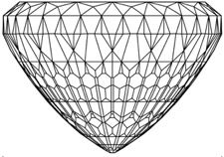
World heritage
5. FRANCE
“FRAGILITY OF THE ETERNAL”
Photo: Dmitry Stolyarevich
Cubic Zirconia (synthetic)
427 carats
860 facets

Slide 21
Thanks for your attention!
E-mail: vtuzlukov@hotmail.com
Whatsapp: +7 926 732 0799

