Slide 1
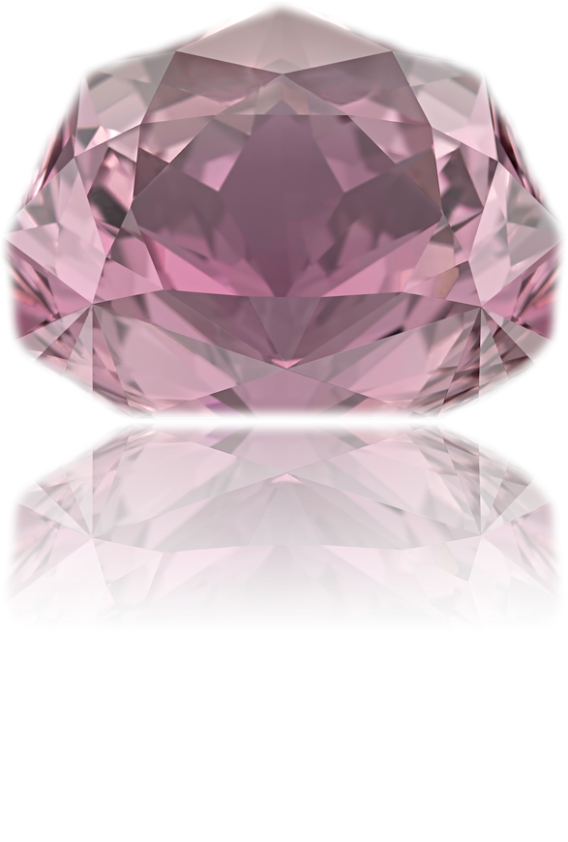
The “constellation” collection
Victor Tuzlukov (Russia – Thailand)

Slide 2
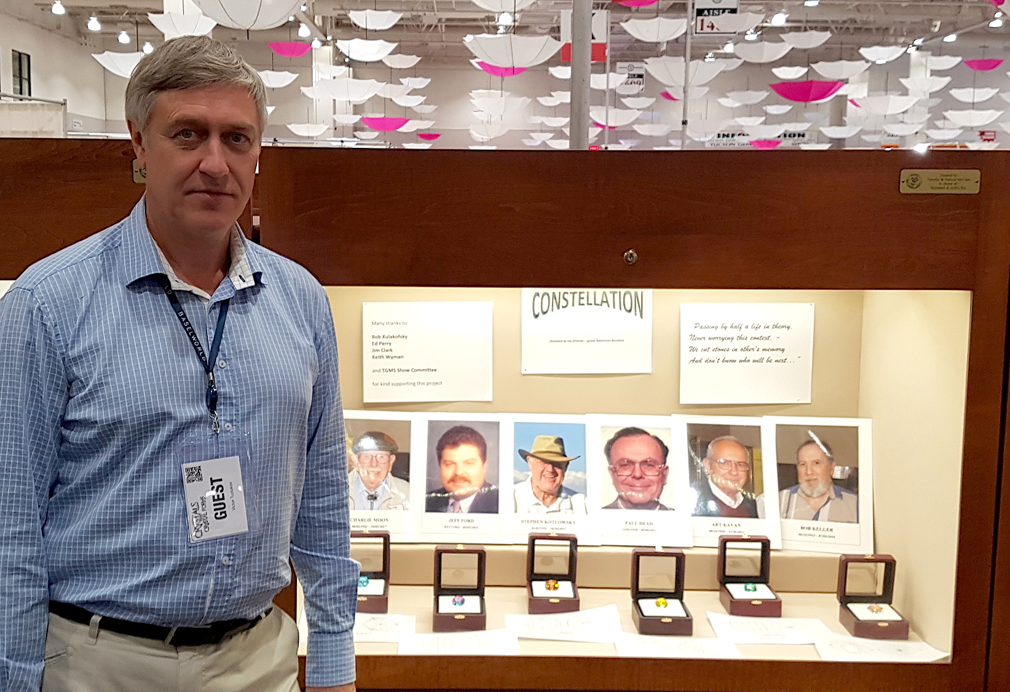
Exposition at TGMS Show - February, 2018

Slide 3
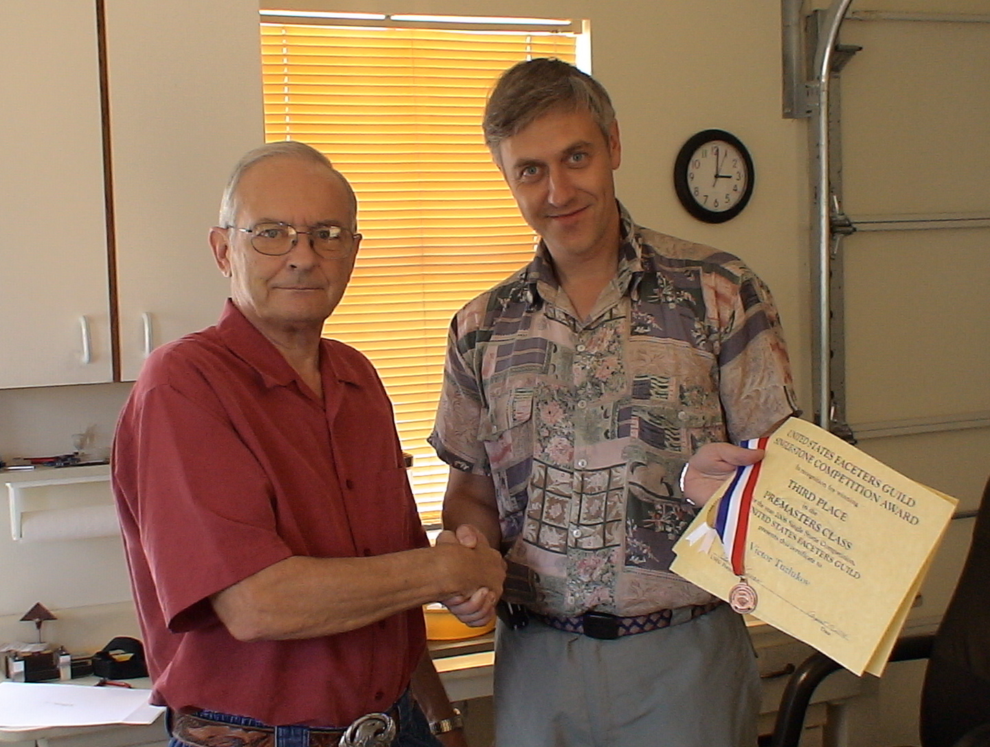
With Art Kavan – August, 2006.

Slide 4
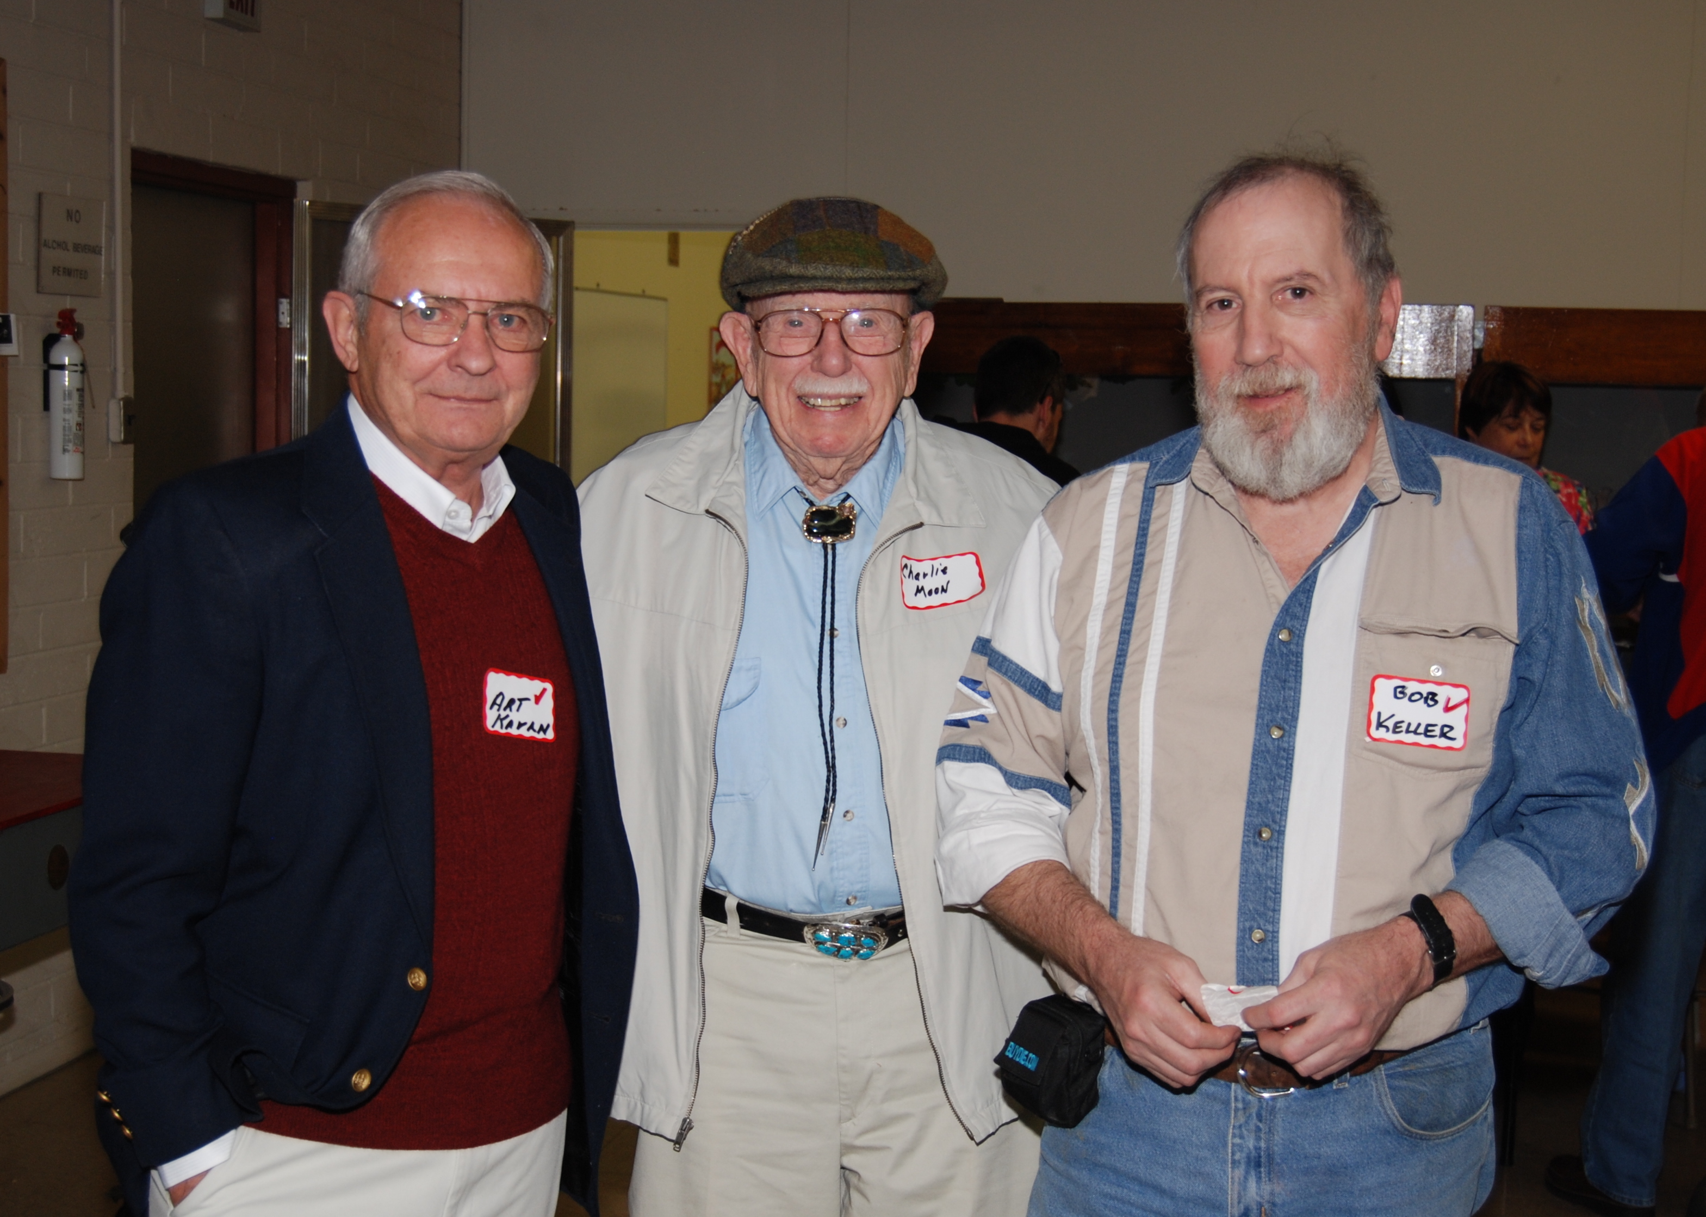
Art Kavan, Charlie Moon, Bob Keller – February, 2007.

Slide 5
Stephen Kotlowsky

Slide 6
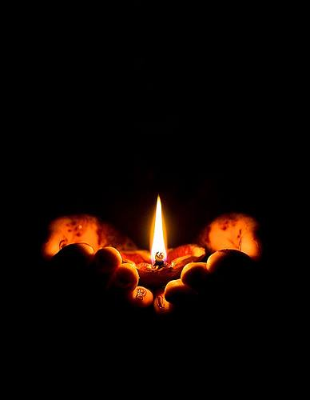
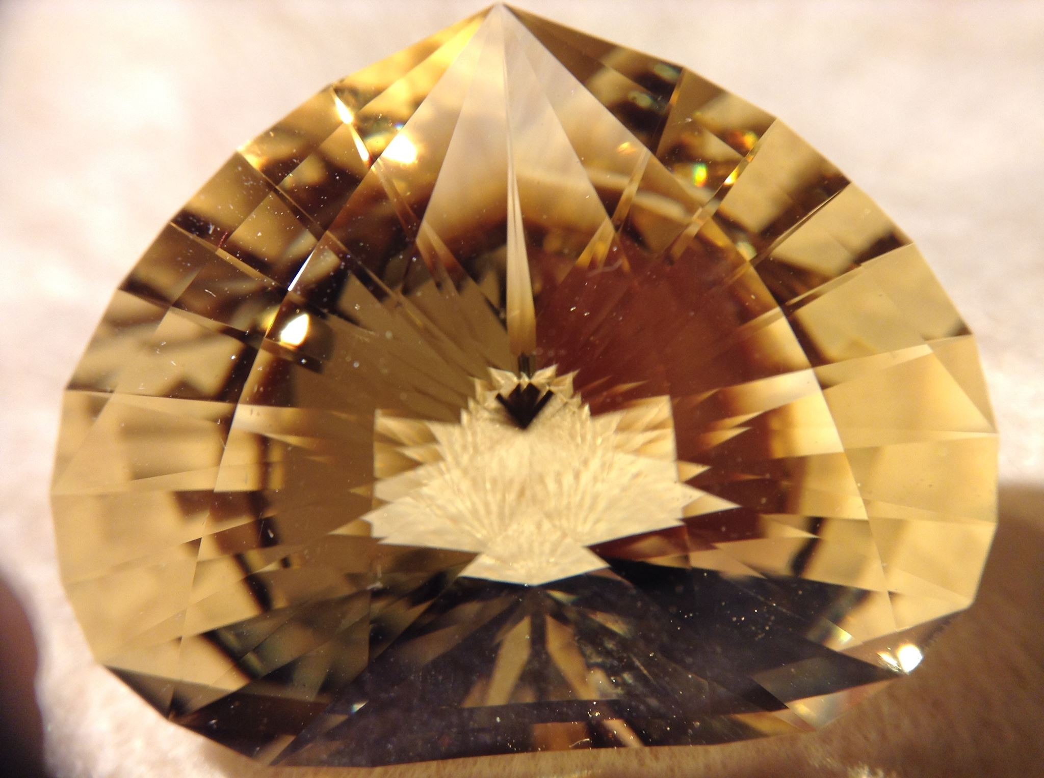

Slide 7
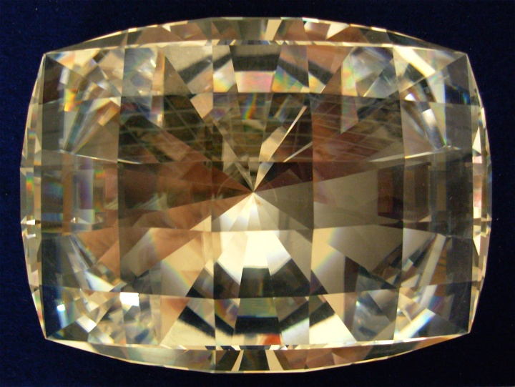
Quartz about 15,000 carats faceted by Art Kavan

Slide 8
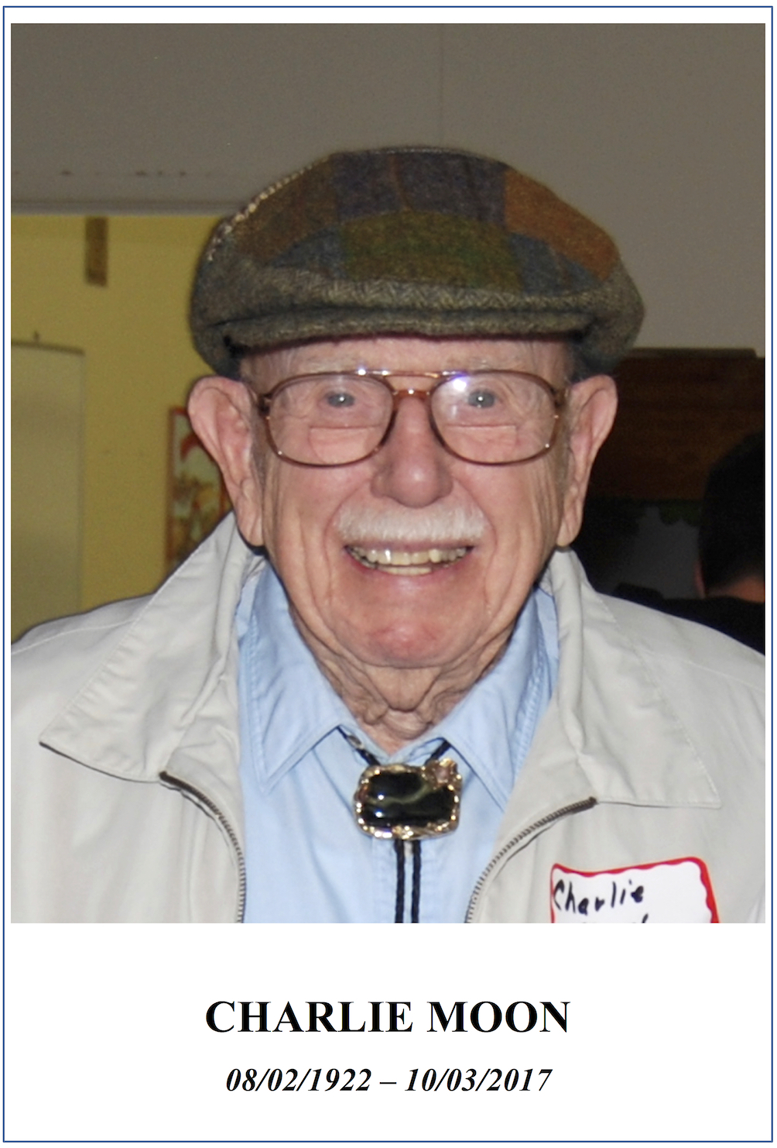
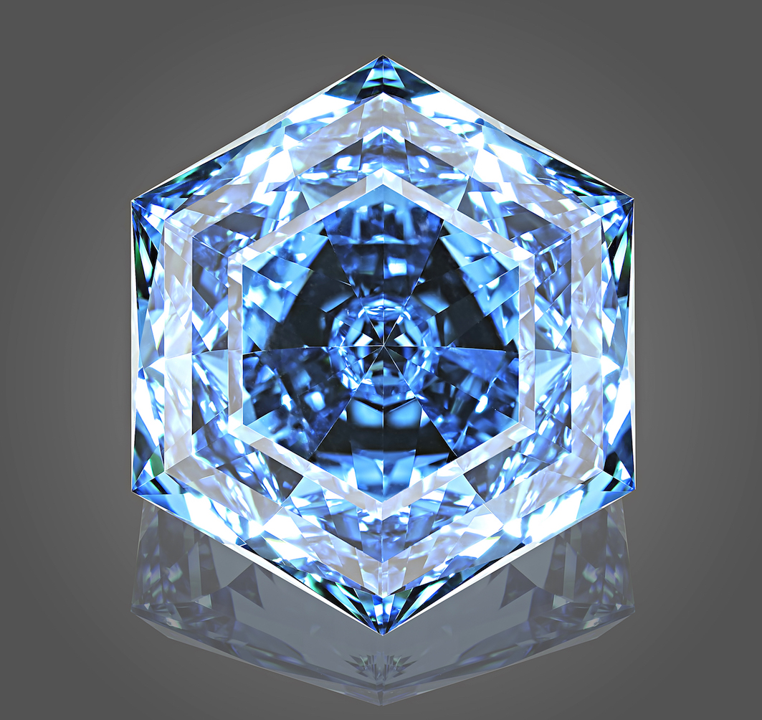
“Chevron Hexagonal #6”
98.98 carats

Slide 9
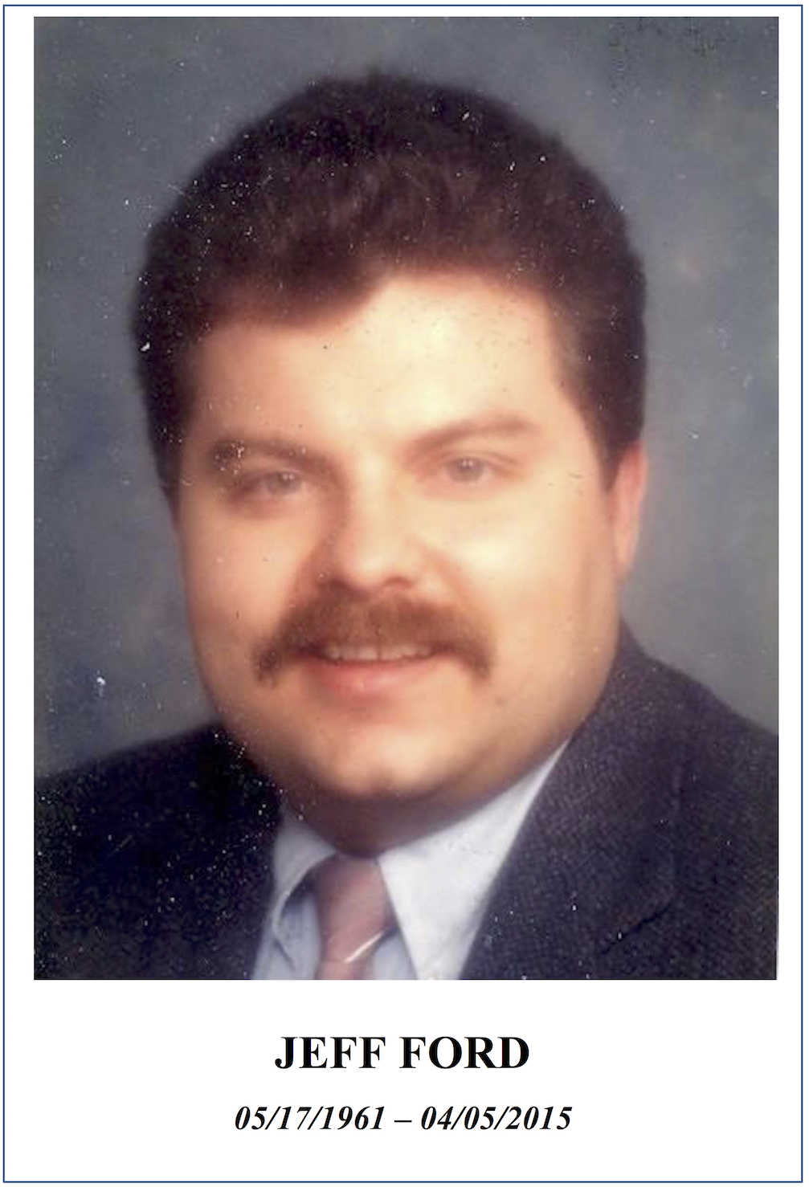
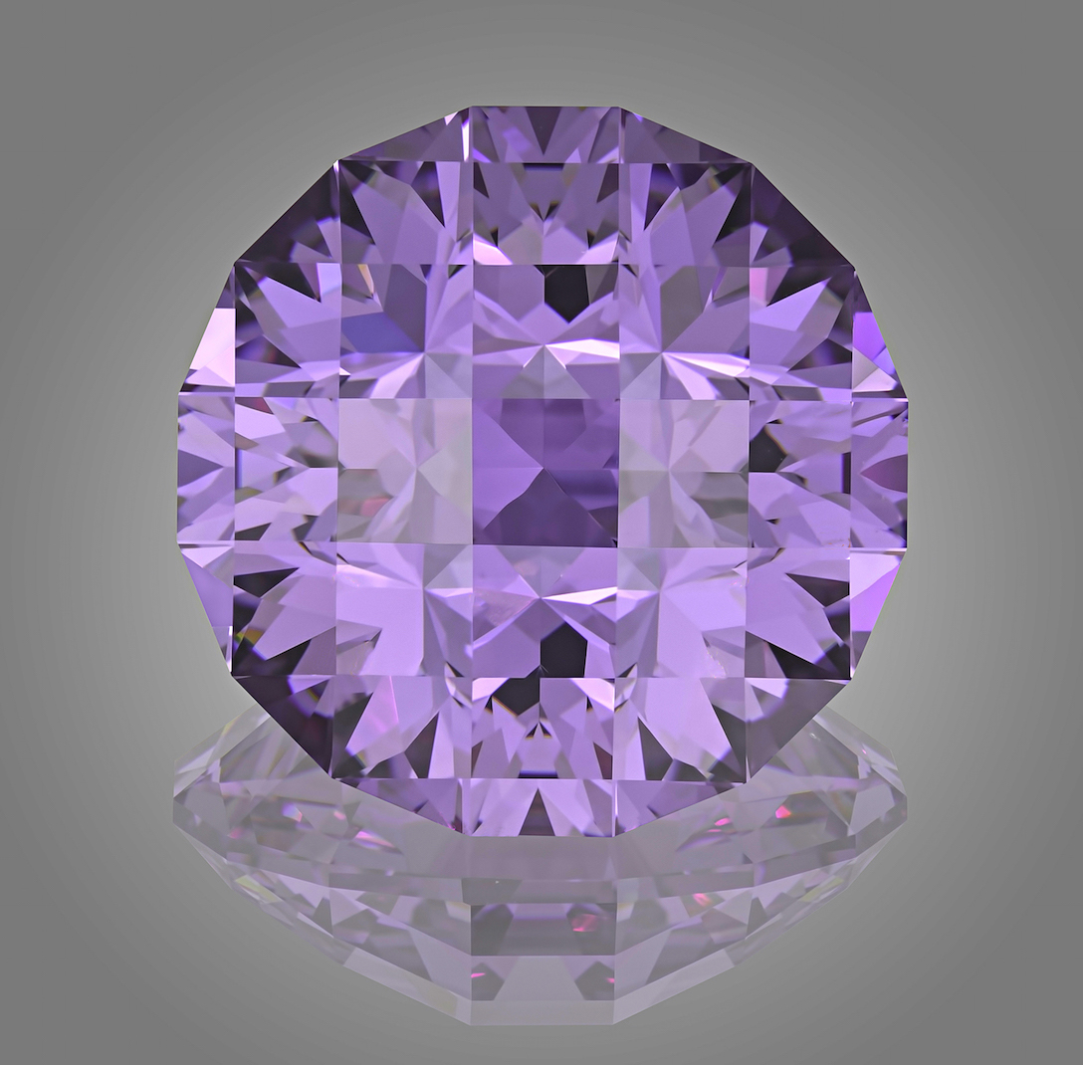
“Check it”
110.60 carats

Slide 10
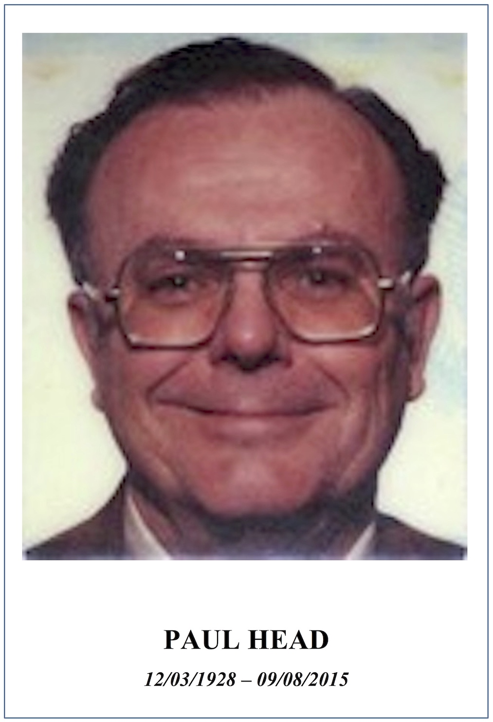
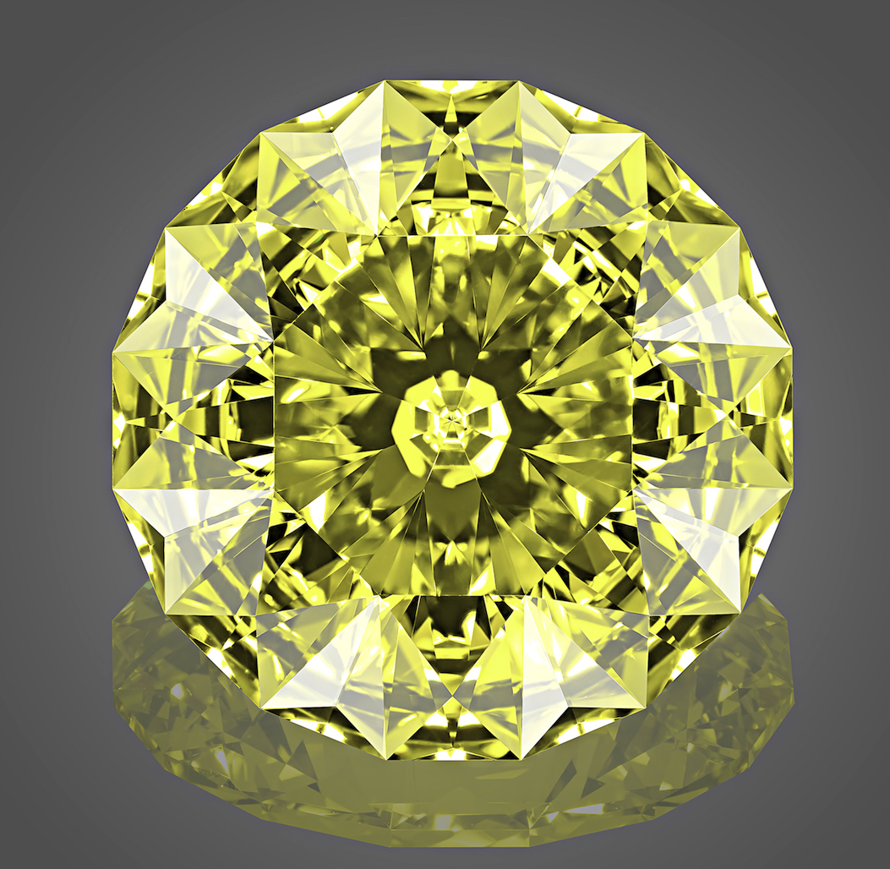
“Bright Angel”
78.46 carats

Slide 11
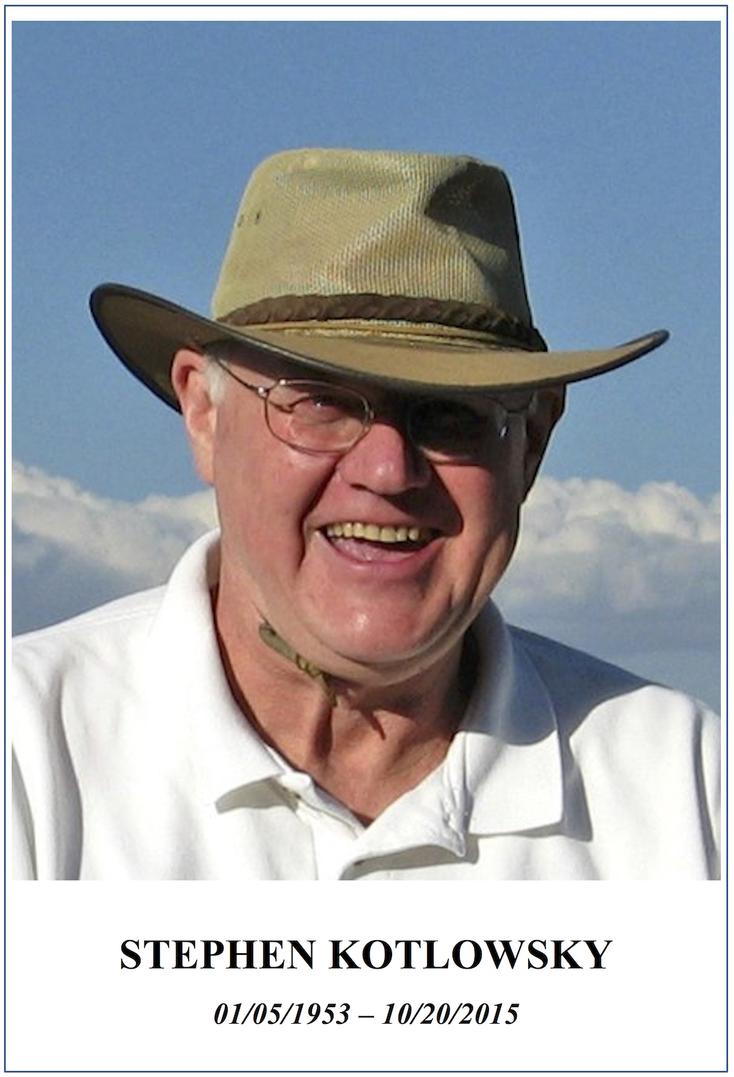
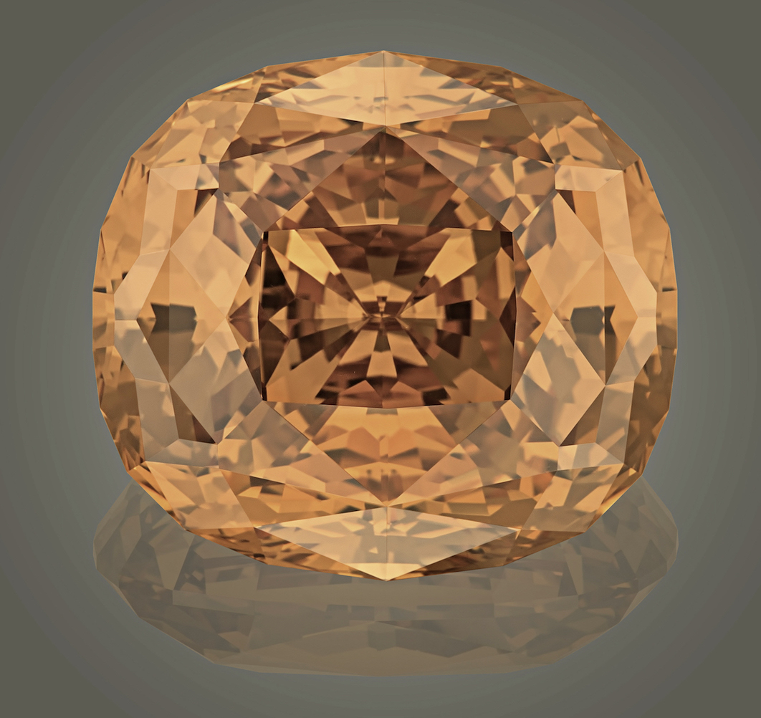
“Sweetheart”
154.61 carats

Slide 12
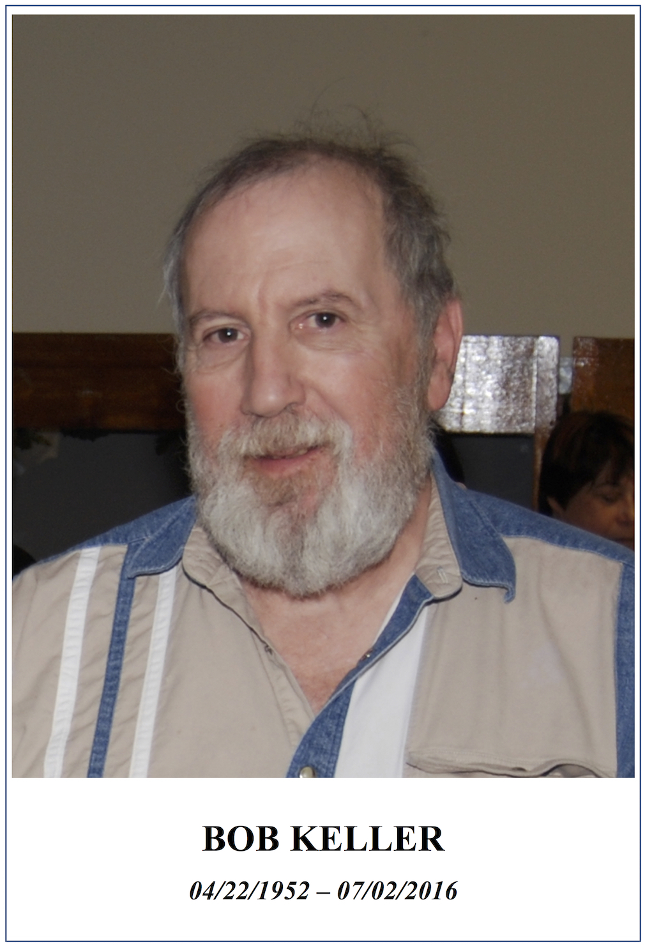
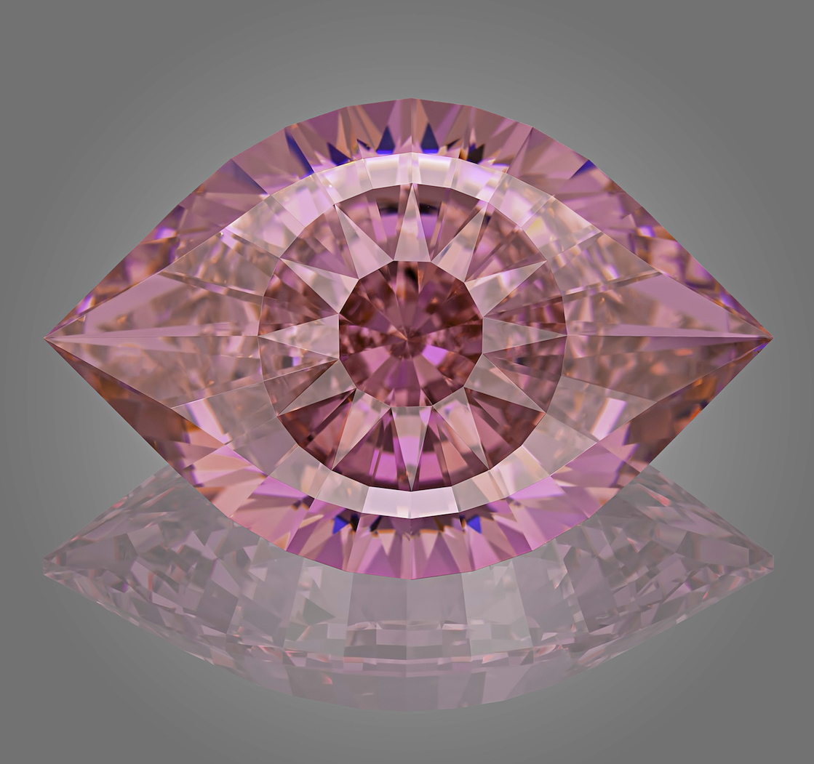
“Cleopatra’s Eye”
96.50 carats

Slide 13
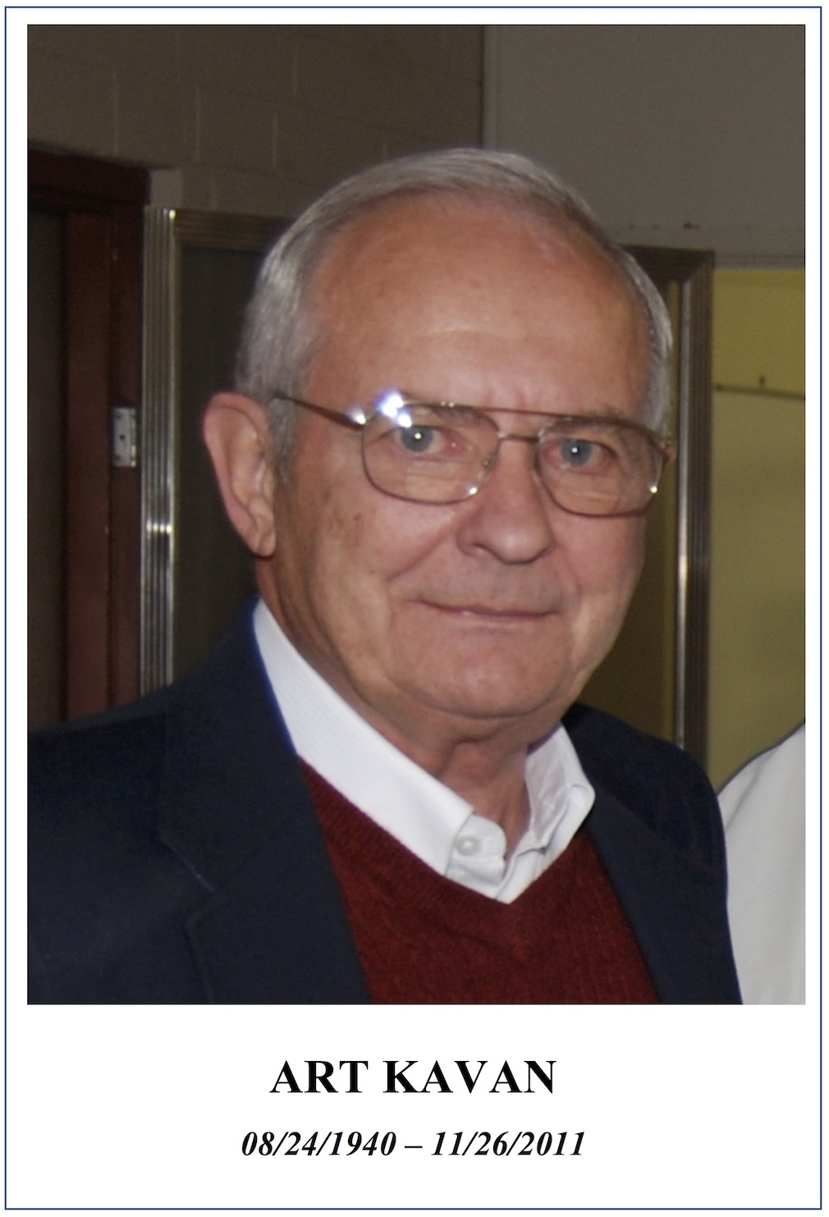
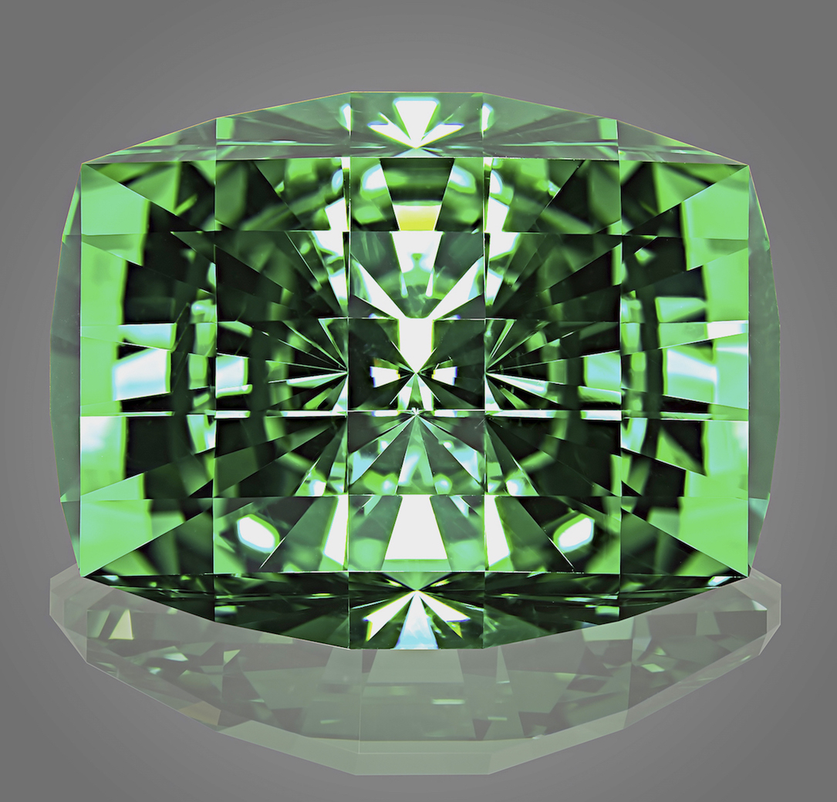
“Checkerboard cushion”
73.99 carats

Slide 14
Precision and artistic cut: today and tomorrow
Victor Tuzlukov (Russia – Thailand)

Slide 15
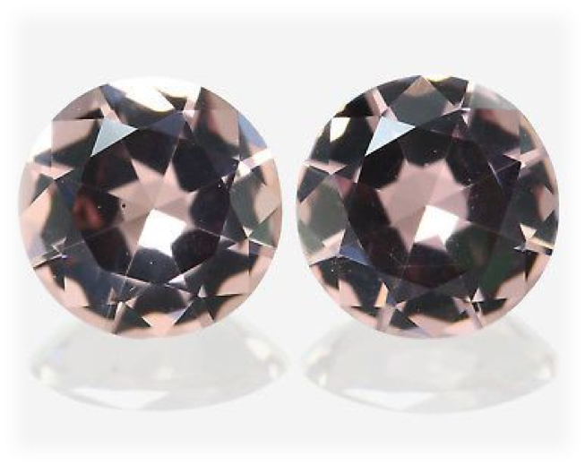
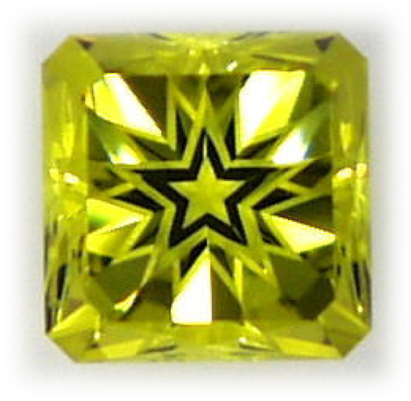
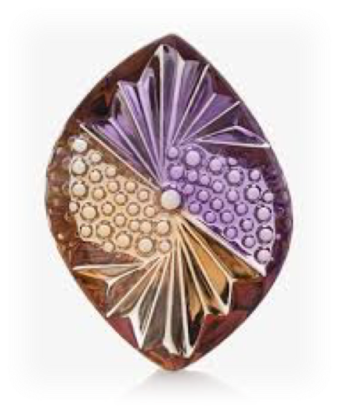
Precision cut?

Slide 16
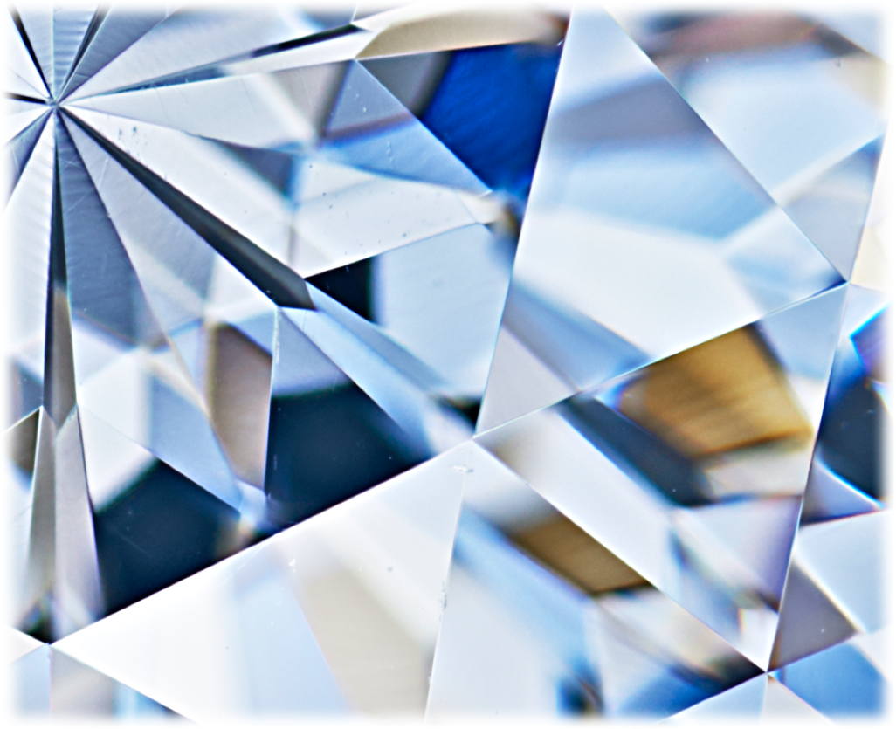
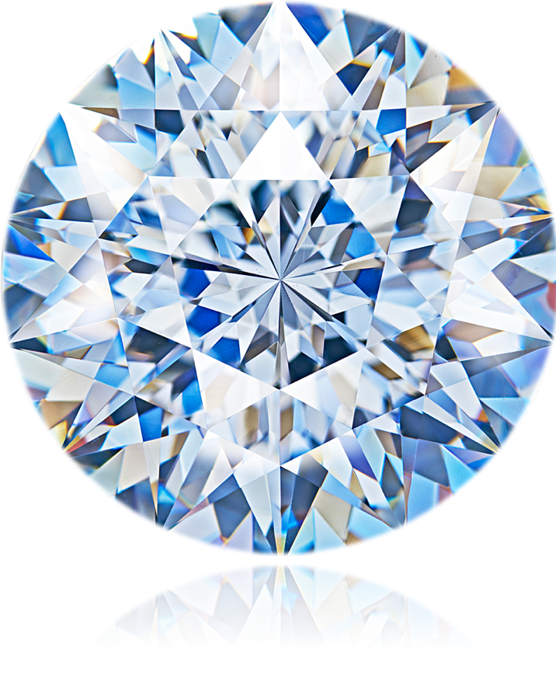
Precision cut

Slide 17
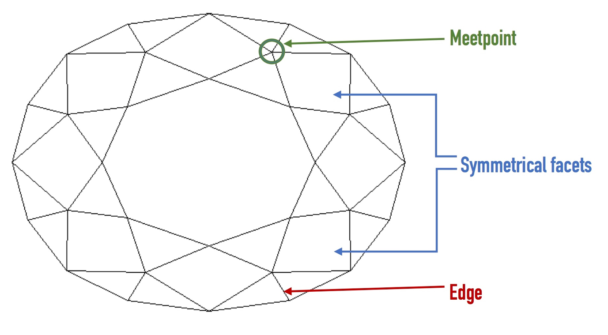
Pattern points

Slide 18
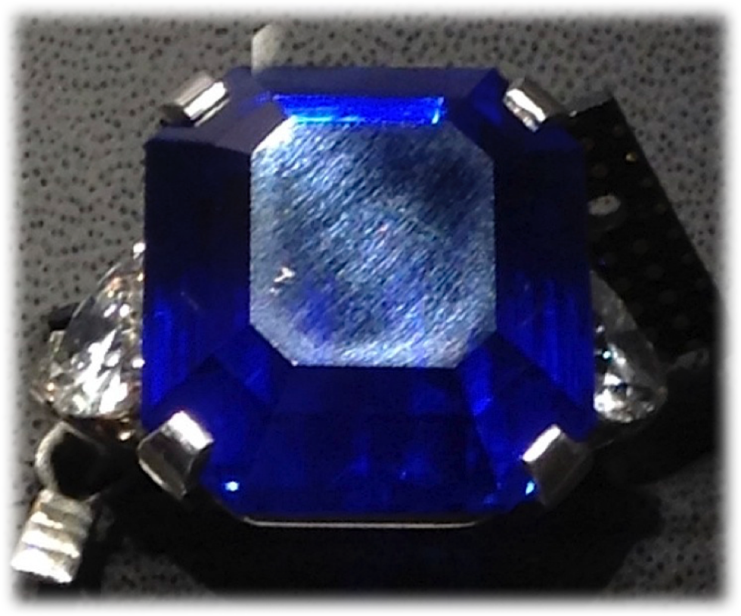
Example:
To see better, you should direct light perpendicularly to scratches direction.

Slide 19
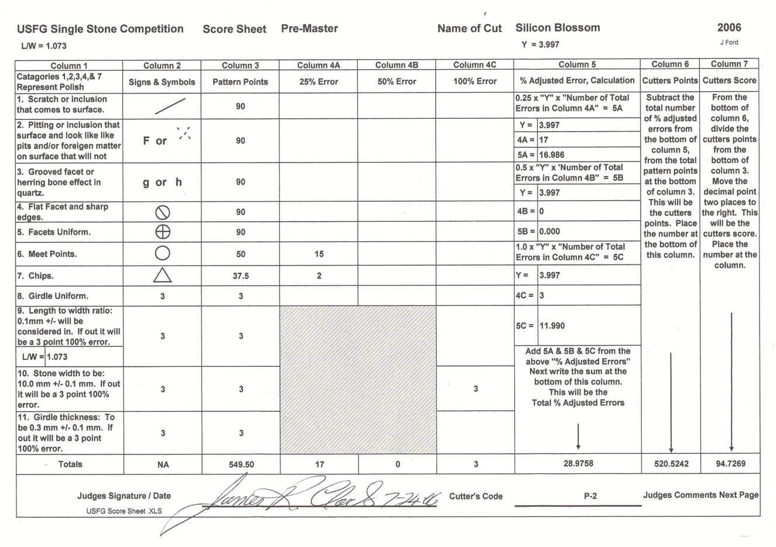
Example:
Judging sheet from the USFG competition

Slide 20
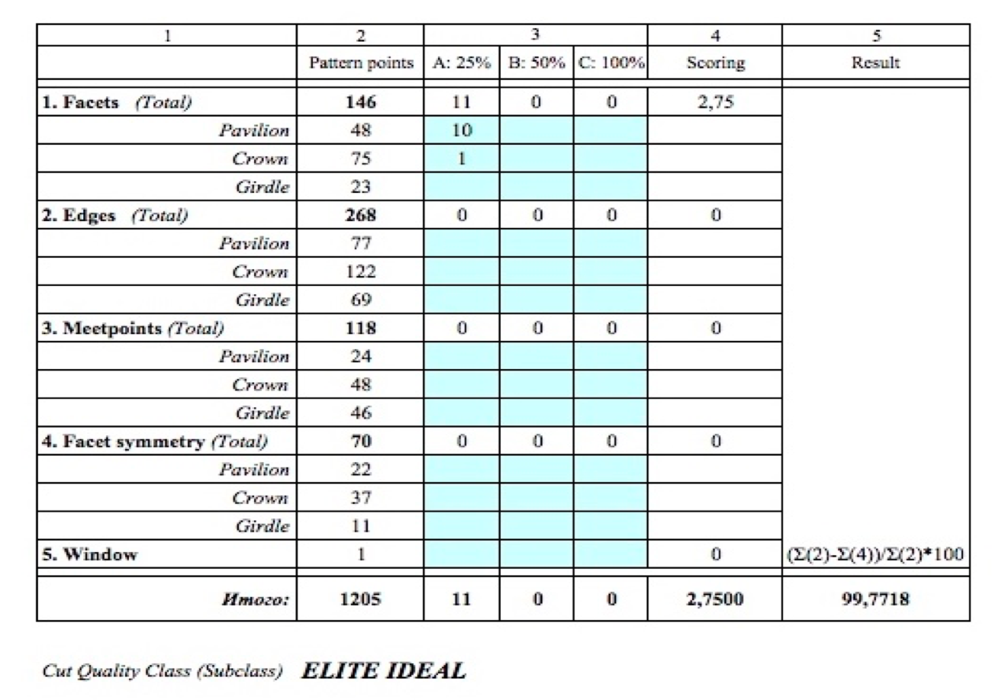
Example:
Work spreadsheet for cut grading

Slide 21
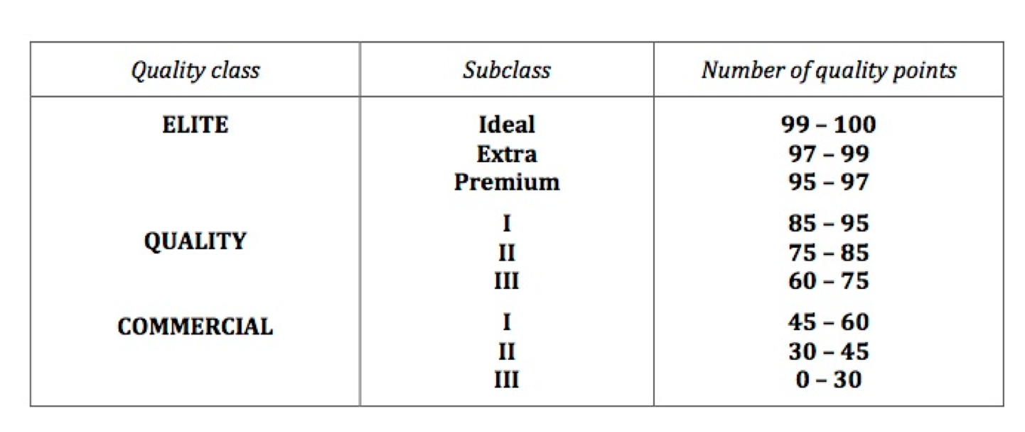
Faceting quality classes

Slide 22
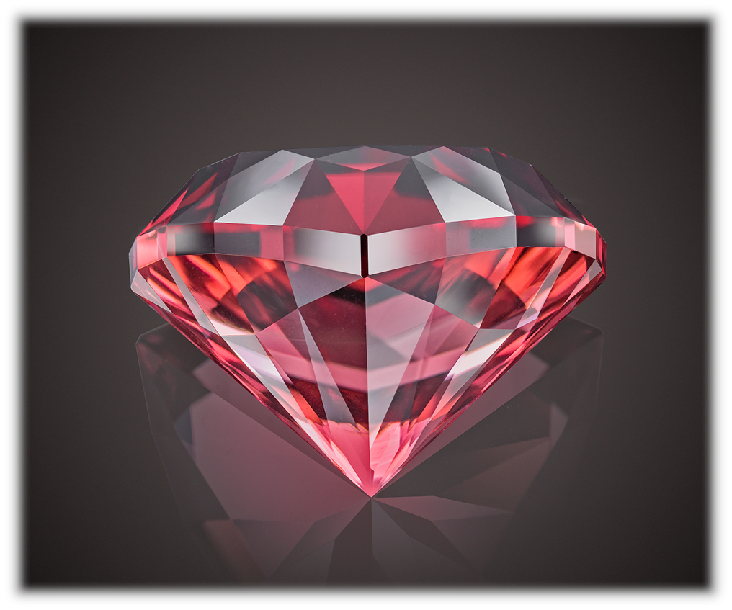
Example:
“Tytanic”
Cut specially for
Vigoff private collection.
Rubellite Turmaline,
26.1 carats

Slide 23
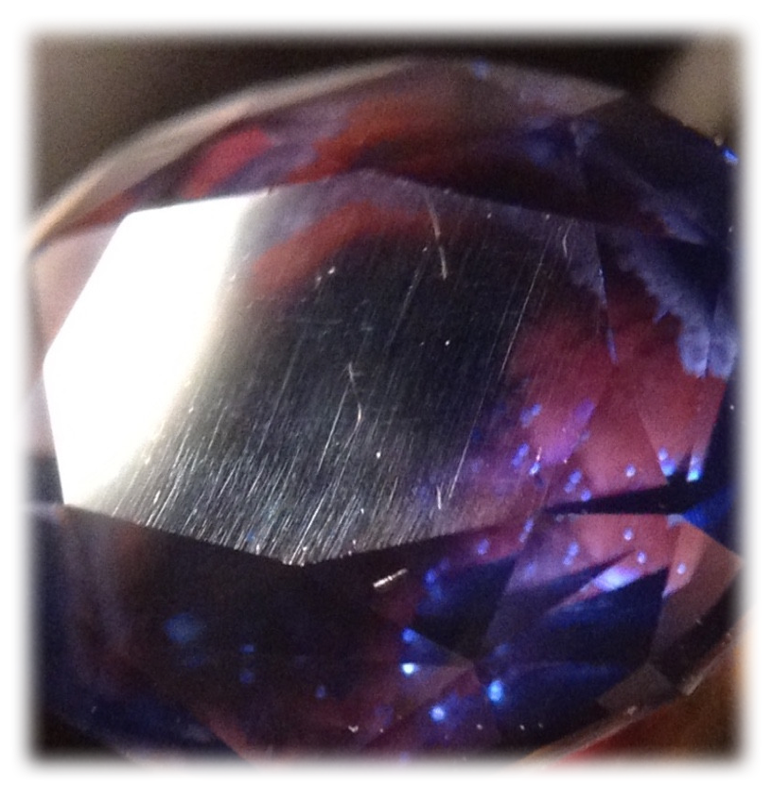
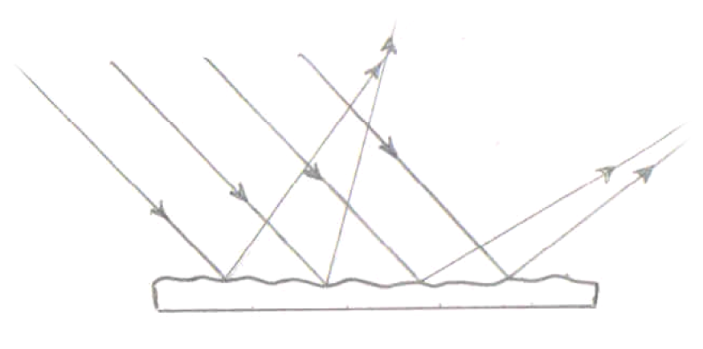
Light diffusion:
Commercial polish
(uneven surface)

Slide 24
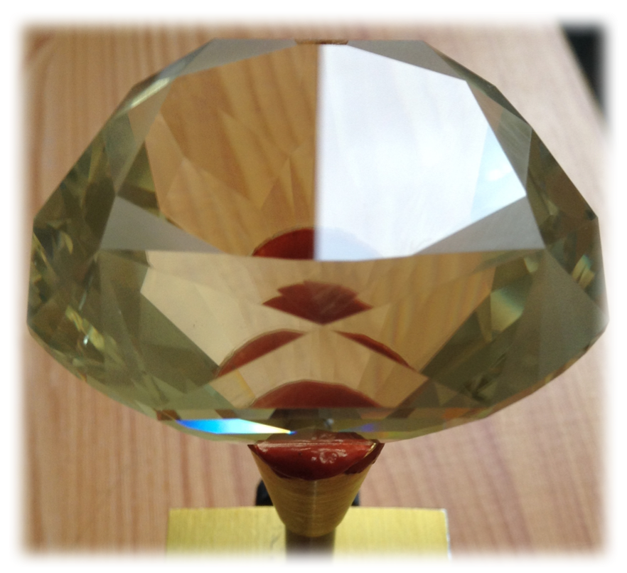
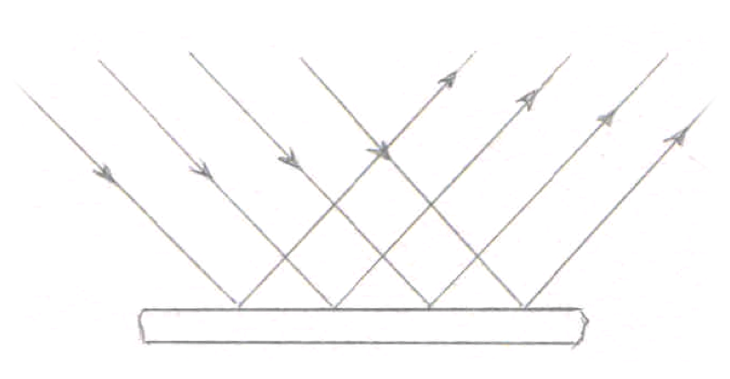
Light diffusion:
Perfect polish
(even surface)

Slide 25
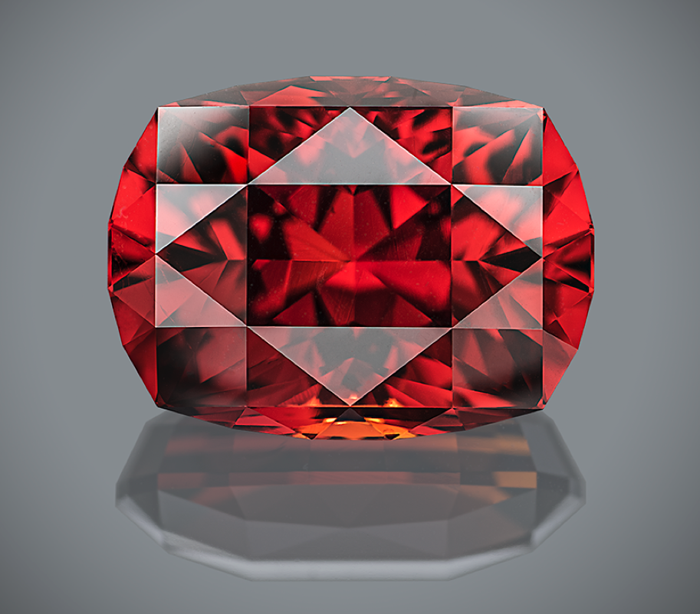
Example:
“Mars ascending”
Cut specially for
Vigoff private collection.
Spessartite Garnet,
32.85 carats

Slide 26
Part II.
Art of faceting

Slide 27
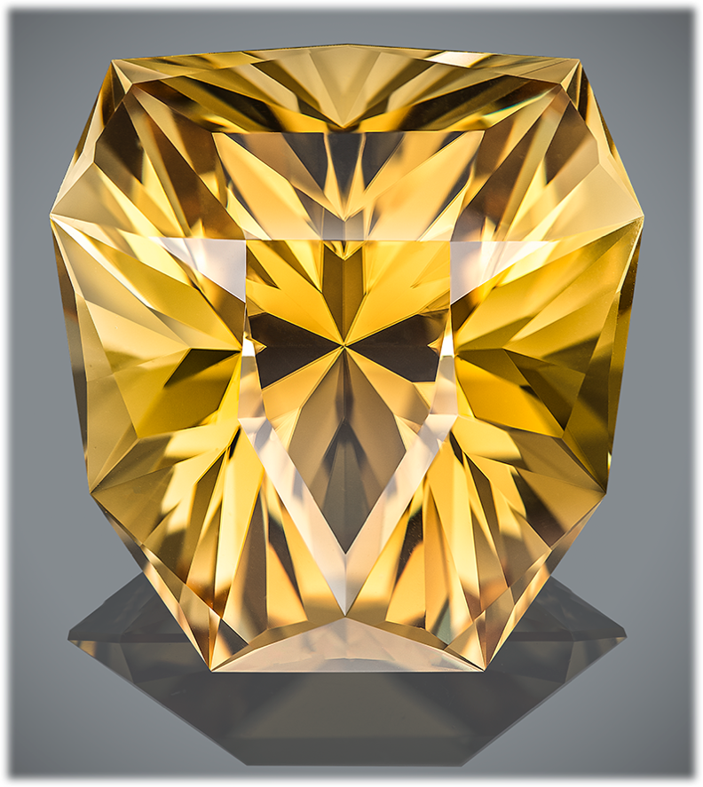
Example:
“Look of the King”
…He stood looking at me – gracious and wise – and oceans of power and dignity splashed in his eyes, captivating me, dissolving me and taking away somewhere behind the limits of human self-actualization…
One time, at minute of weakness and discouragement, this look will flash before me again. Look of the KING.
Scapolite,
68.08 carats

Slide 28
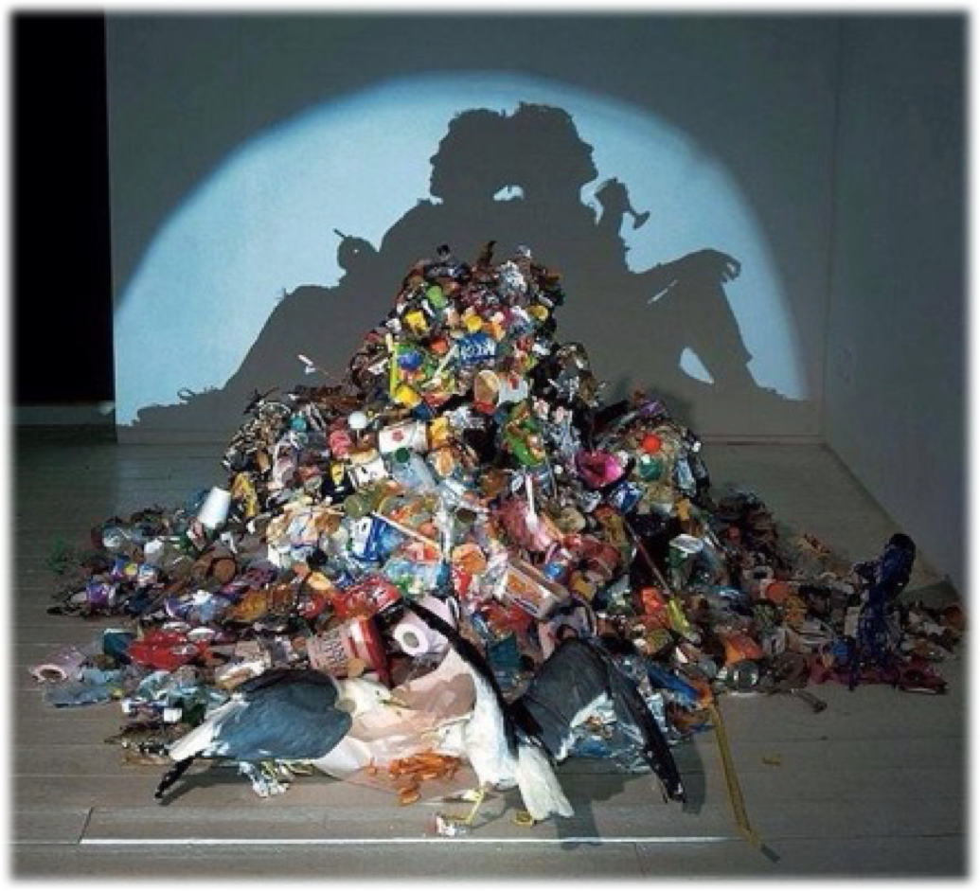
Example:
Trash art

Slide 29
Example:
Spyder.
Just spyder.

Slide 30
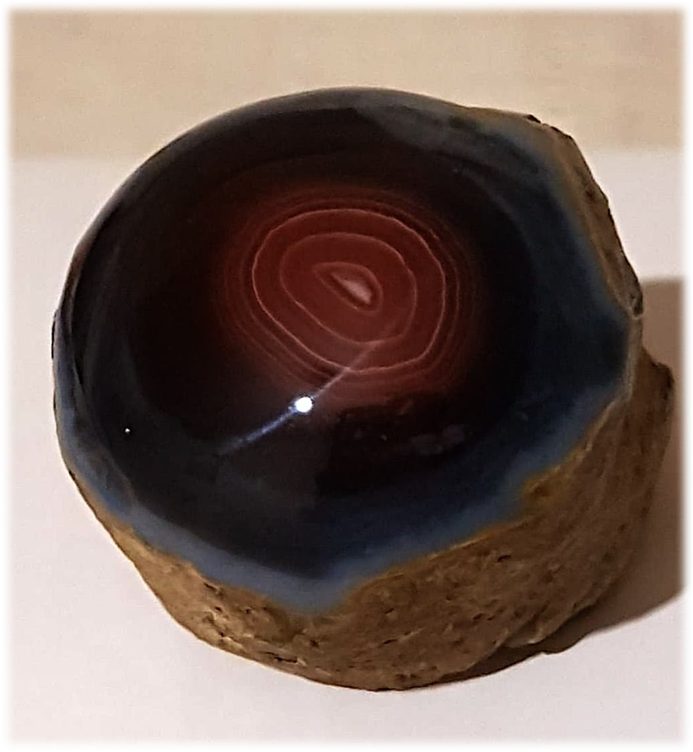
Example:
«The last glance”

Slide 31
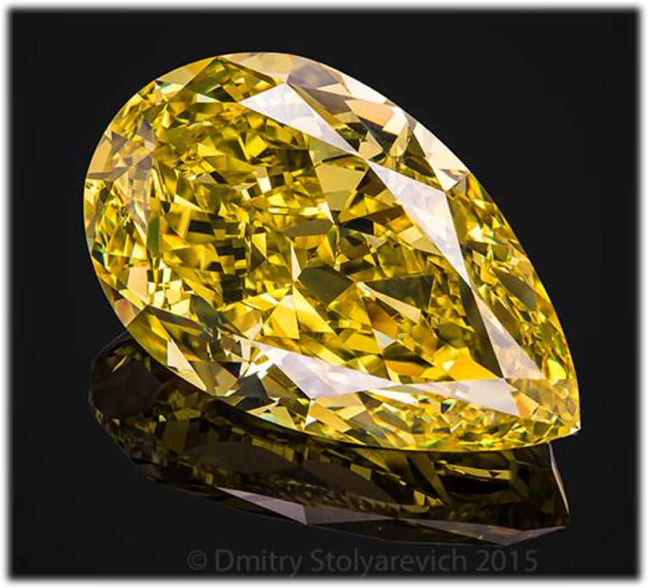
Example:
”Intense” yellow diamond
Photo: Dmitry Stolyarevich
(Moscow)

Slide 32
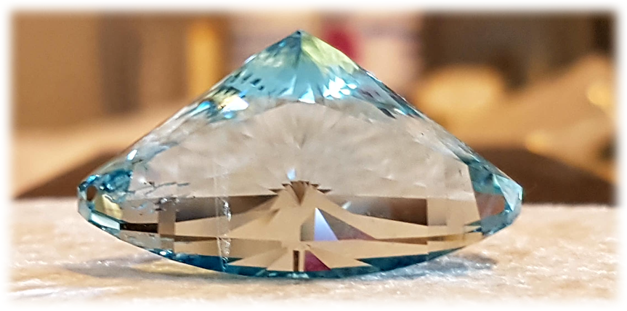
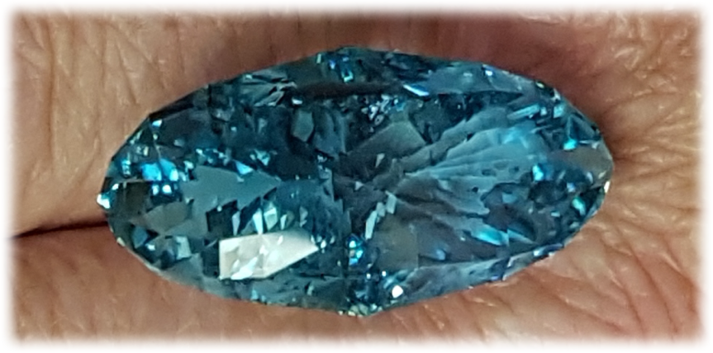
Untreated Topaz,
170.9 carats
Light / Intense Blue

Slide 33
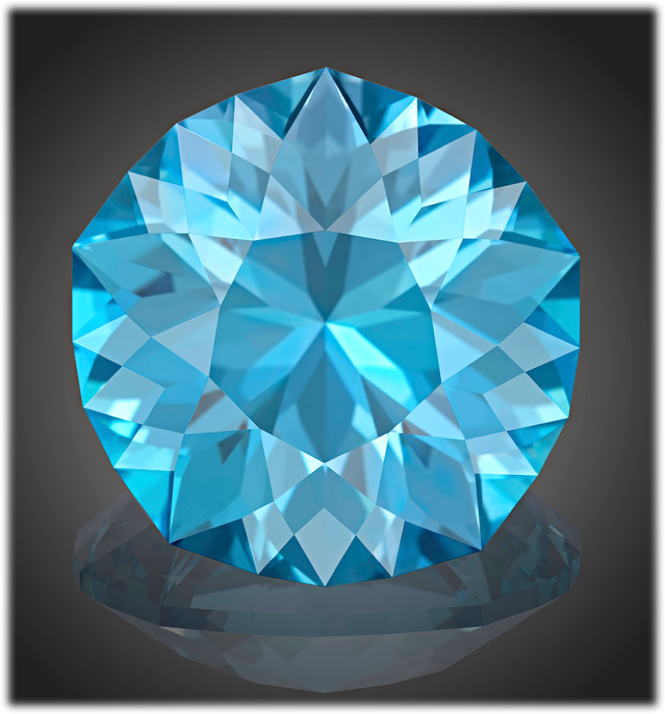
“Forget-me-not”
Passing away, I will not disappear.
I will dissolve in the coolness of the evening breeze. I will sprout among bright spring grass. I will meet you by the song of the distant stars and smile to you by each dewdrop.
Manage to recognize my joy in the light that hugs you. Manage to hear my voice in the whisper of wind, dancing with you. Manage to see my body in the sparkles of forget-me-nots...
Forget. Me. Not... We may be always together.
Blue Topaz,
136.02 carats

Slide 34
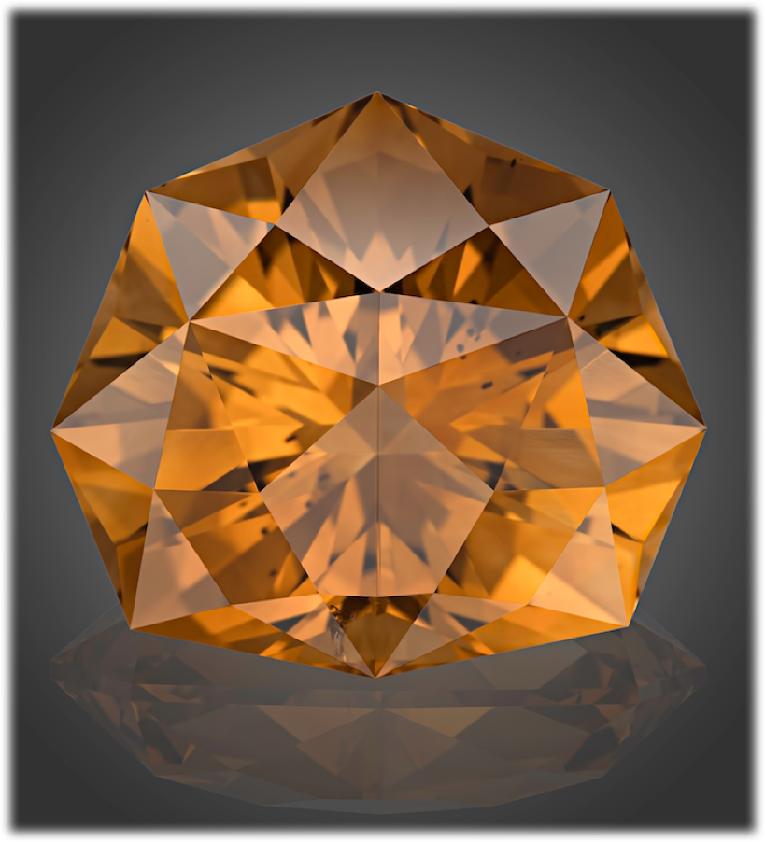
“Rose”
They say that stars are fading when fall down from the sky... It is wrong. Just body of star is fading, but her soul is incarnating in the flower – to have some rest during short time of blossoming. Then, saying "Bye..." to falling petals, it ascends and shines by refresh light, full of silent charm of summer morning.
Each star has her own character. Some of them fire as bright tulips, others hide as scattering of dandelions. Some of them attract by color, others by aroma... But just a few, like Queens of flower garden, are perfect in everything.
I will put white rose by the head of your bed.
Let Star shine!
Citrine,
74.31 carats

Slide 35
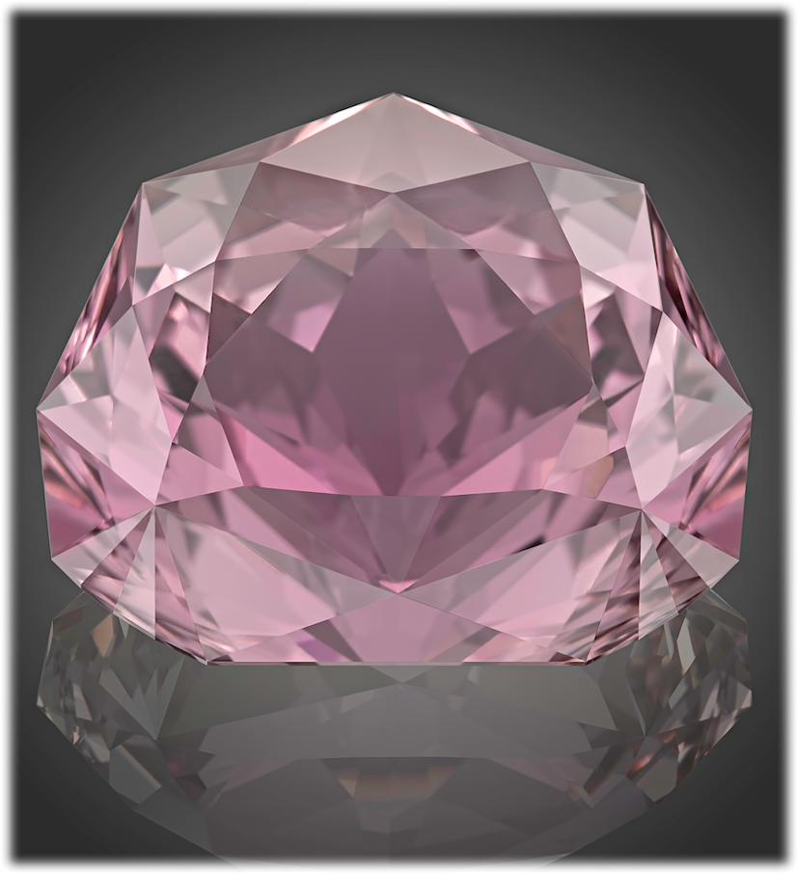
“Lotus”
Our life is music.
In the dark depth of the Unknowable, the initial vibration of melody borns like a Lotus bud. It swells up, taking power from sacred roots; expands by joyful greenery of leaves. And, like a strong steam, the piercing main tune strives upward – from black mud of Matter, through cloudy water of Ignorance, through clearness of Cognizing, upper and upper – to the pure first-manifested Light, to open out by wonderful flower of Perfection, and to dissolve there becoming the Light itself...
Blessed those who realized Harmony!
Kunzite,
161.68 carats

Slide 36
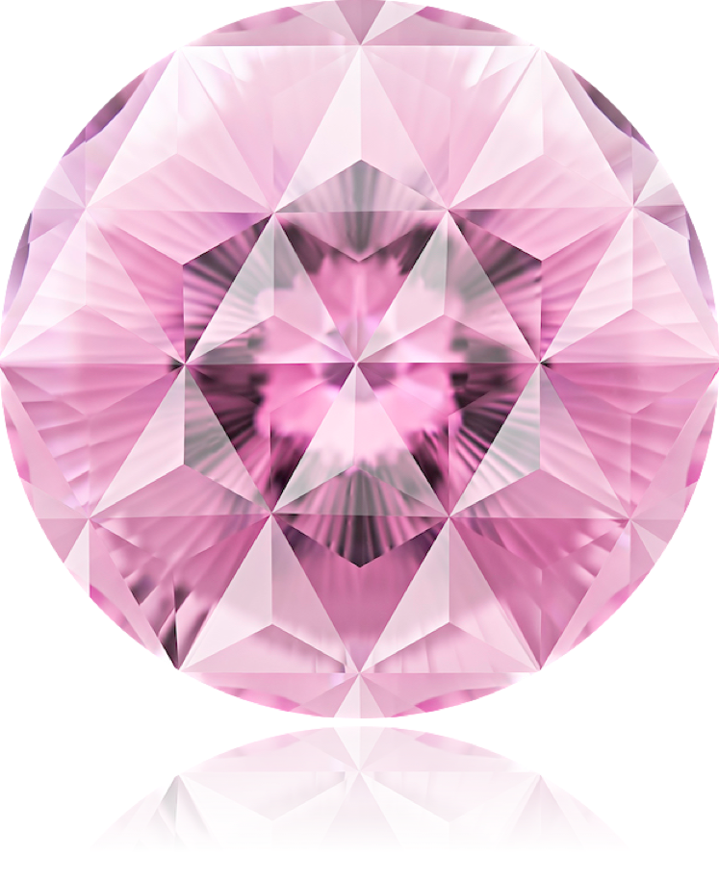
“Faces of Perfection”
(Japan)
Sakura finishes blossoming quite fast and flight of arrow is swift. But beauty of flower is immortal, as well as power of flying arrow. Power and Beauty are two faces of the single Perfection.
Kunzite,
122.85 carats

Slide 37
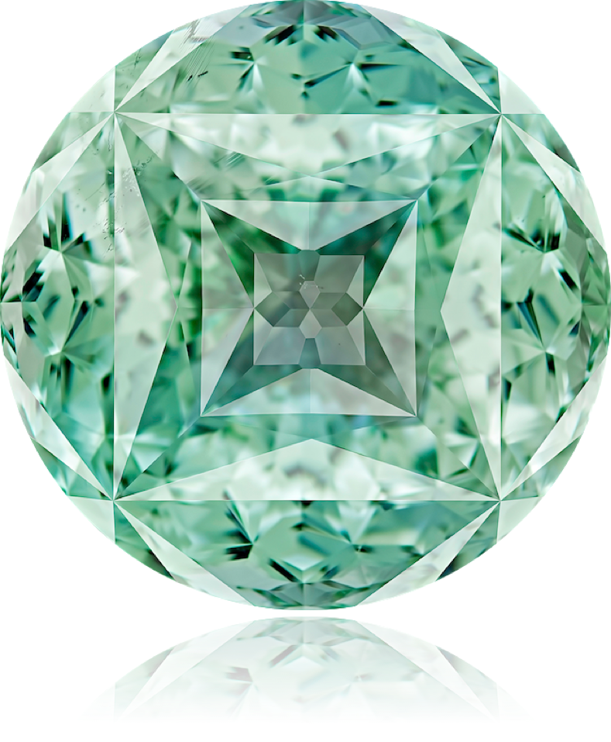
“The Great in a tiny”
(Tibet)
The Great Mandala is shining in the small gemstone. A small man is realizing the great teachings. The tiny may contain the Grand, being the beginning, the end and the evolution itself...
Topaz,
160.95 carats

Slide 38
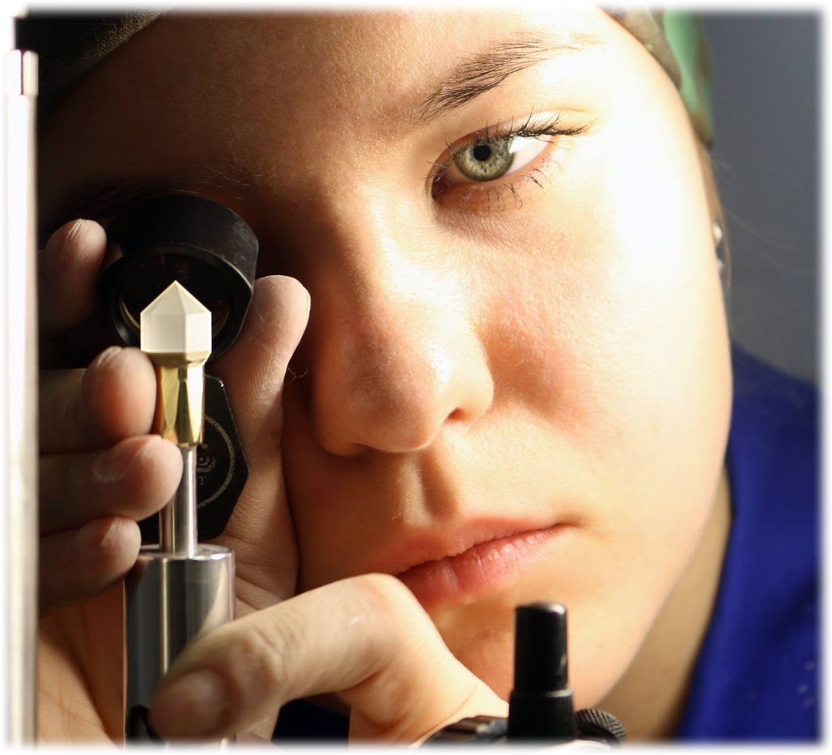
One of participants of WorldSkills – Russia
Competition
Moscow, 2018

Slide 39
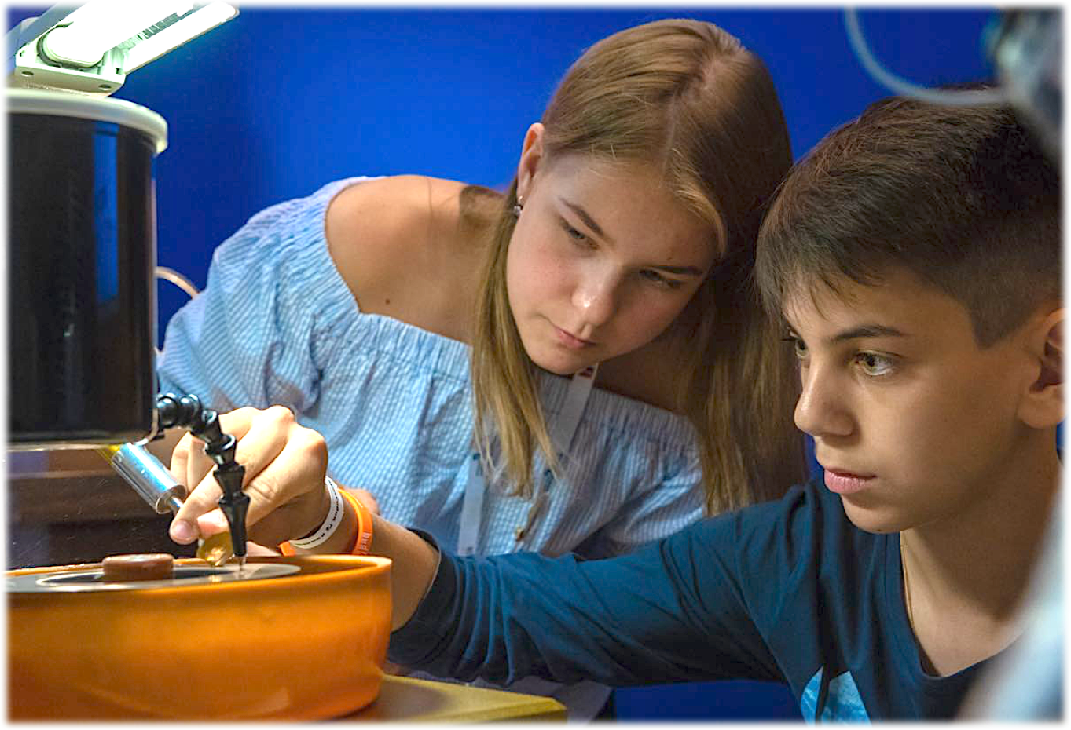

Slide 40
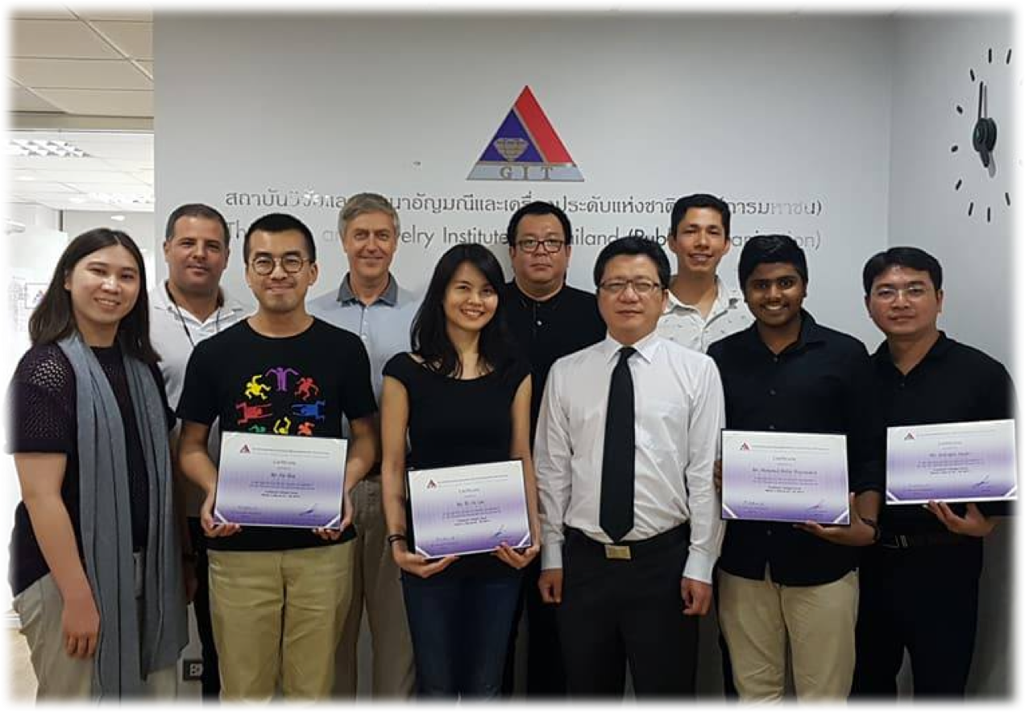
Graduates of faceting course “Basic of precision cut”
Gems and Jewelry Institute of Thailand,
Bangkok
October, 2016

Slide 41
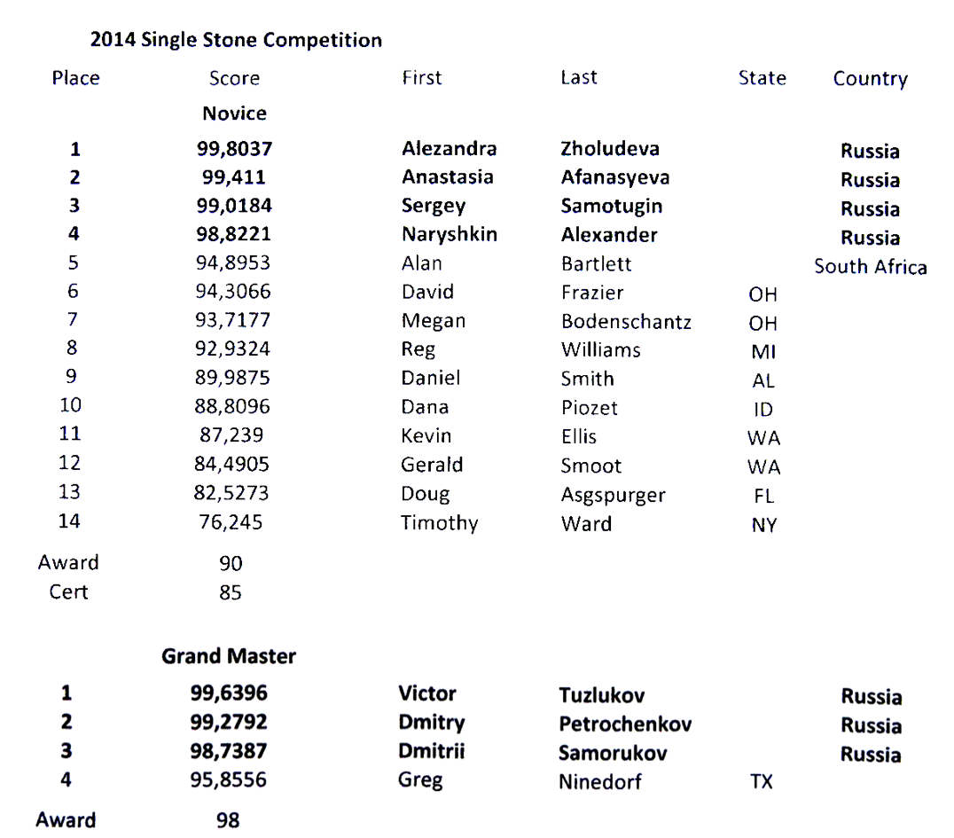
Results of the Single Stone Competition provided by the US Faceters Guild
(Novice and Grand Master classes)
September, 2014

Slide 42


VS

Slide 43

Example:
Cubic Zirconia, 6.72 carats
Cut by Ivan Tuzlukov, 8 years old

Slide 44



Slide 45
Victor Tuzlukov
Gemstone artist
Graduate Gemologist (GIA)
Grand-Master competition cutter (USFG)
World champion and record-breaker in technic of faceting
Phone: +7 926 732 0799
Whatsapp: +7 926 732 0799
Email: vtuzlukov@hotmail.com
Photo of gemstones by: Dmitry Stolyarevich (Moscow)
Arjuna Irsutti (Bangkok)

