Slide 1

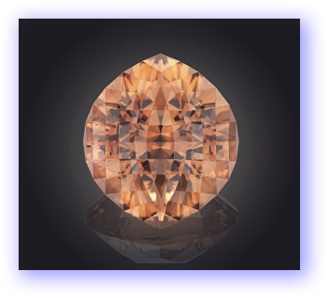

Victor Tuzlukov
Appraisal specialties for gems with artistic and precision cut
Russian Faceters Guild

Slide 2
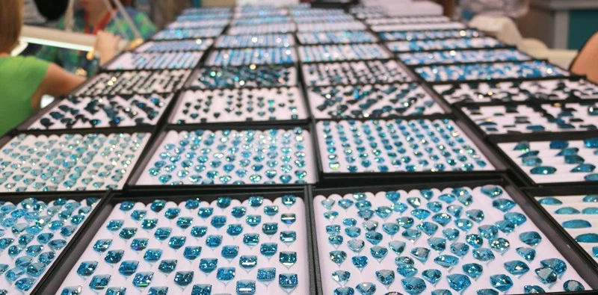
Víctor Tuzlukov
Appraisal specialties for gems with artistic and precision cut

Slide 3
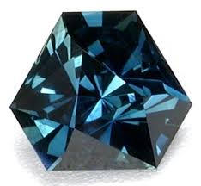
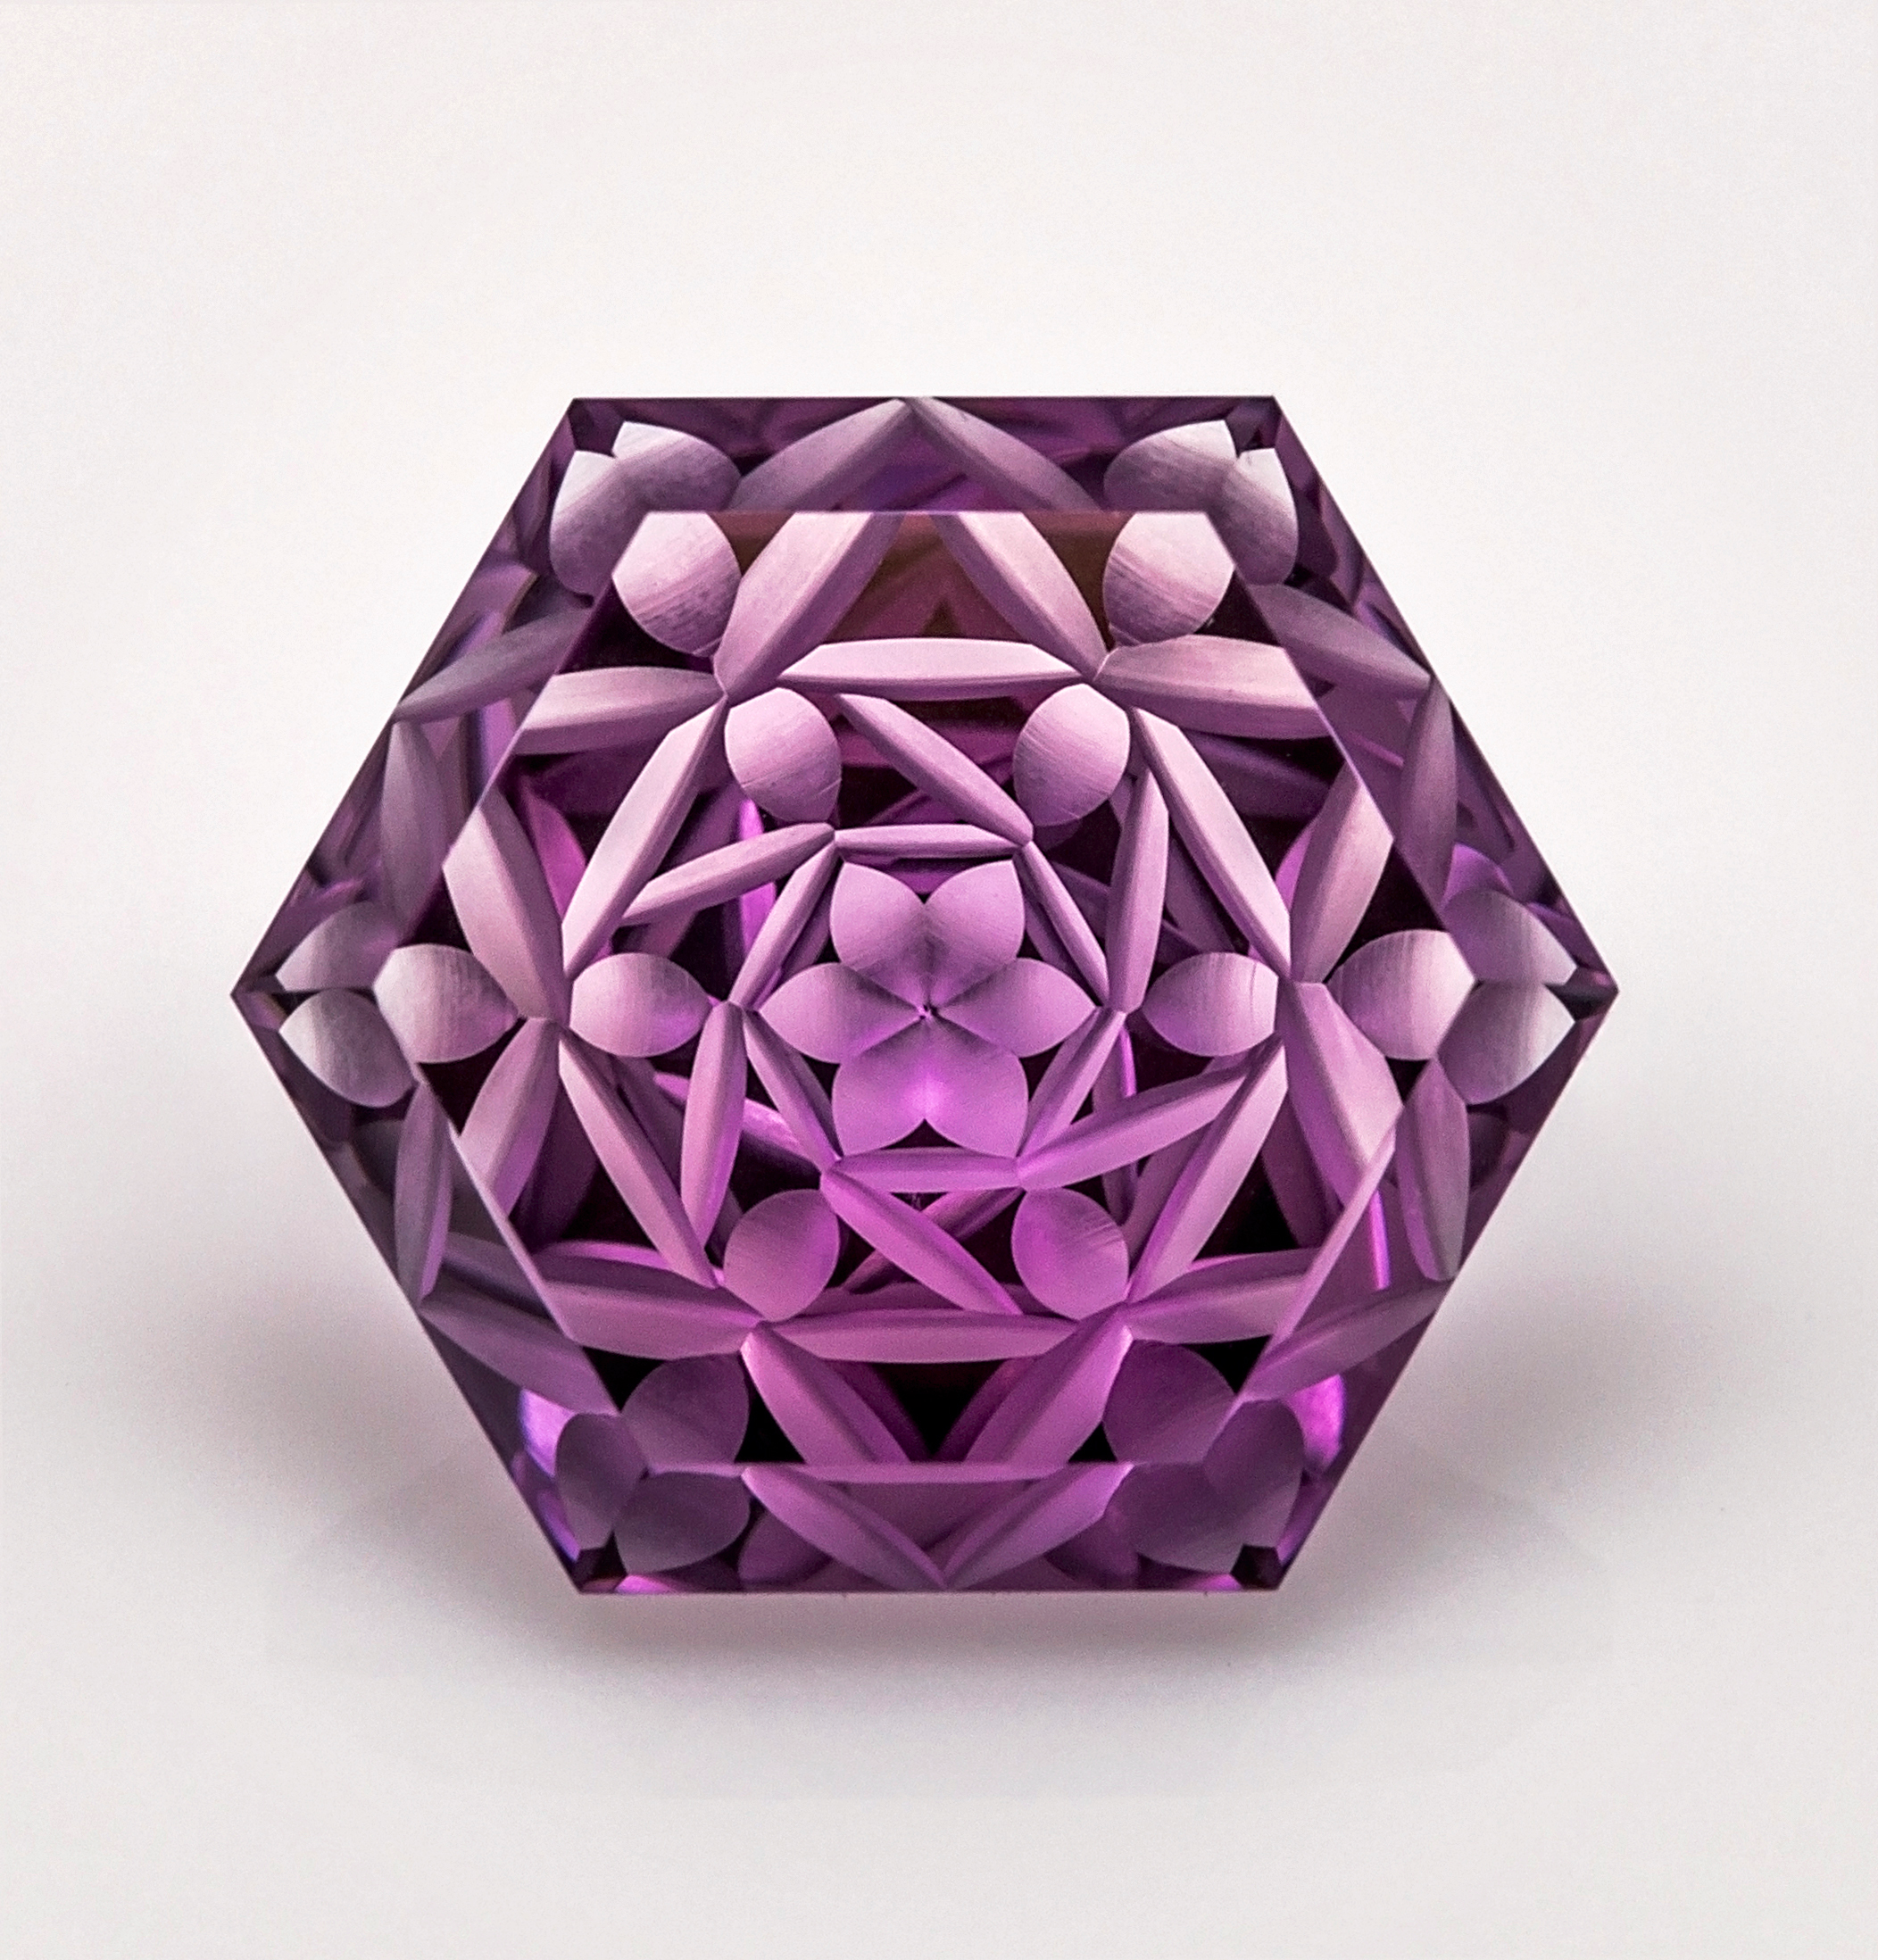
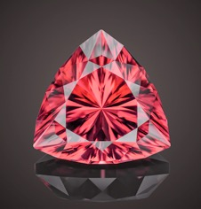
Víctor Tuzlukov
Appraisal specialties for gems with artistic and precision cut

Slide 4
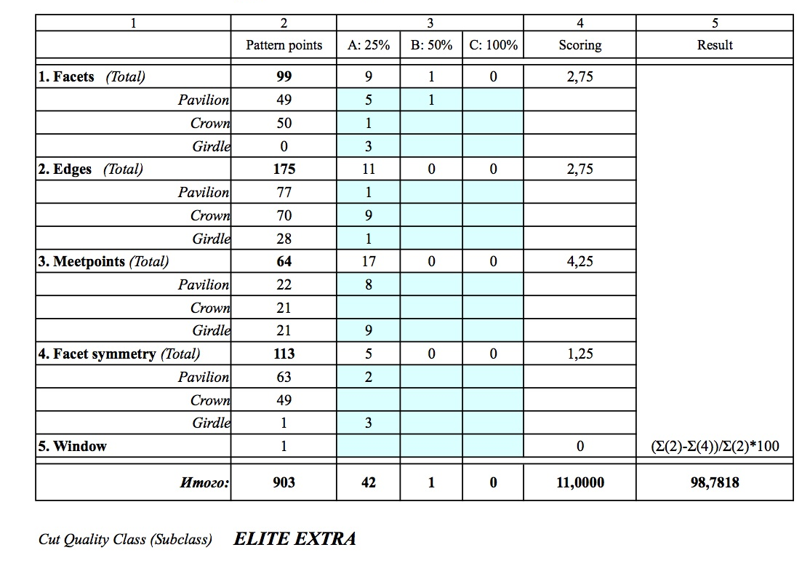
Víctor Tuzlukov
Appraisal specialties for gems with artistic and precision cut

Slide 5
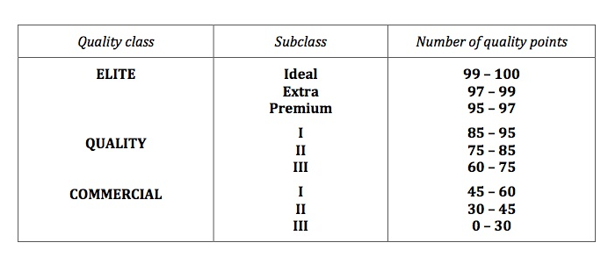
Víctor Tuzlukov
Appraisal specialties for gems with artistic and precision cut
Cut Grading System: Cut Classes

Slide 6
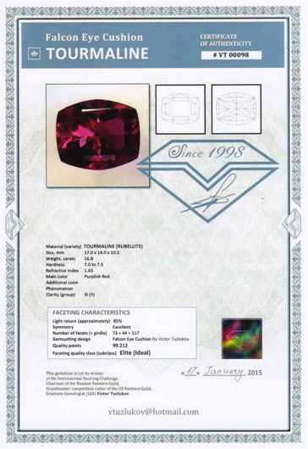
Víctor Tuzlukov
Cut Grading System:
Author’s certificate
with cut quality
evaluation

Slide 7
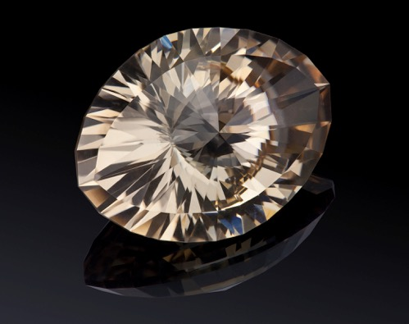
Víctor Tuzlukov
Appraisal specialties for gems with artistic and precision cut
“SHIVA’S EYE”
Topaz,
36.12 ct
Photo by
S.Pryanechnikov

Slide 8
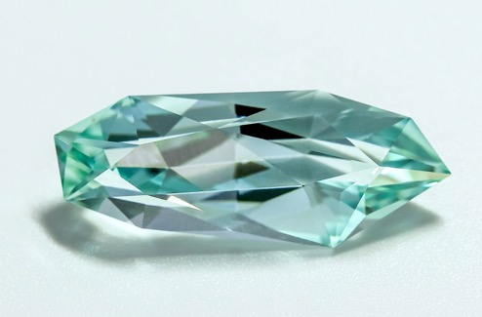
Víctor Tuzlukov
Appraisal specialties for gems with artistic and precision cut
Photo:
Ekaterina
Finogenova
“SPROUT of the UNIVERSE”
Aquamarine, 12 ct

Slide 9
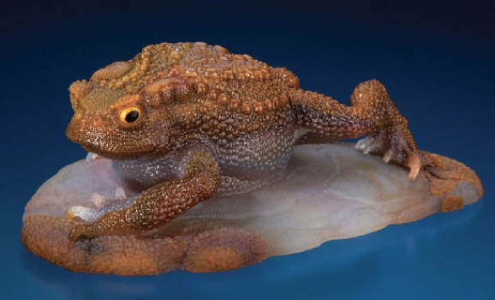
Víctor Tuzlukov
Appraisal specialties for gems with artistic and precision cut
Gerd and Patrick Dreher - FROG

Slide 10
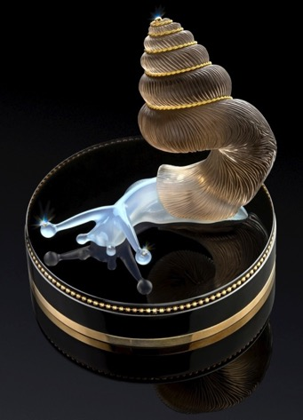
Víctor Tuzlukov
Appraisal specialties for gems with artistic and precision cut
Slava Tulupov
“BALANCE”
Photo by
Sergey Pryanechnikov

Slide 11
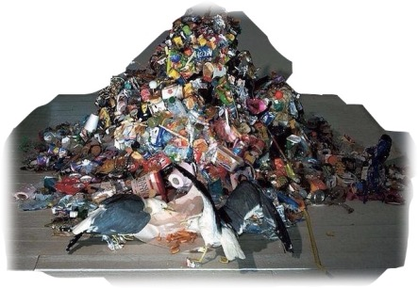
Víctor Tuzlukov
Appraisal specialties for gems with artistic and precision cut
Sample of trash

Slide 12
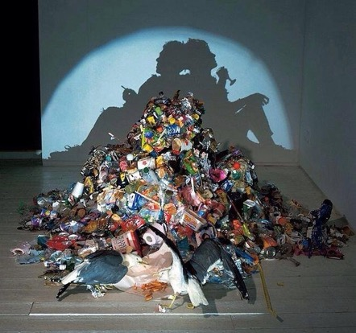
Víctor Tuzlukov
Appraisal specialties for gems with artistic and precision cut
Sample of trash-art

Slide 13
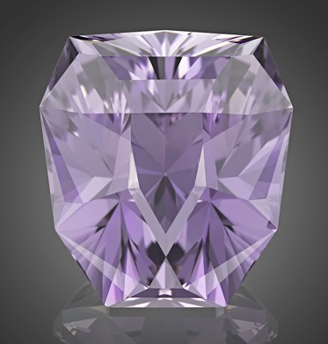
Víctor Tuzlukov
Appraisal specialties for gems with artistic and precision cut
“WINNER”
Kunzite, 200 ct
He standed and looked at me – gracious and wise – and oceans of power and dignity splashed in his eyes, captivating me, dissolving me and taking away somewhere behind the limits of human self-actualization... One time, at minute of weakness and discouragement, this look will flash again before me. Look of the KING.
Photo by
Arjuna Irsutti

Slide 14
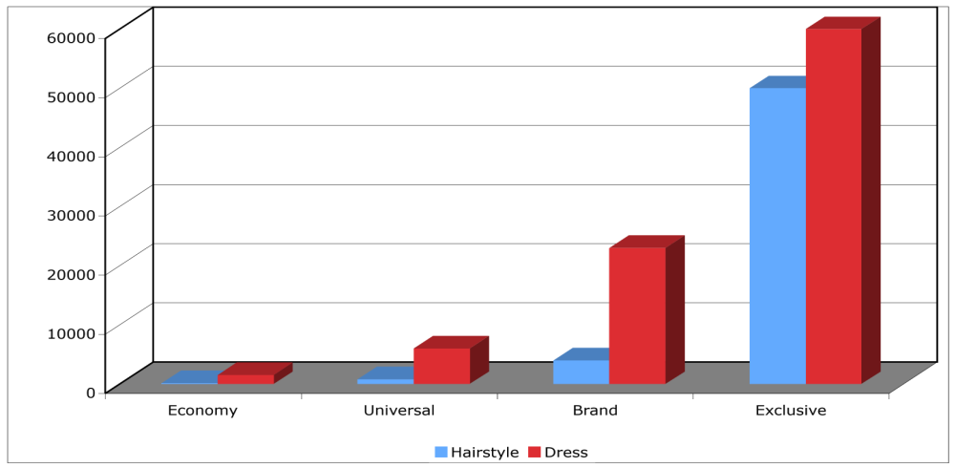
Víctor Tuzlukov
Appraisal specialties for gems with artistic and precision cut
Price categories in some image-making products (roubles)

Slide 15
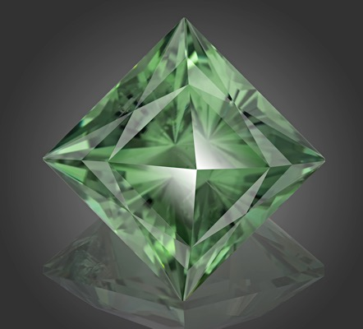
Víctor Tuzlukov
Appraisal specialties for gems with artistic and precision cut
“TOUCHING
of HURRICANE”
Green Quartz,
73.71 ct
(“Elements” collection)
Photo by
Arjuna Irsutti

Slide 16
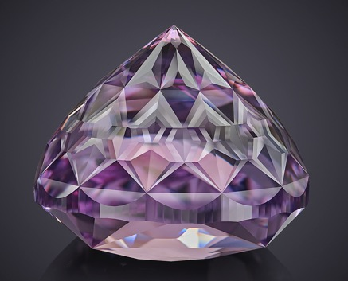
Víctor Tuzlukov
Appraisal specialties for gems with artistic and precision cut
Mail to:
vtuzlukov@hotmail.com
Facebook:
Victor.Tuzlukov
Thanks for your attention!

