Slide 1
Precision and artistic cut: today and tomorrow
Victor Tuzlukov (Russia – Thailand)

Slide 2
Precision cut?

Slide 3
Precision cut

Slide 4
Pattern points

Slide 5
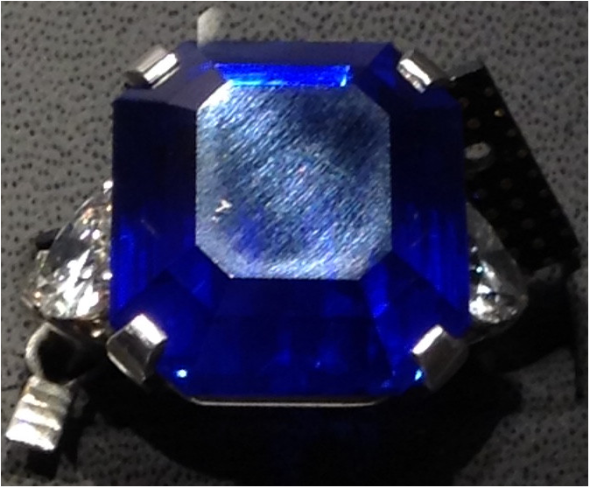
Ring from the Sotheby’s auction, 11.2014
Kashmir Sapphire,
27.54 cts

Slide 6
Example:
Judging sheet from the US competition

Slide 7
Example:
Work spreadsheet for cut grading

Slide 8
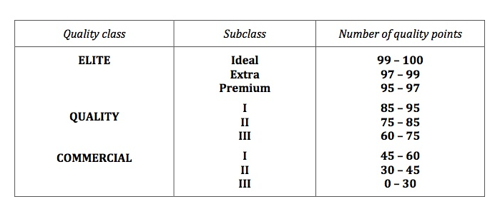
Faceting quality classes

Slide 9
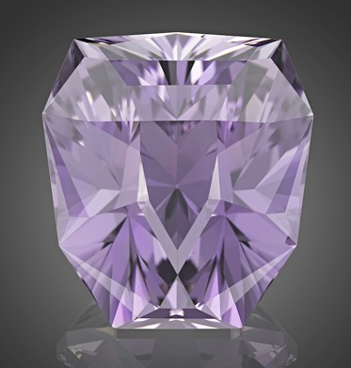
Example:
“Winner” from
“ Philosophical Stone” collection.
Kunzite, 200 carats

Slide 10
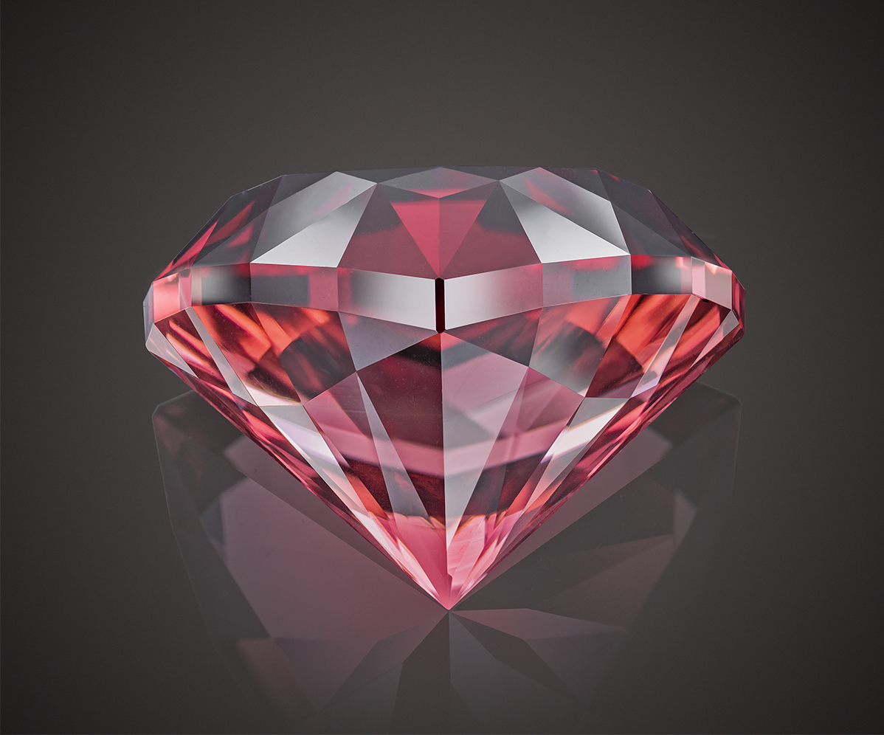
Thanks for your attention!
Victor Tuzlukov
Gemstone artist
Graduate Gemologist (GIA)
Grand-Master competition cutter (USFG)
World champion and record-breaker in technic of faceting
Phone: +7 926 732 0799
Whatsapp: +7 926 732 0799
Email: vtuzlukov@hotmail.com
Photo by: Dmitry Stolyarevich (Moscow)
Arjuna Irsutti (Bangkok)

