Slide 1
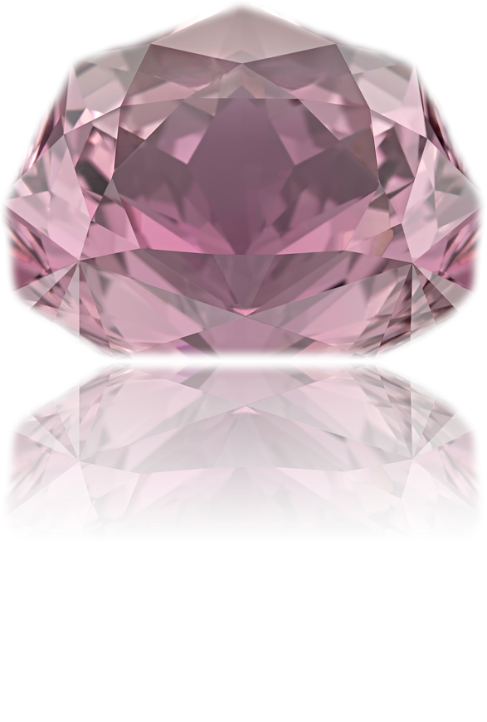
Precision and artistic cut: today and tomorrow
Hong Kong Mineral Show - 2018
Victor Tuzlukov (Russia – Thailand)

Slide 2
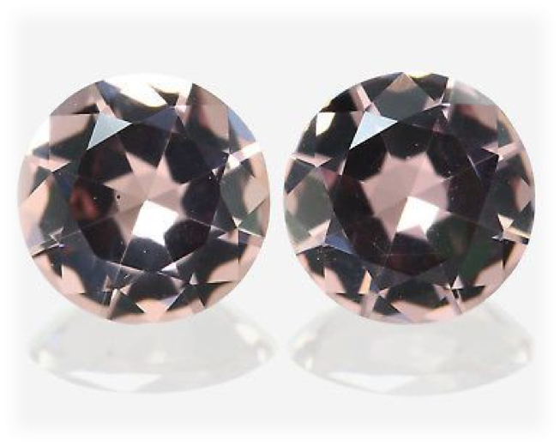
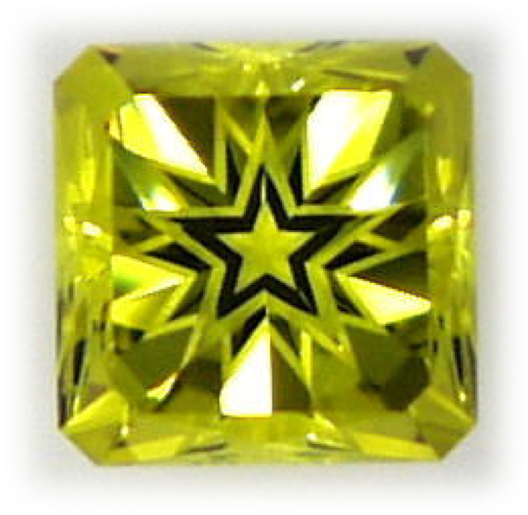
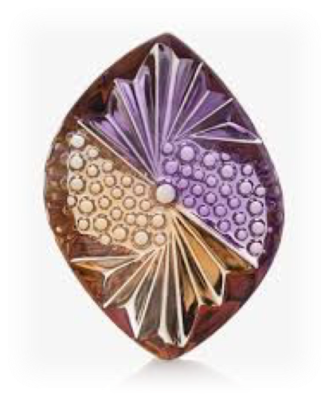
Precision cut?
Hong Kong Mineral Show - 2018

Slide 3
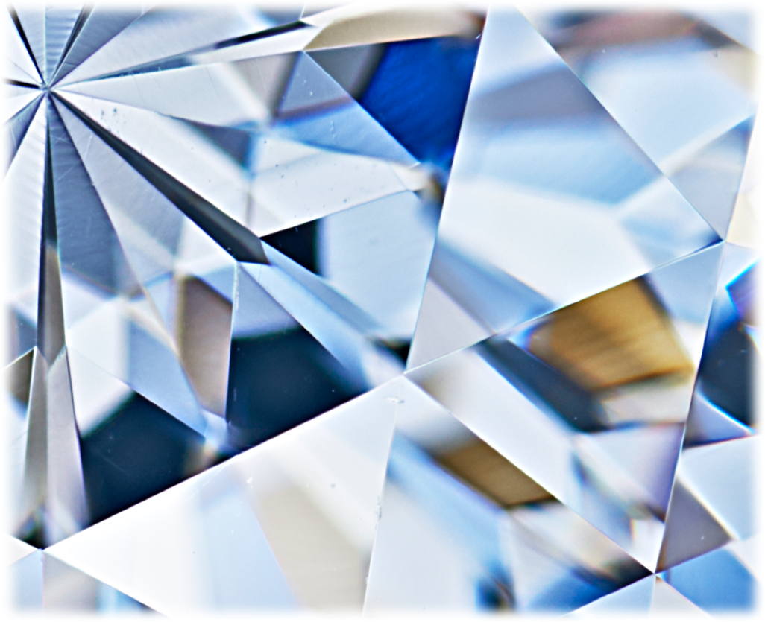
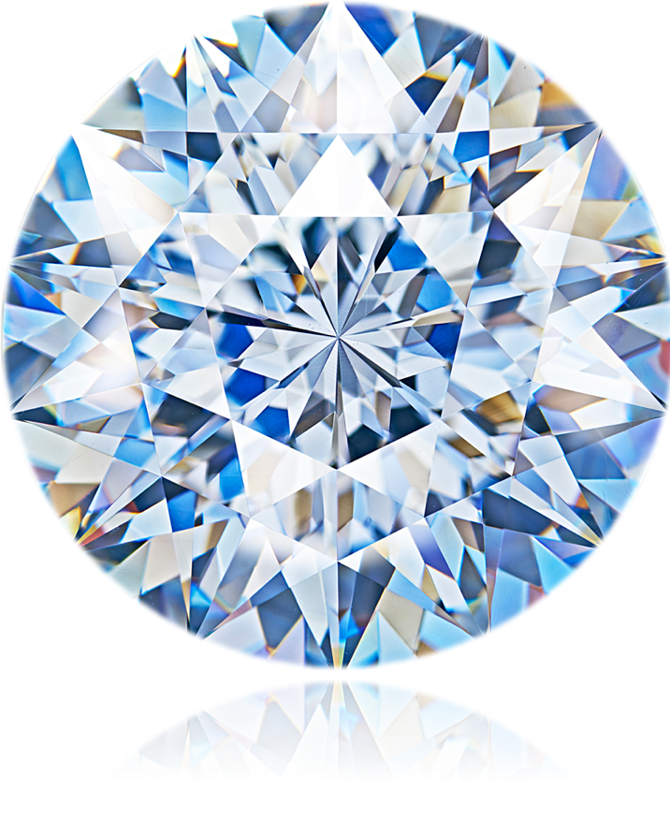
Precision cut
Hong Kong Mineral Show - 2018

Slide 4
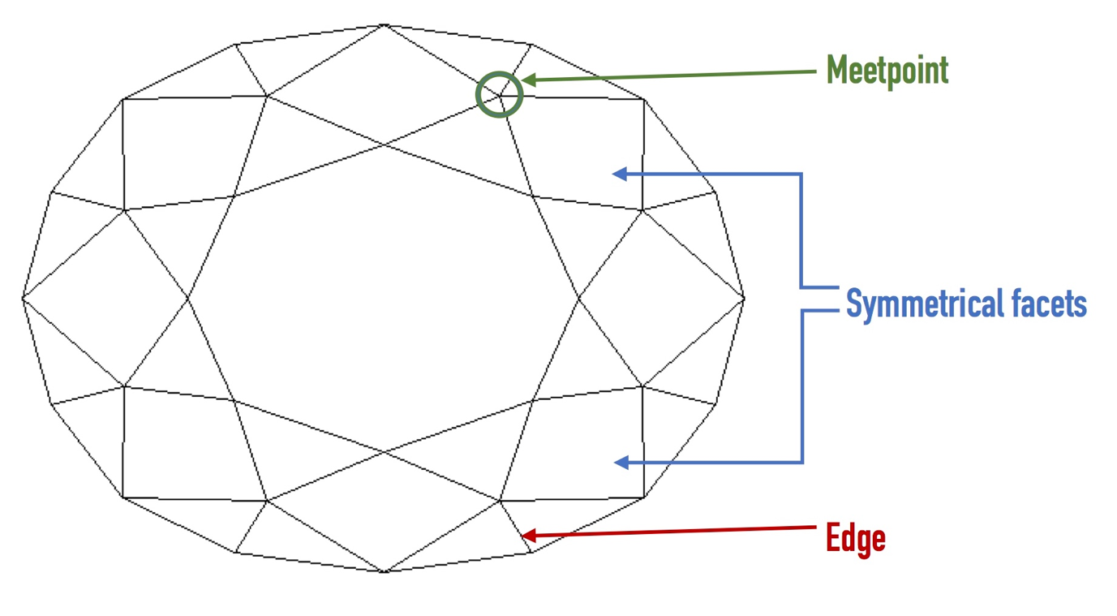
Pattern points
Hong Kong Mineral Show - 2018

Slide 5
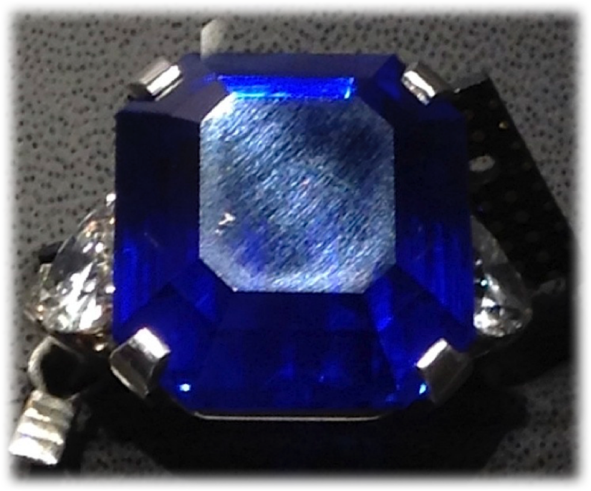
Example:
To see better, you should direct light perpendicularly to scratches direction.
Hong Kong Mineral Show - 2018

Slide 6
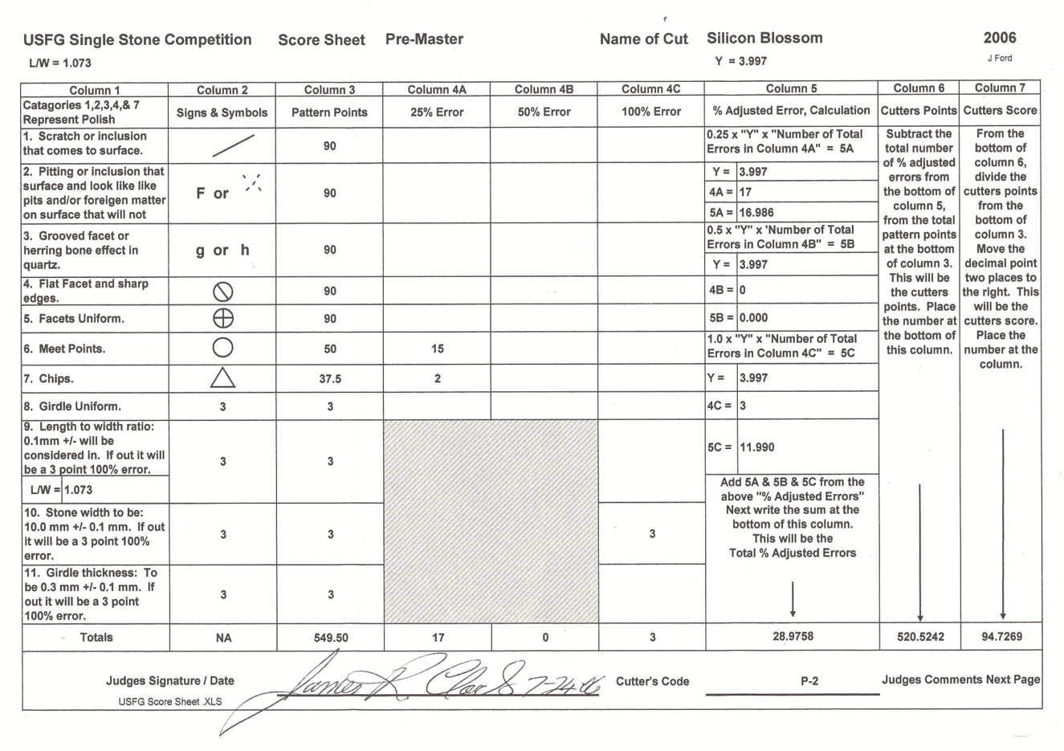
Example:
Judging sheet from the US competition
Hong Kong Mineral Show - 2018

Slide 7
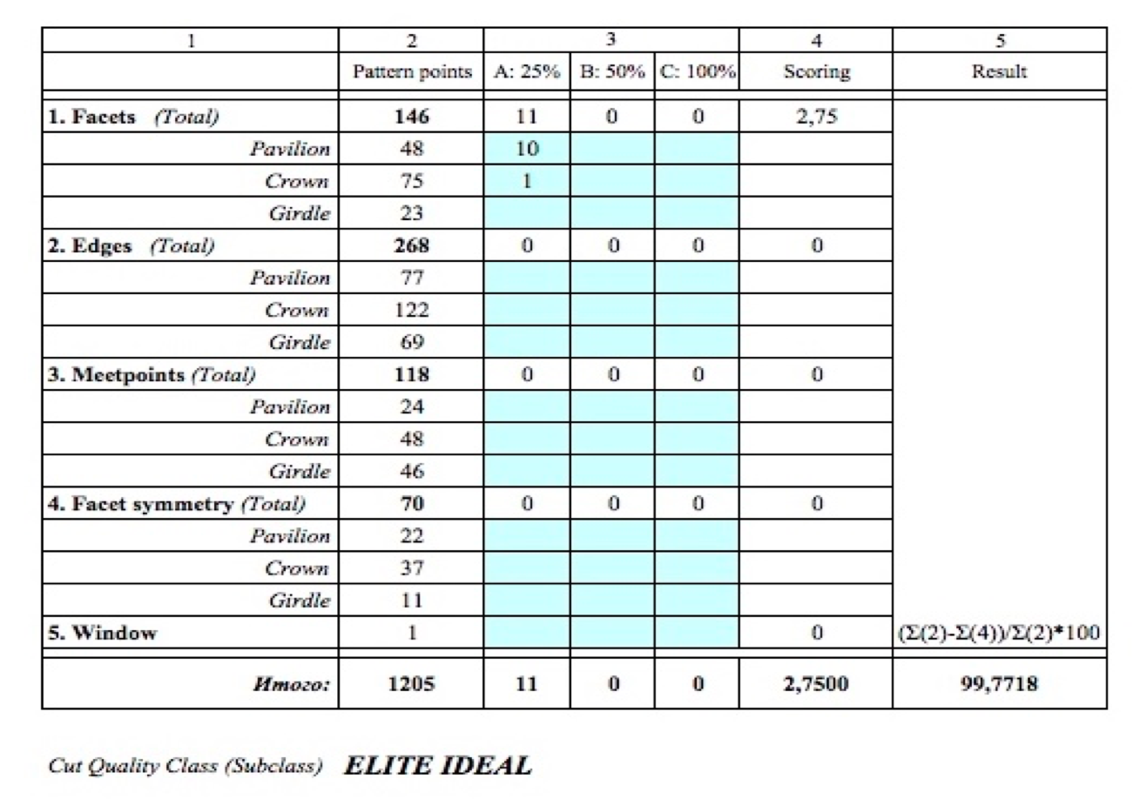
Example:
Work spreadsheet for cut grading
Hong Kong Mineral Show - 2018

Slide 8
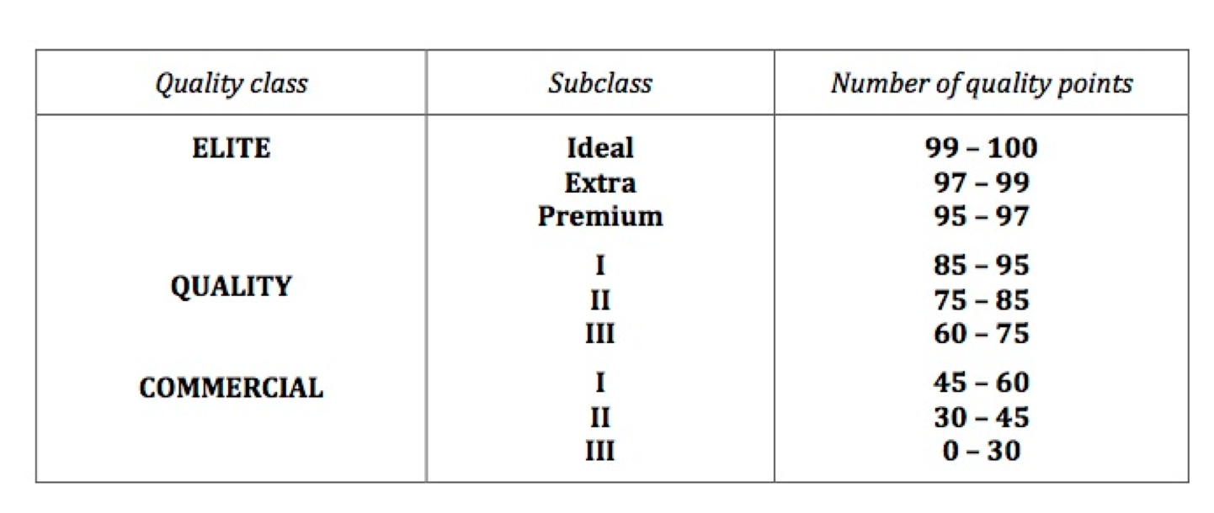
Faceting quality classes
Hong Kong Mineral Show - 2018

Slide 9
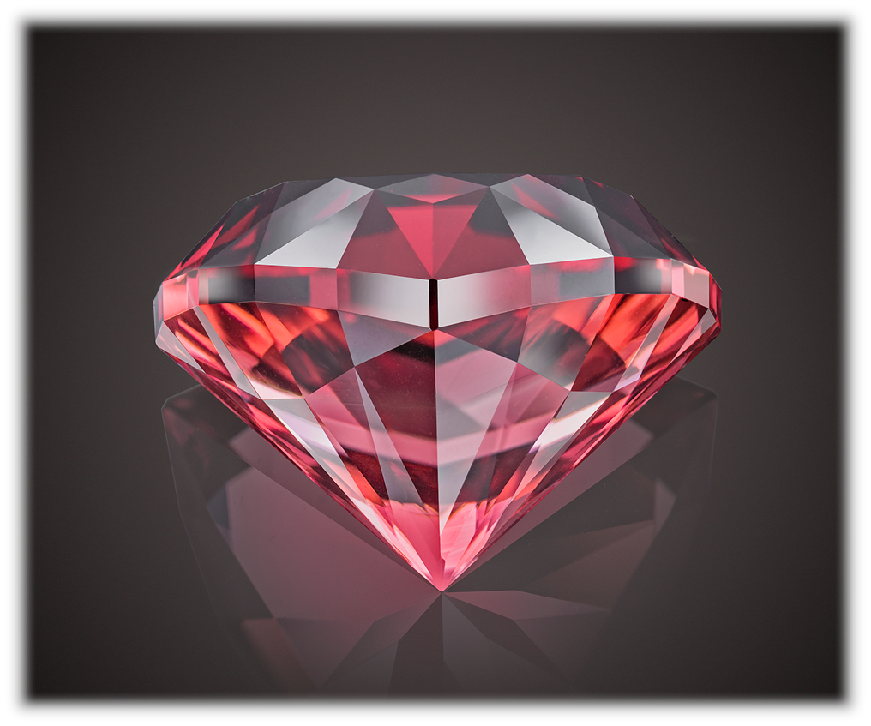
Example:
“Tytanic”
Cut specially for
Vigoff private collection.
Rubellite Turmaline,
26.1 carats
Hong Kong Mineral Show - 2018

Slide 10
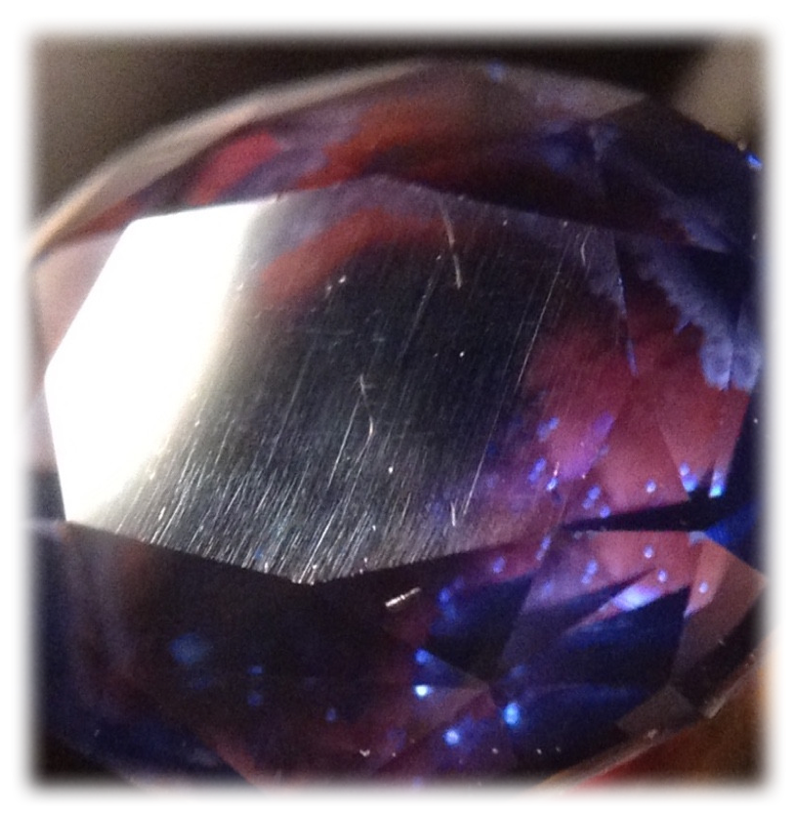
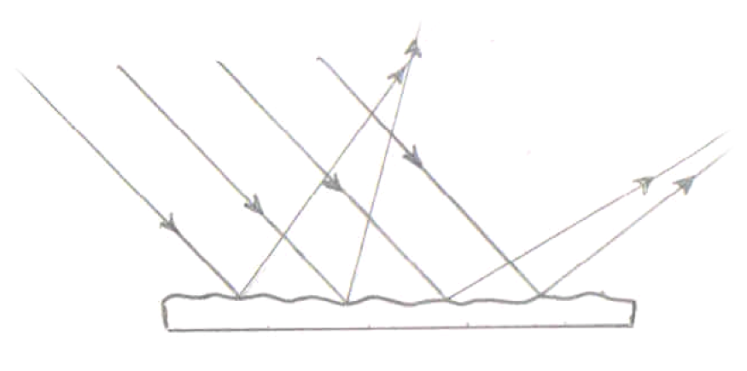
Light diffusion:
Commercial polish
(uneven surface)
Hong Kong Mineral Show - 2018

Slide 11
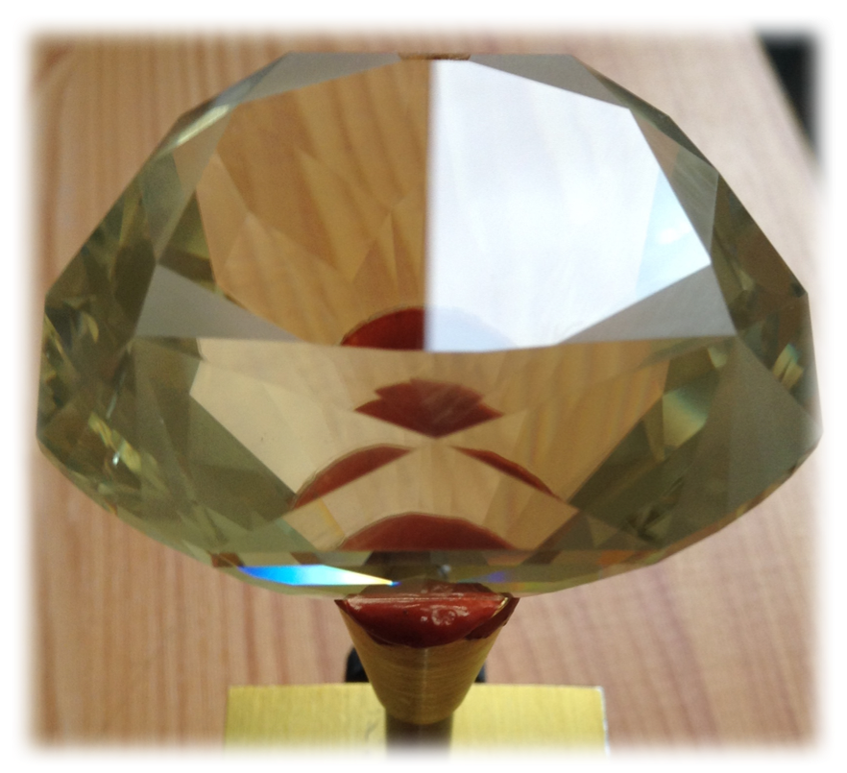
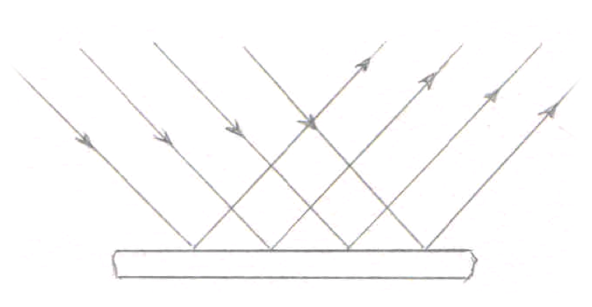
Light diffusion:
Perfect polish
(even surface)
Hong Kong Mineral Show - 2018

Slide 12
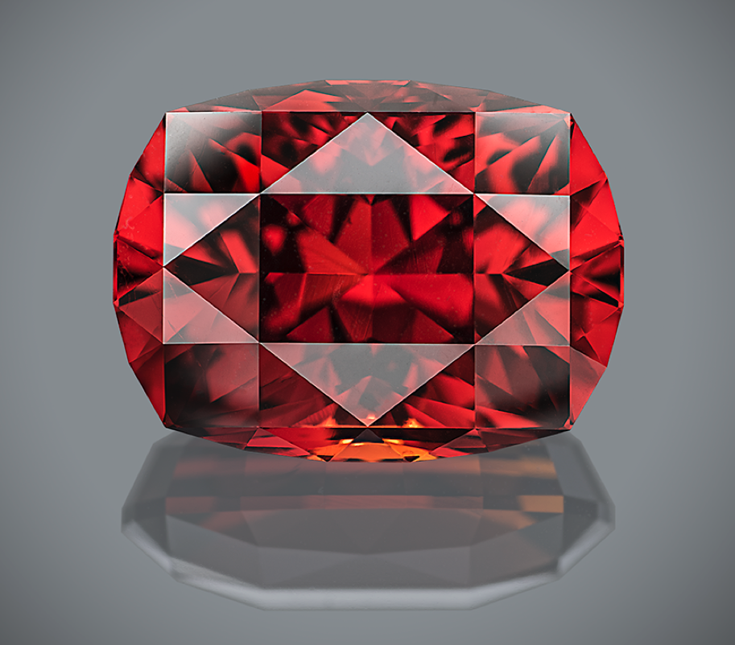
Example:
“Mars ascending”
Cut specially for
Vigoff private collection.
Spessartite Garnet,
32.85 carats
Hong Kong Mineral Show - 2018

Slide 13
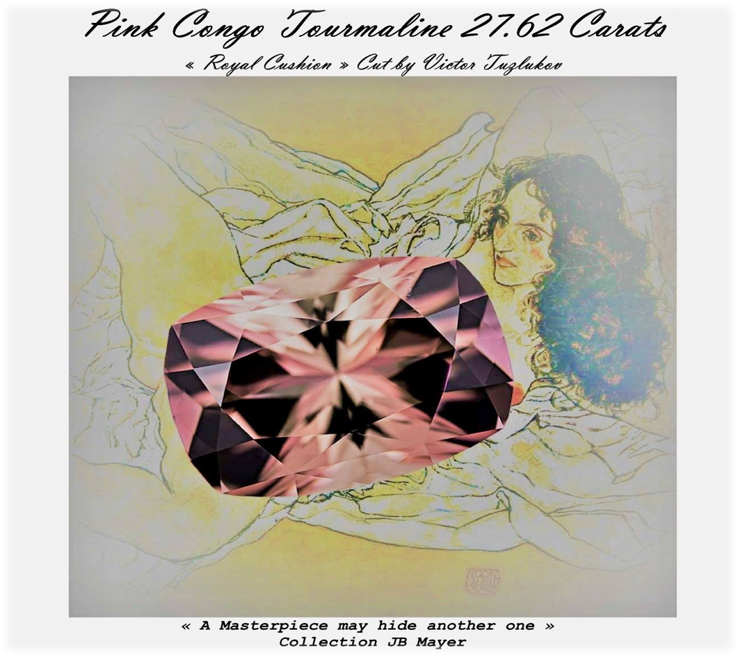
Hong Kong Mineral Show - 2018
Part II.
Art of faceting

Slide 14
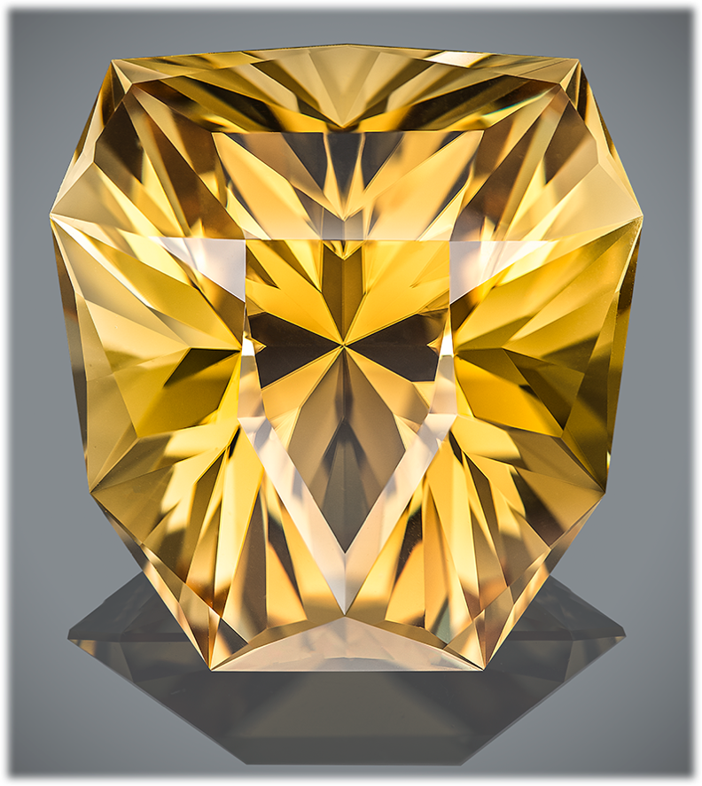
Example:
“Look of the King”
…He stood looking at me – gracious and wise – and oceans of power and dignity splashed in his eyes, captivating me, dissolving me and taking away somewhere behind the limits of human self-actualization…
One time, at minute of weakness and discouragement, this look will flash before me again. Look of the KING.
Scapolite,
68.08 carats
Hong Kong Mineral Show - 2018

Slide 15
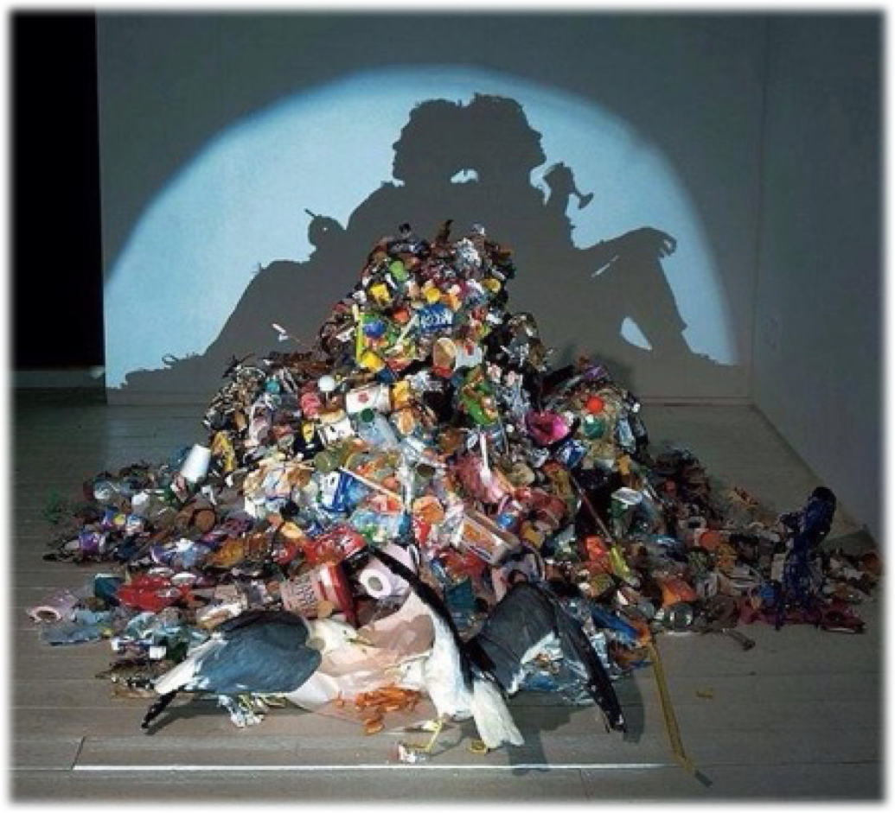
Example:
Trash art
Hong Kong Mineral Show - 2018

Slide 16
Example:
Spyder.
Just spyder.
Hong Kong Mineral Show - 2018

Slide 17
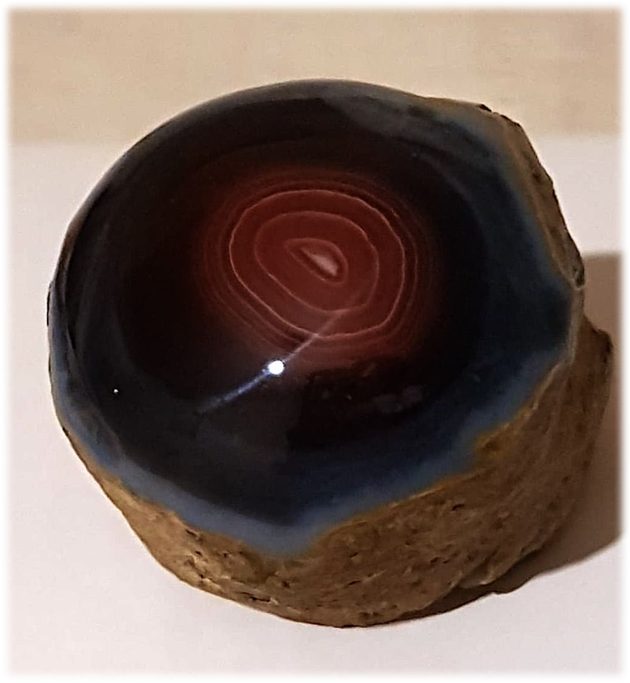
Example:
«The last glance”
Hong Kong Mineral Show - 2018

Slide 18
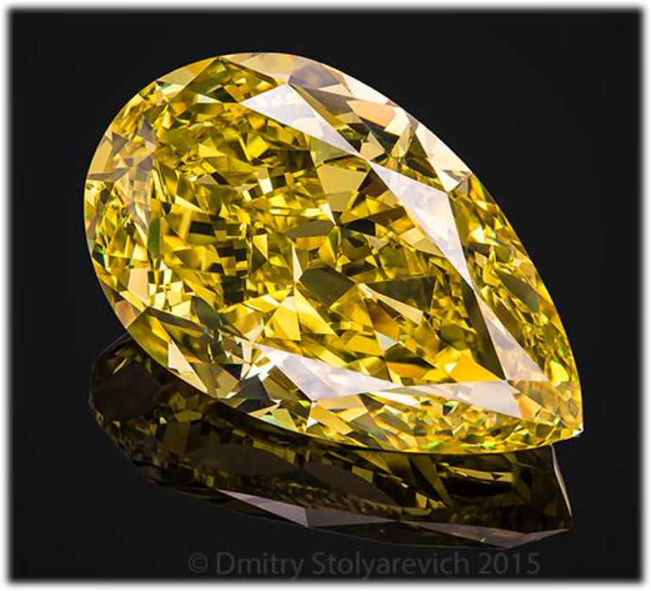
Example:
”Intense” yellow diamond
Photo: Dmitry Stolyarevich
(Moscow)
Hong Kong Mineral Show - 2018

Slide 19
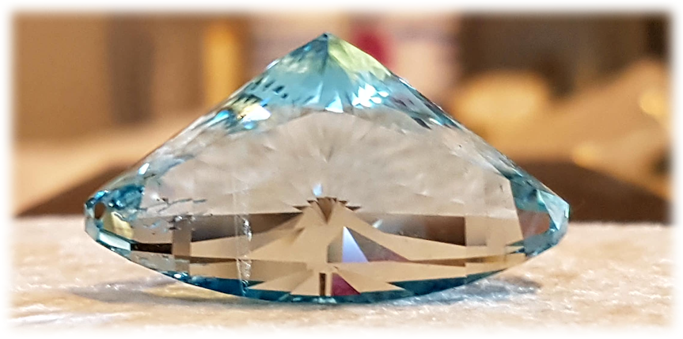
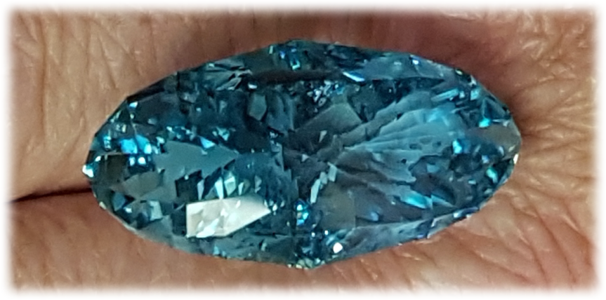
Untreated Topaz,
170.9 carats
Light / Intense Blue
Hong Kong Mineral Show - 2018

Slide 20
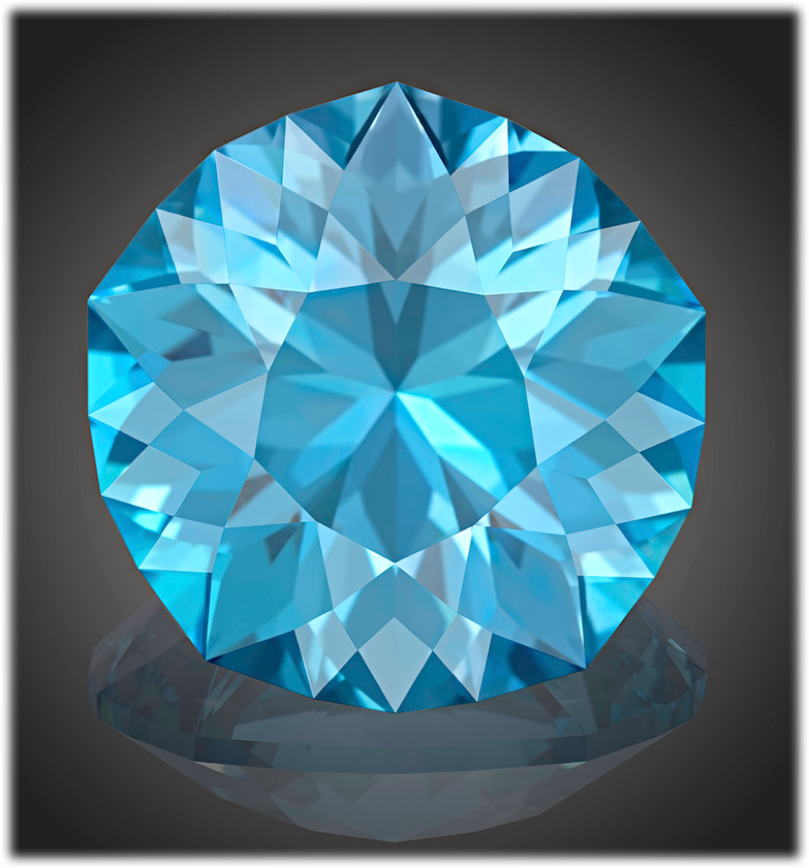
“Forget-me-not”
Passing away, I will not disappear.
I will dissolve in the coolness of the evening breeze. I will sprout among bright spring grass. I will meet you by the song of the distant stars and smile to you by each dewdrop.
Manage to recognize my joy in the light that hugs you. Manage to hear my voice in the whisper of wind, dancing with you. Manage to see my body in the sparkles of forget-me-nots...
Forget. Me. Not... We may be always together.
Blue Topaz,
136.02 carats
Hong Kong Mineral Show - 2018

Slide 21
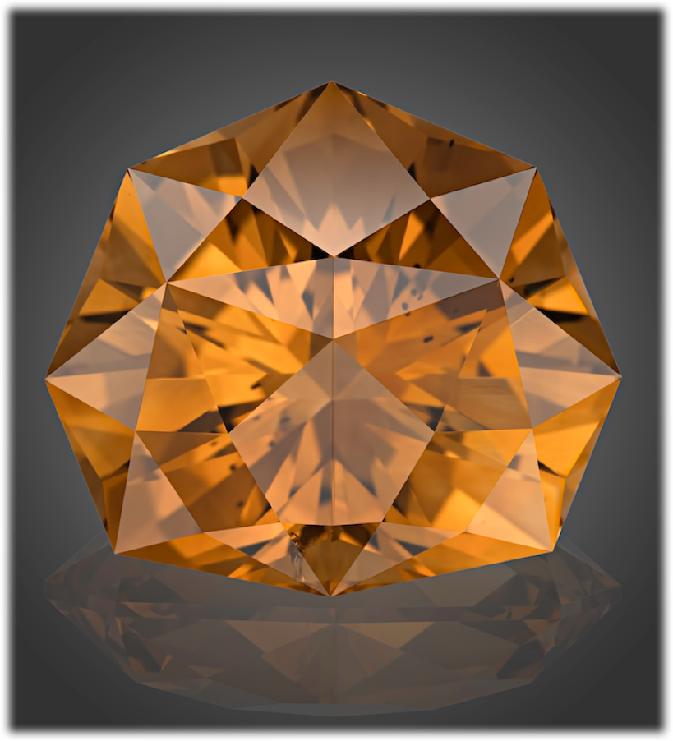
“Rose”
They say that stars are fading when fall down from the sky... It is wrong. Just body of star is fading, but her soul is incarnating in the flower – to have some rest during short time of blossoming. Then, saying "Bye..." to falling petals, it ascends and shines by refresh light, full of silent charm of summer morning.
Each star has her own character. Some of them fire as bright tulips, others hide as scattering of dandelions. Some of them attract by color, others by aroma... But just a few, like Queens of flower garden, are perfect in everything.
I will put white rose by the head of your bed.
Let Star shine!
Citrine,
74.31 carats
Hong Kong Mineral Show - 2018

Slide 22
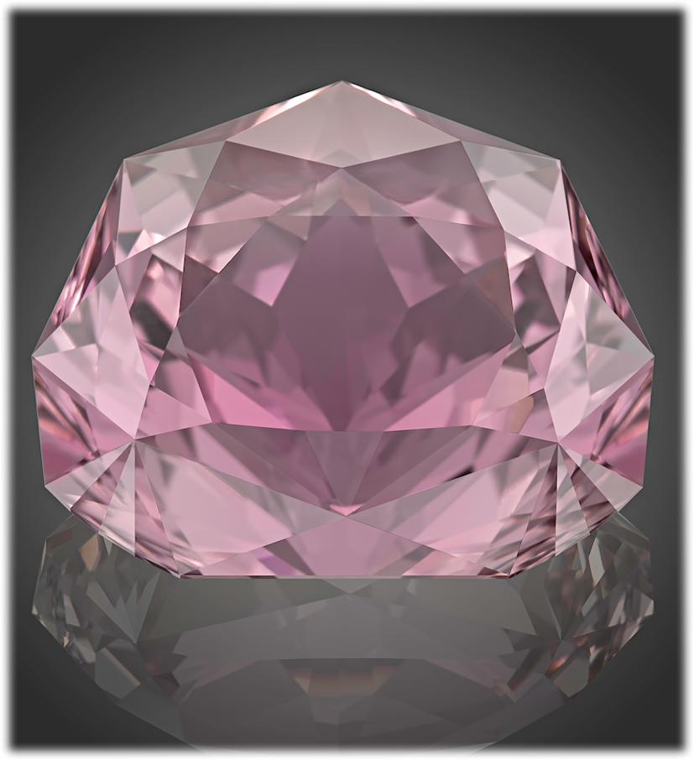
“Lotus”
Our life is music.
In the dark depth of the Unknowable, the initial vibration of melody borns like a Lotus bud. It swells up, taking power from sacred roots; expands by joyful greenery of leaves. And, like a strong steam, the piercing main tune strives upward – from black mud of Matter, through cloudy water of Ignorance, through clearness of Cognizing, upper and upper – to the pure first-manifested Light, to open out by wonderful flower of Perfection, and to dissolve there becoming the Light itself...
Blessed those who realized Harmony!
Kunzite,
161.68 carats
Hong Kong Mineral Show - 2018

Slide 23
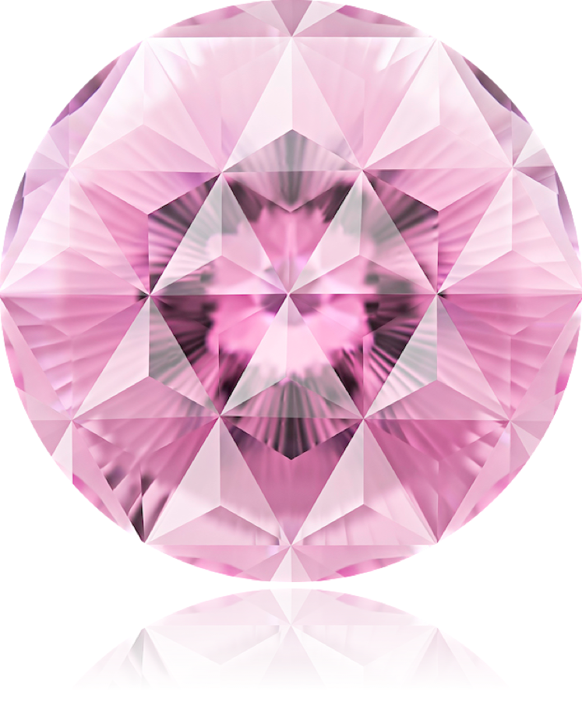
“Faces of Perfection”
(Japan)
Sakura finishes blossoming quite fast and flight of arrow is swift. But beauty of flower is immortal, as well as power of flying arrow. Power and Beauty are two faces of the single Perfection.
Kunzite,
122.85 carats
Hong Kong Mineral Show - 2018

Slide 24
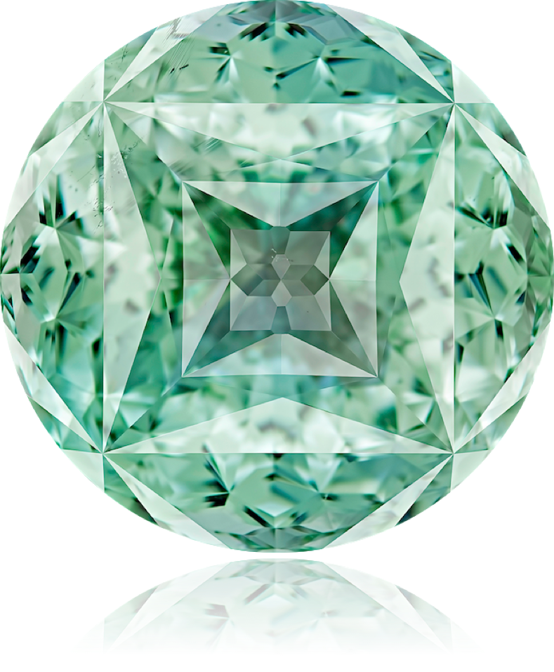
“The Great in a tiny”
(Tibet)
The Great Mandala is shining in the small gemstone. A small man is realizing the great teachings. The tiny may contain the Grand, being the beginning, the end and the evolution itself...
Topaz,
160.95 carats
Hong Kong Mineral Show - 2018

Slide 25
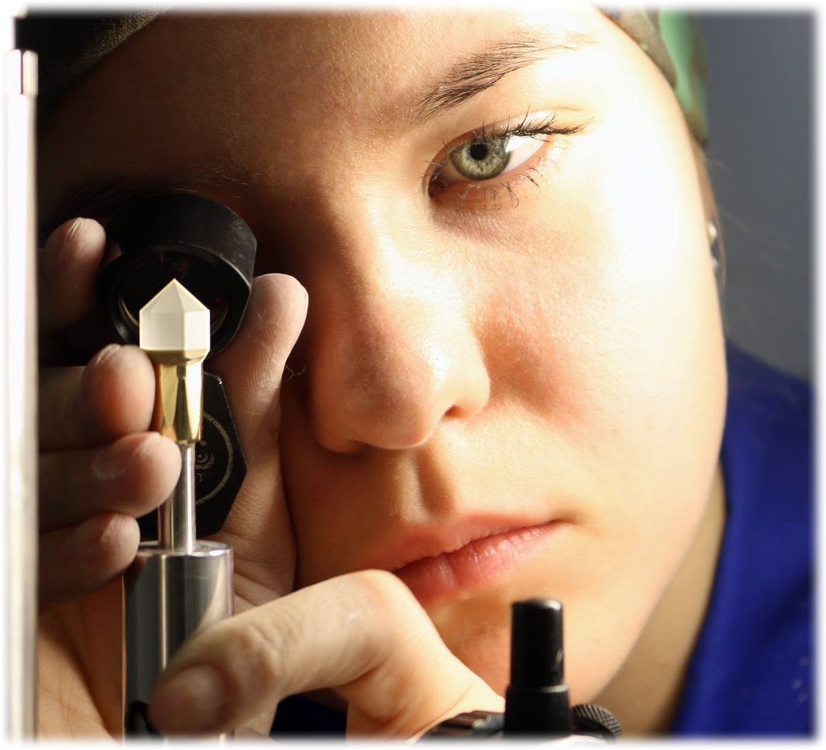
Hong Kong Mineral Show - 2018
One of participants of WorldSkills – Russia
Competition
Moscow, 2018

Slide 26
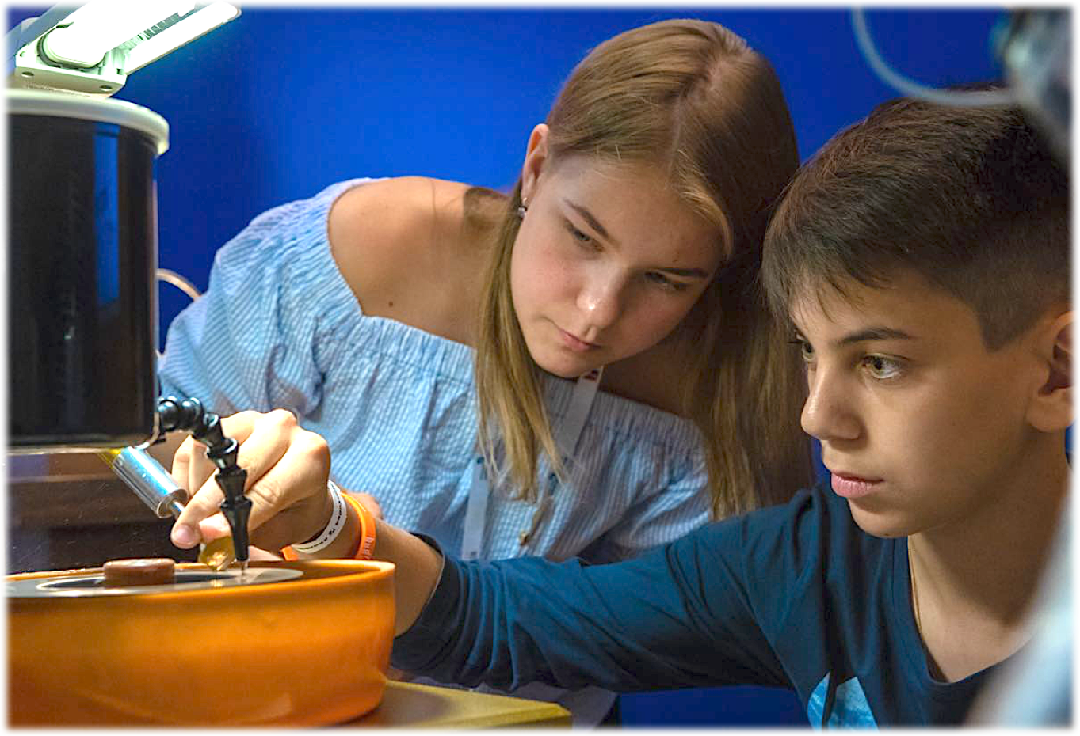
Hong Kong Mineral Show - 2018

Slide 27
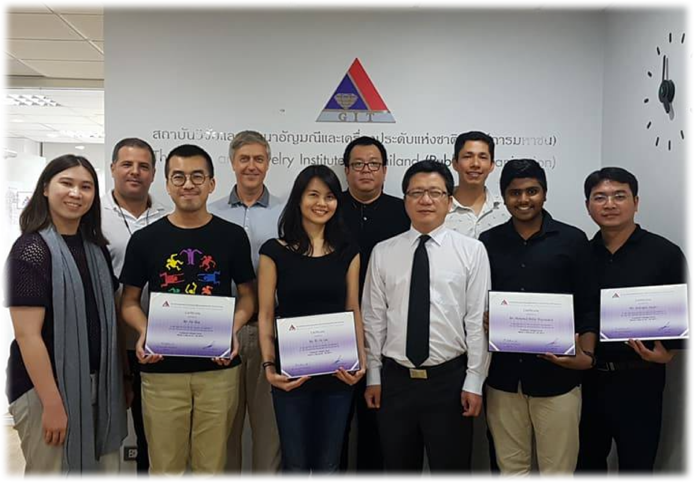
Hong Kong Mineral Show - 2018
Graduates of faceting course “Basic of precision cut”
Gems and Jewelry Institute of Thailand,
Bangkok
October, 2016

Slide 28
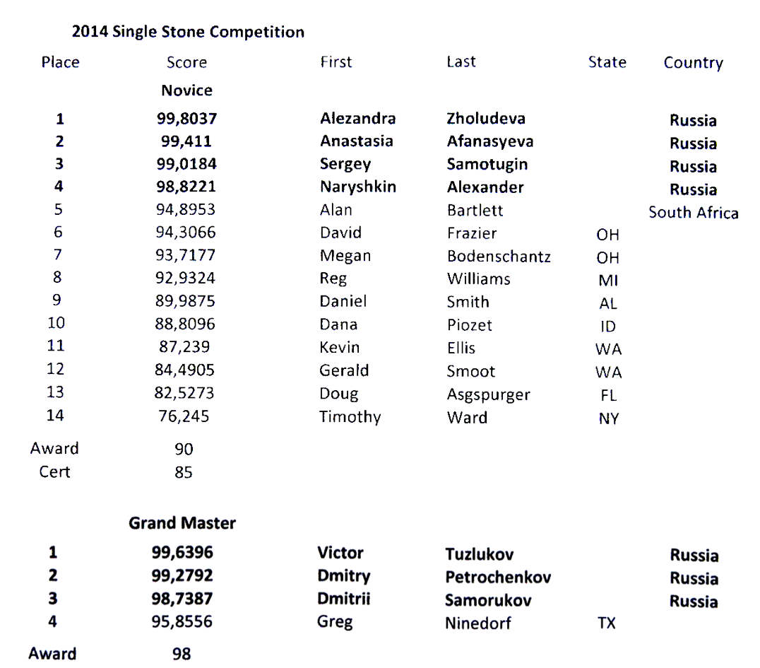
Hong Kong Mineral Show - 2018
Results of the Single Stone Competition provided by the US Faceters Guild
(Novice and Grand Master classes)
September, 2014

Slide 29
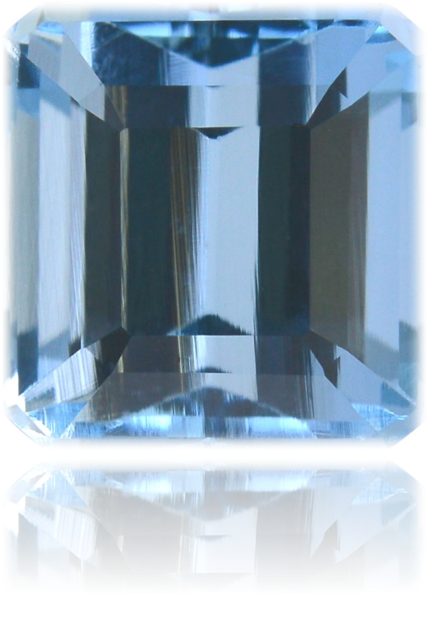
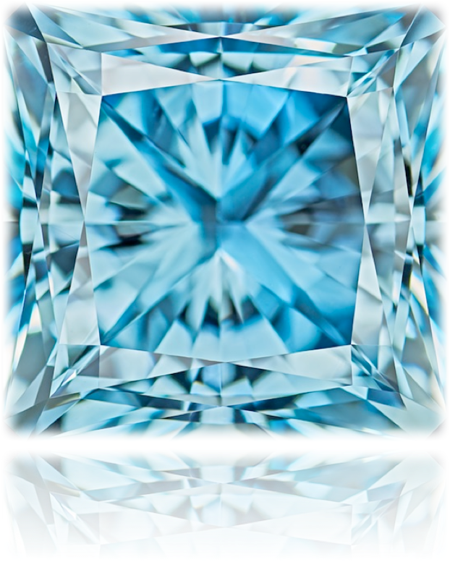
Hong Kong Mineral Show - 2018
VS

Slide 30
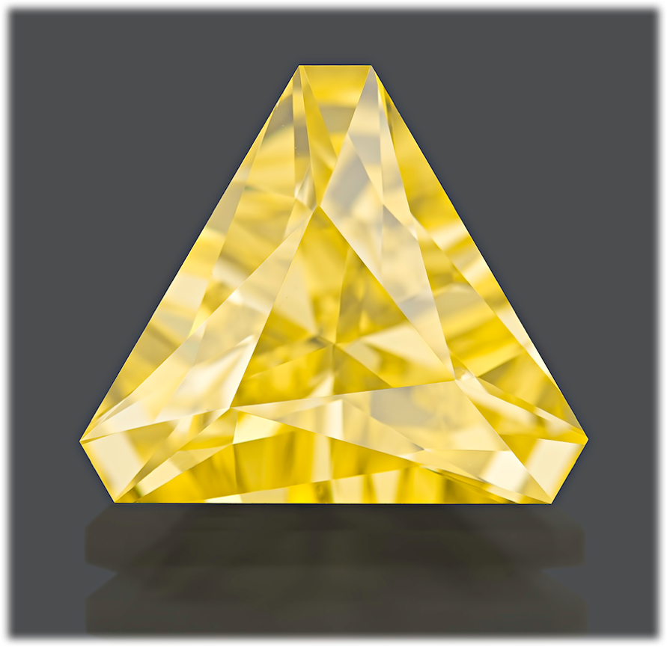
Gem-A conference – London 2018
Example:
Cubic Zirconia, 6.72 carats
Cut by Ivan Tuzlukov, 8 years old

Slide 31

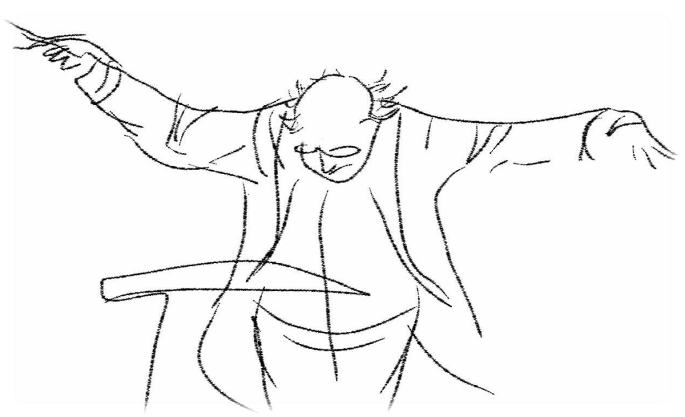
Hong Kong Mineral Show - 2018

Slide 32

Victor Tuzlukov
Gemstone artist
Graduate Gemologist (GIA)
Grand-Master competition cutter (USFG)
World champion and record-breaker in technic of faceting
Phone: +7 926 732 0799
Whatsapp: +7 926 732 0799
Email: vtuzlukov@hotmail.com
Photo of gemstones by: Dmitry Stolyarevich (Moscow)
Arjuna Irsutti (Bangkok)

