Slide 1

The fourth “C”: today and tomorrow
GIT 2016
Pattaya

Slide 2
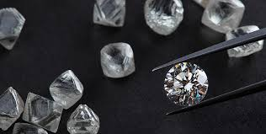
“Russian cut” diamond

Slide 3
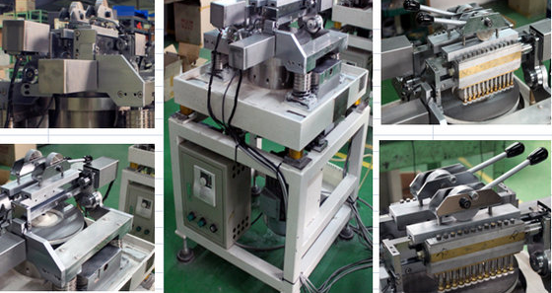
Automatic faceting machine

Slide 4
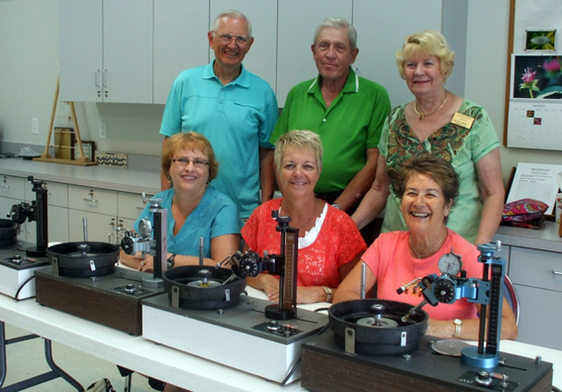
Non-professional faceters in Florida

Slide 5
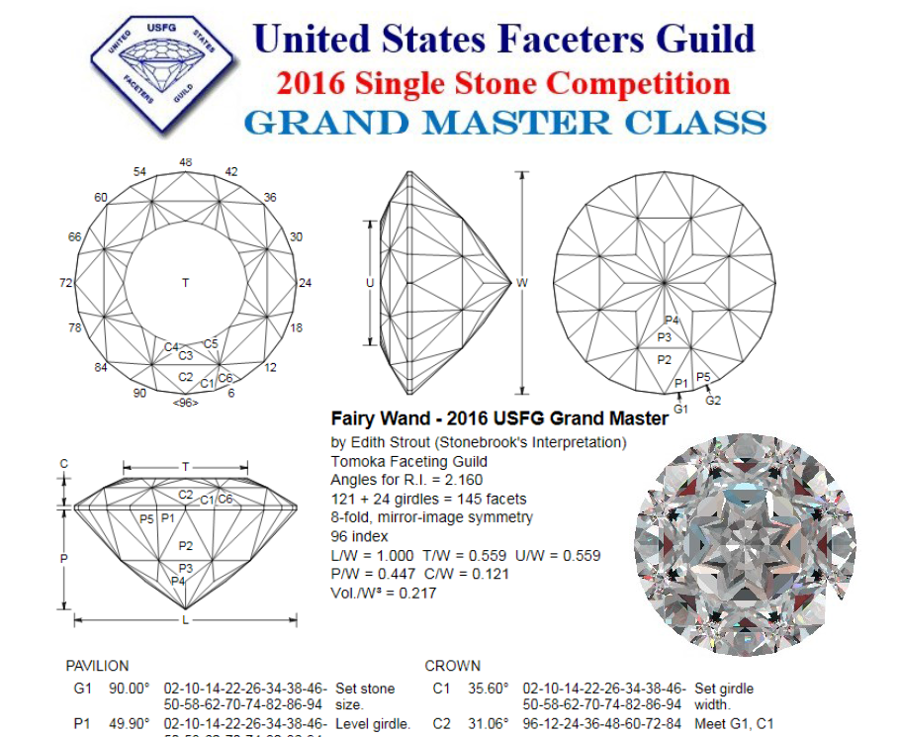
Single Stone Competition (USA)

Slide 6
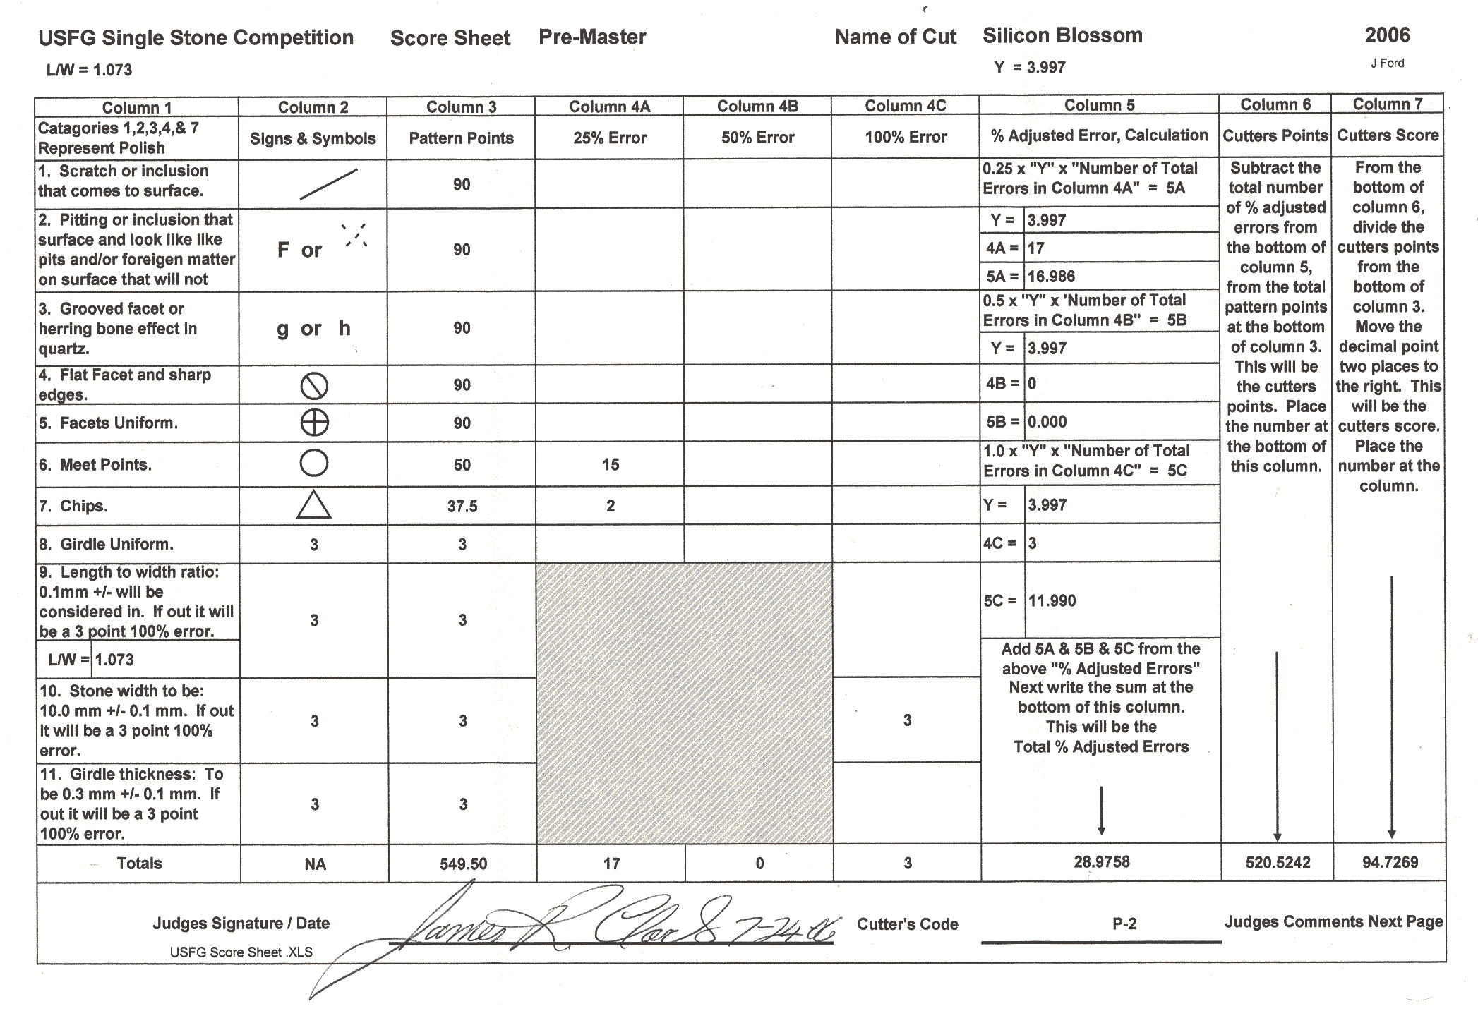
Sample of judging sheet

Slide 7
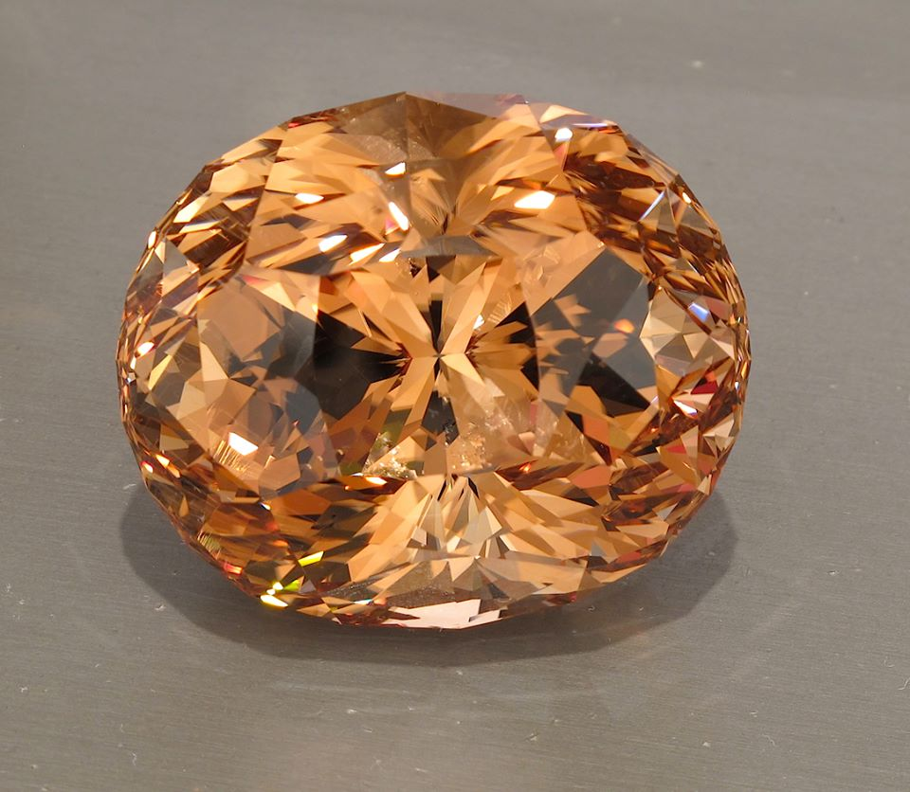
Topaz by Stephen Kotlowski

Slide 8
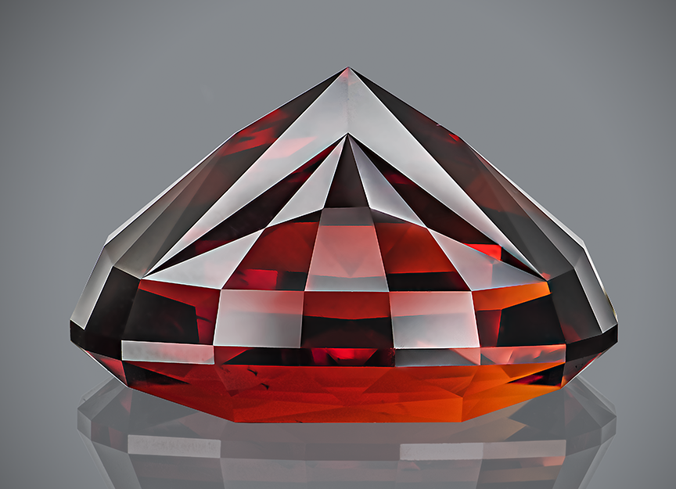
Spessartite, 32.85 carats
(Vigoff collection, USA)

Slide 9
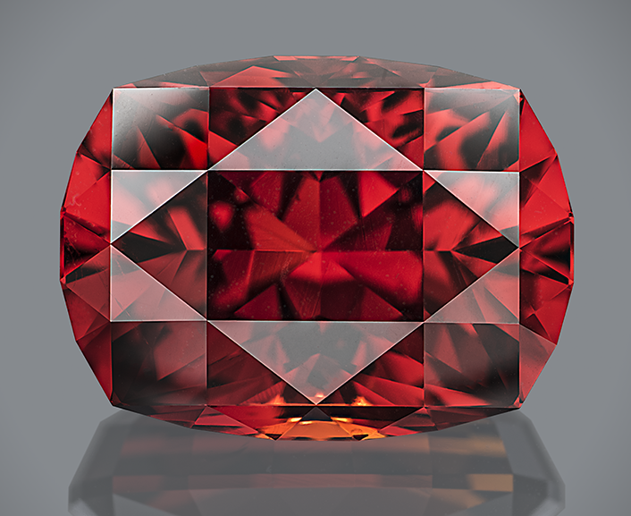
Spessartite, 32.85 carats
(Vigoff collection, USA)

Slide 10
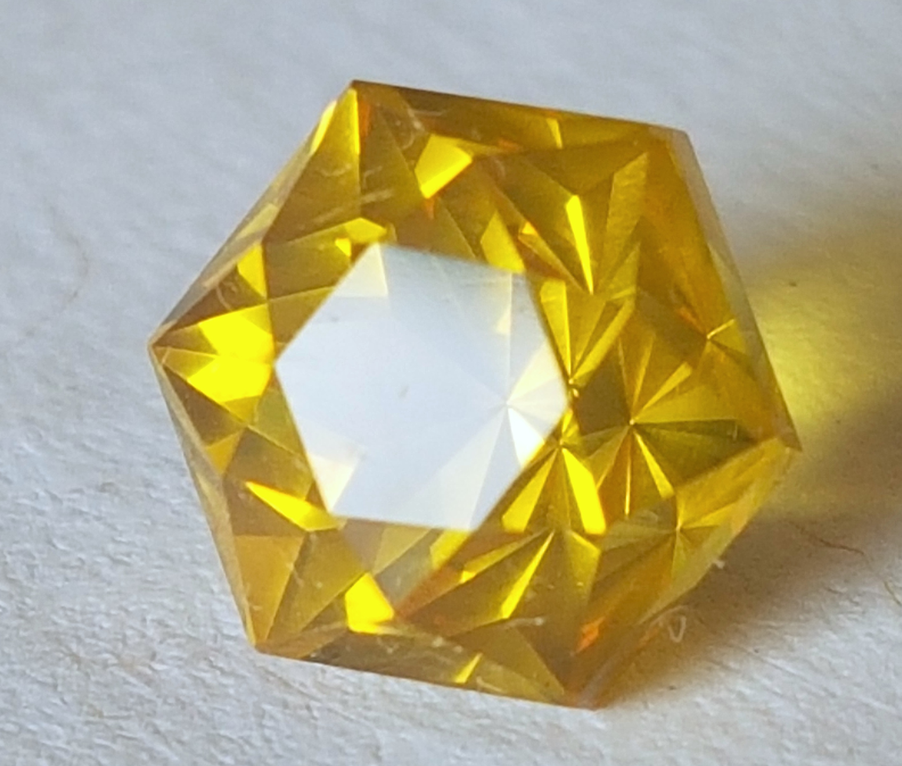
Dominican Amber, 0.765 carat

Slide 11
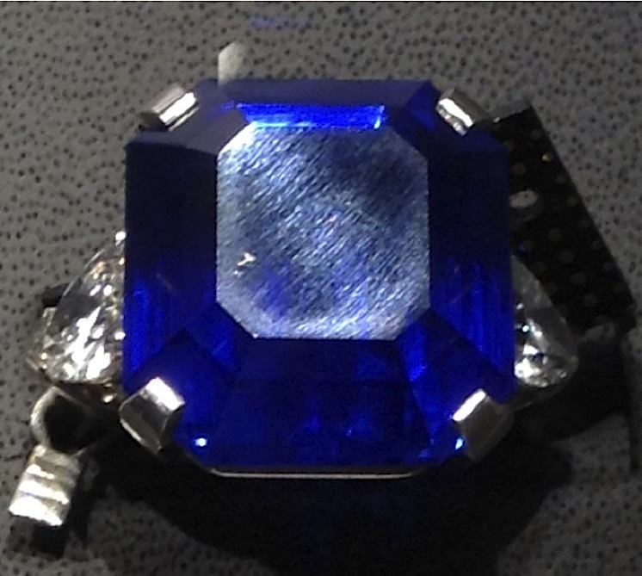
Commercial polishing

Slide 12
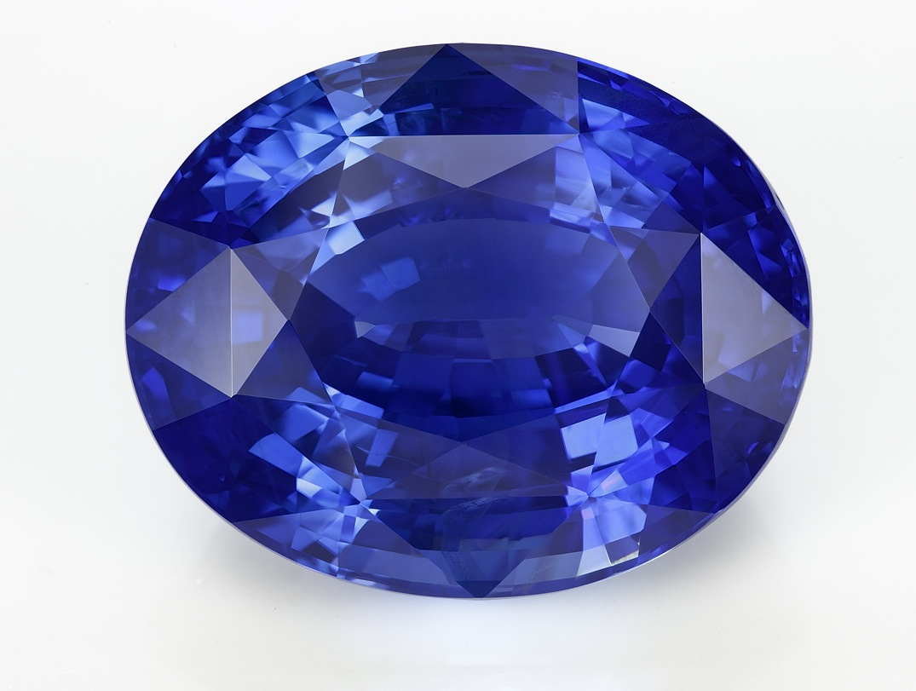
Sri Lankan Sapphire, 44.22 ct
(Private collection, Russia)

Slide 13
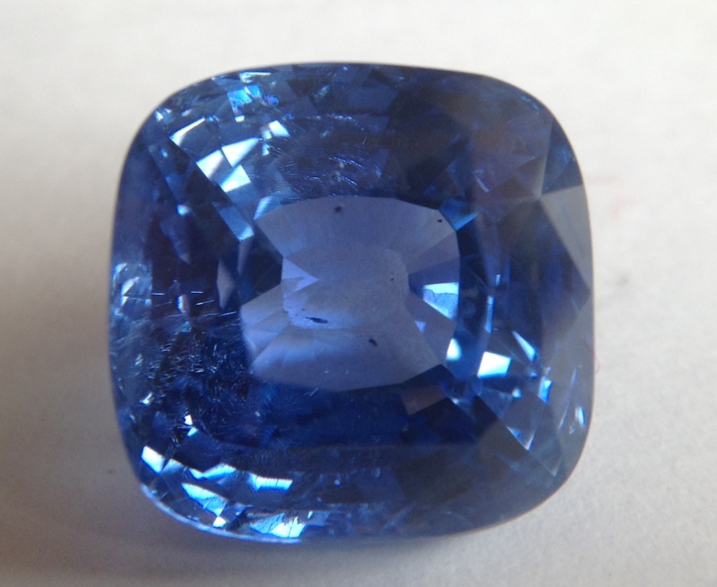
Sapphire before recutting (15.38 ct)

Slide 14
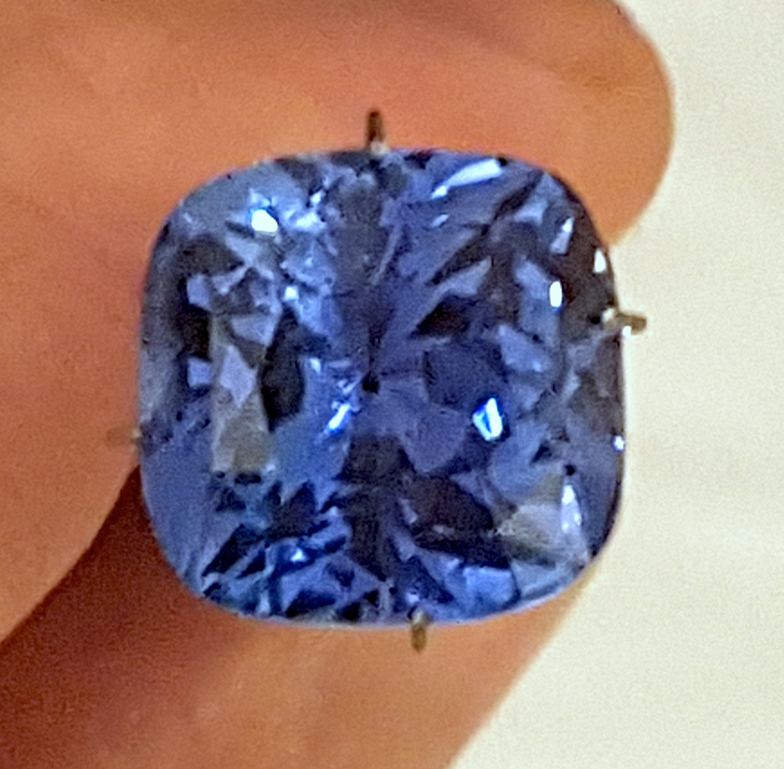
Sapphire after recutting (13.63 ct)

Slide 15
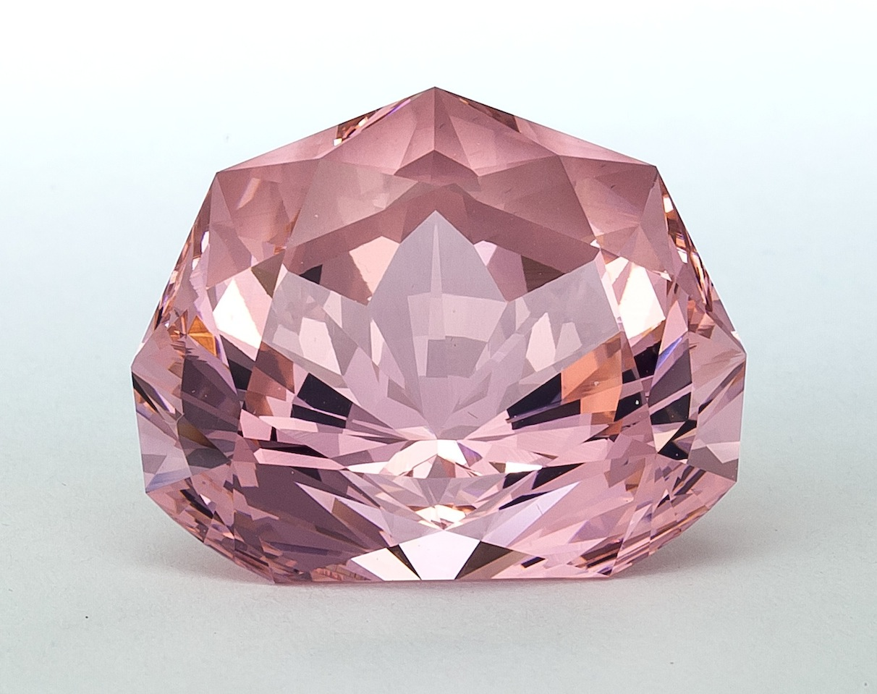
“Touching to the Perfection”
Kunzite, 162 ct

Slide 16
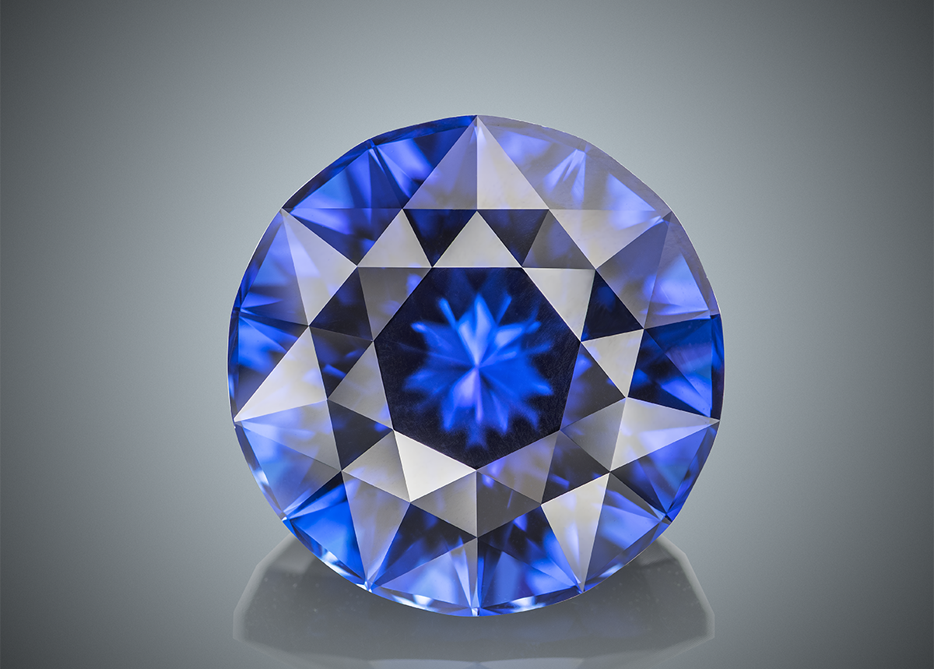
Tanzanite, 17.33 carats
(Private collection, Thailand)

Slide 17
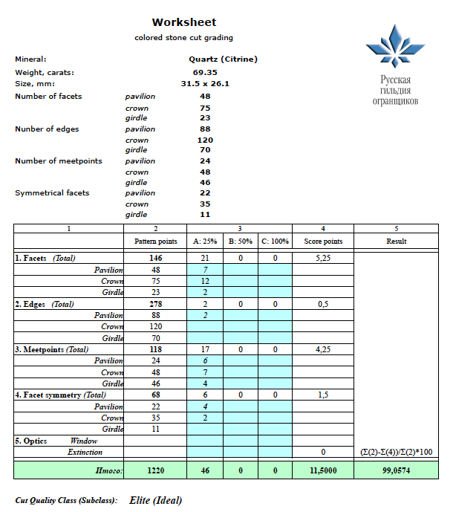
Sample of cut grading worksheet

Slide 18
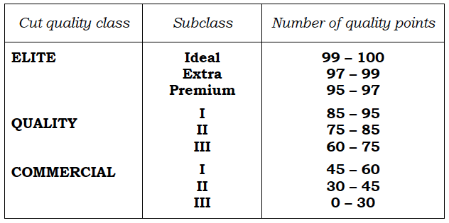
Cut quality classes

Slide 19
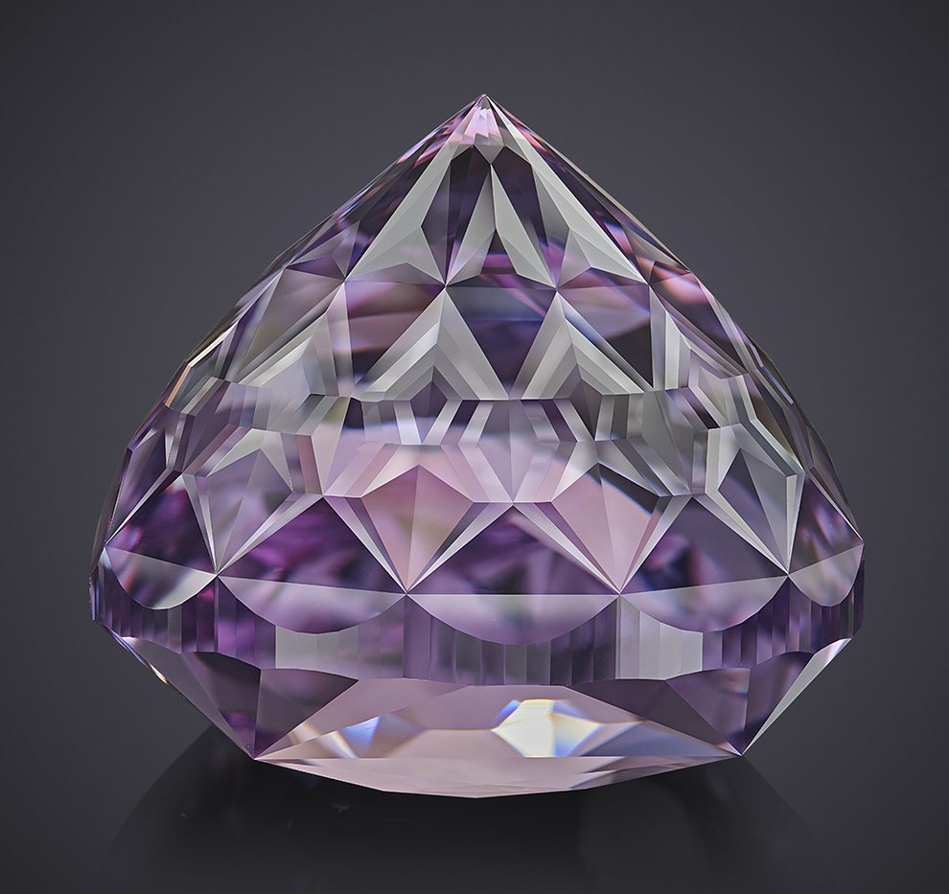
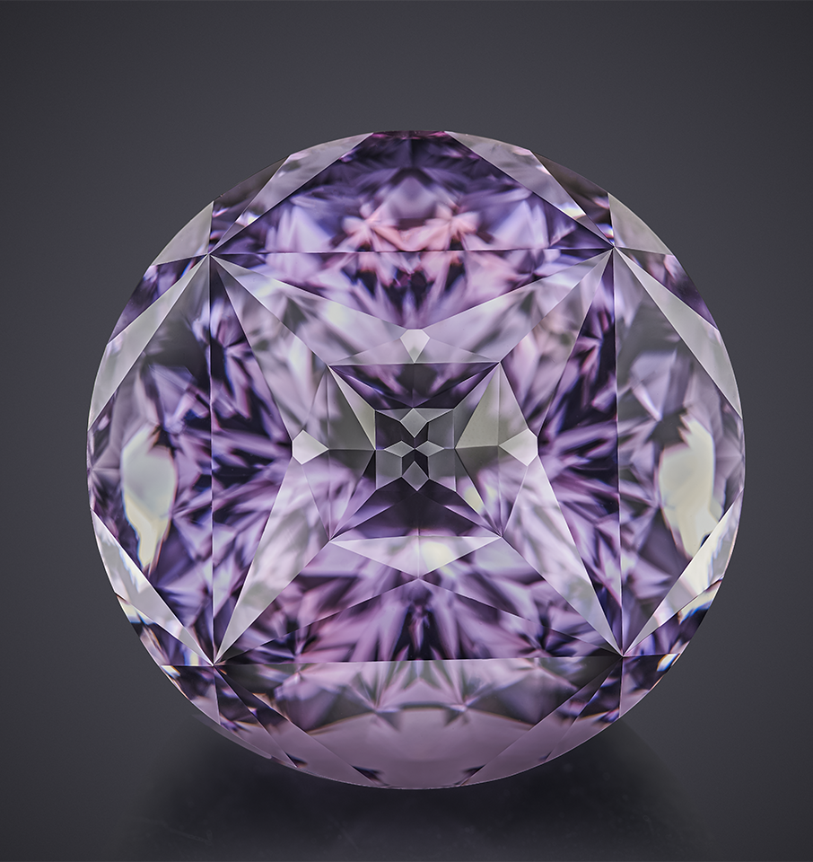
Amethyst, 219 carats, 705 facets
(cut recently)

Slide 20
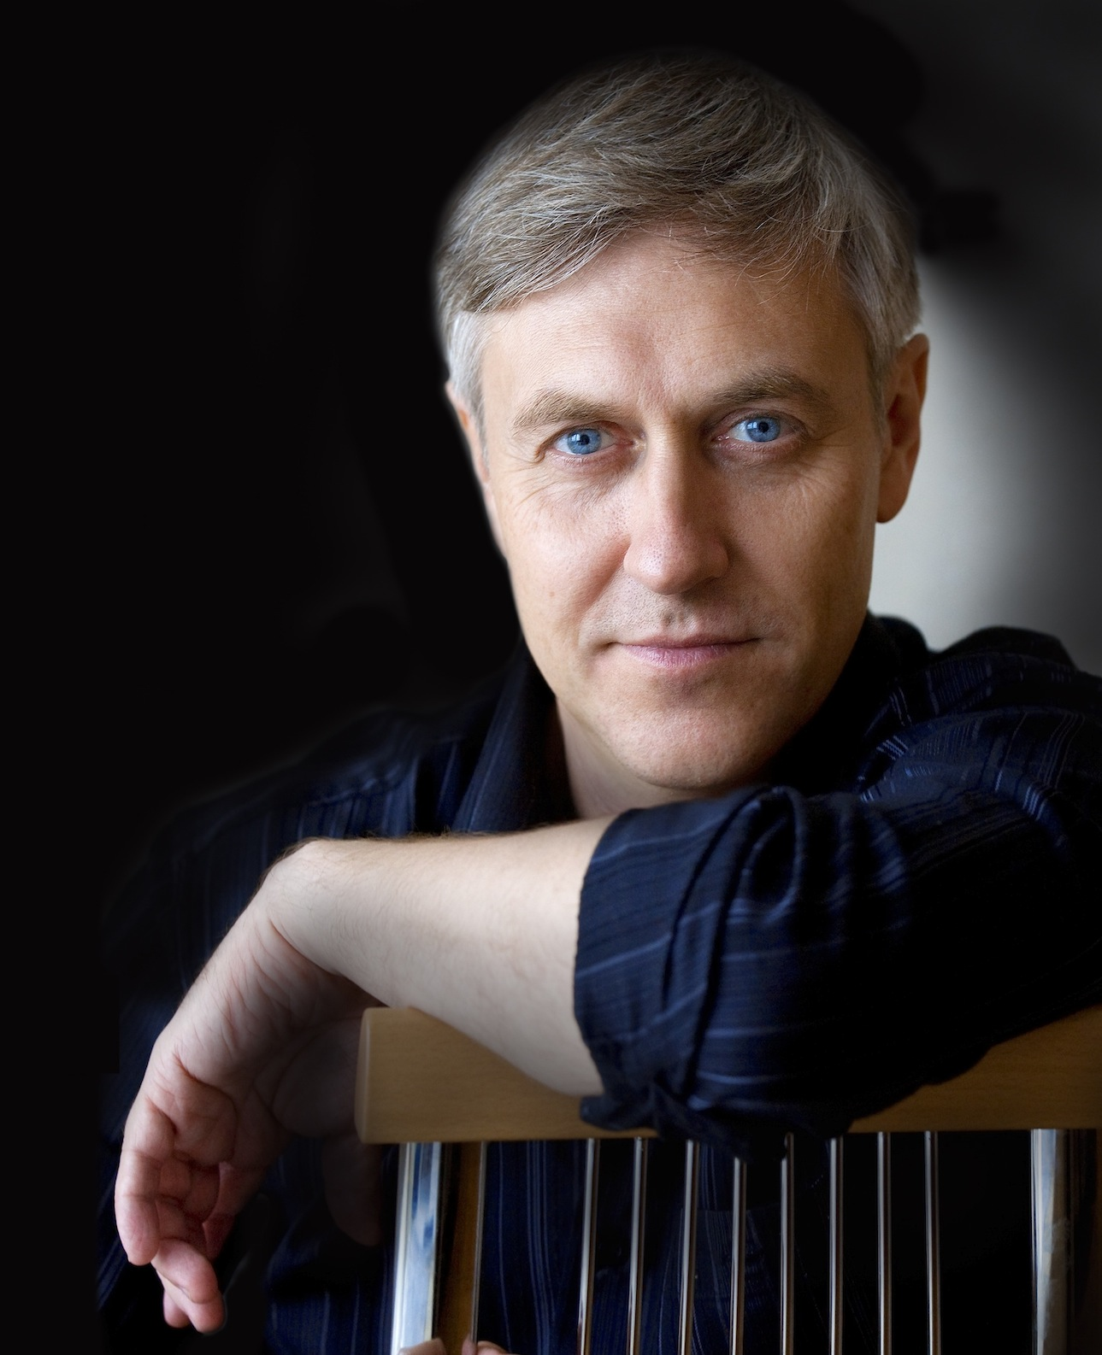
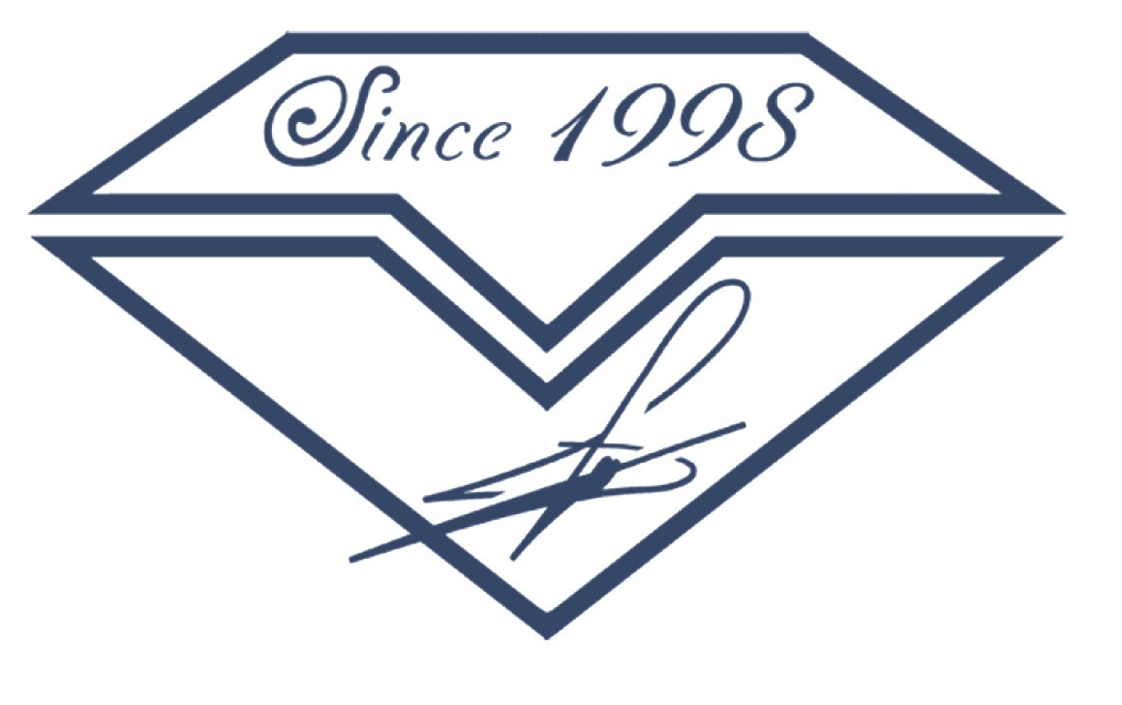
Thanks for your attention!
vtuzlukov@hotmail.com
+66 925 301939

