Slide 1

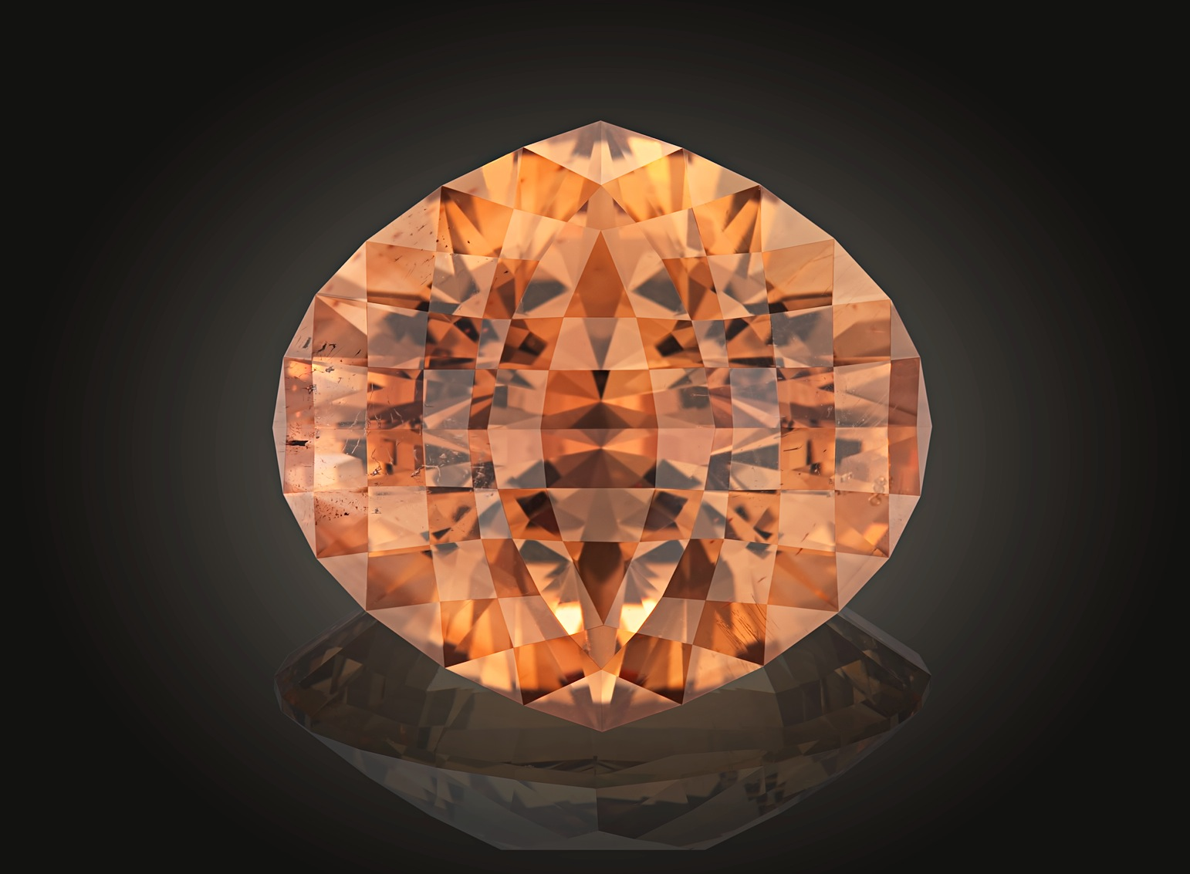

Victor Tuzlukov
Appraisal specialties for gems with artistic and precision cut
Russian Faceters Guild

Slide 2
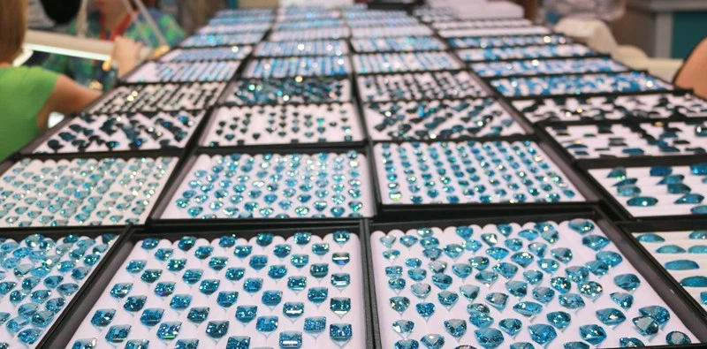
Víctor Tuzlukov
New edge of world gem faceting

Slide 3
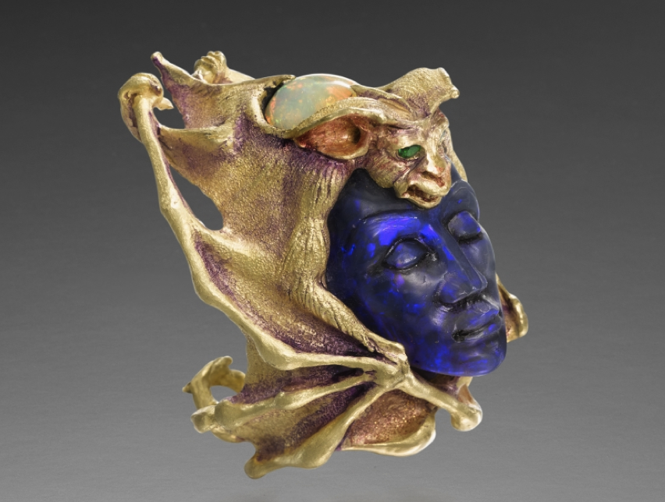
Víctor Tuzlukov
New edge of world gem faceting
Ring by
Kevin Coates

Slide 4
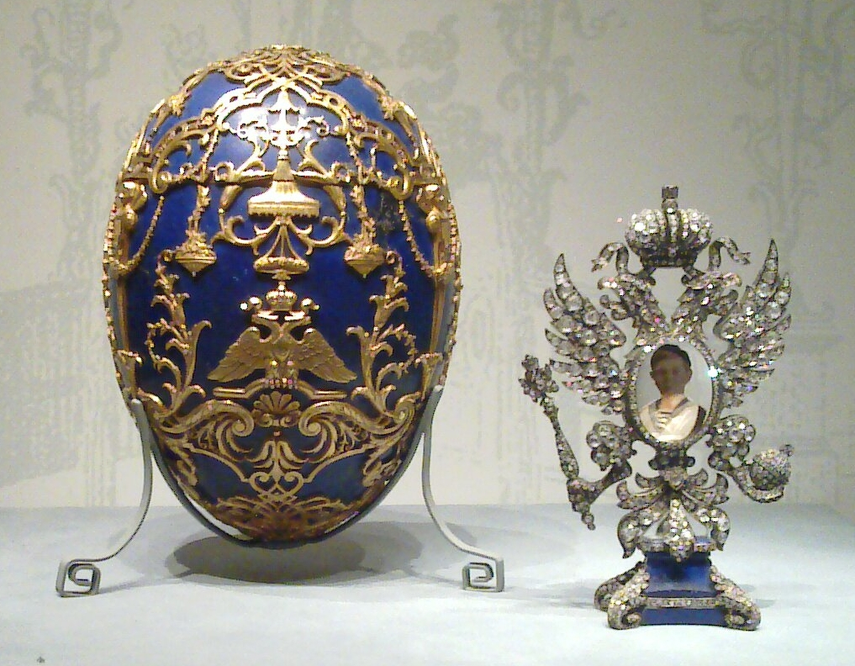
Víctor Tuzlukov
New edge of world gem faceting
Faberge
Egg

Slide 5
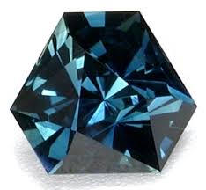
Víctor Tuzlukov
New edge of world gem faceting

Slide 6
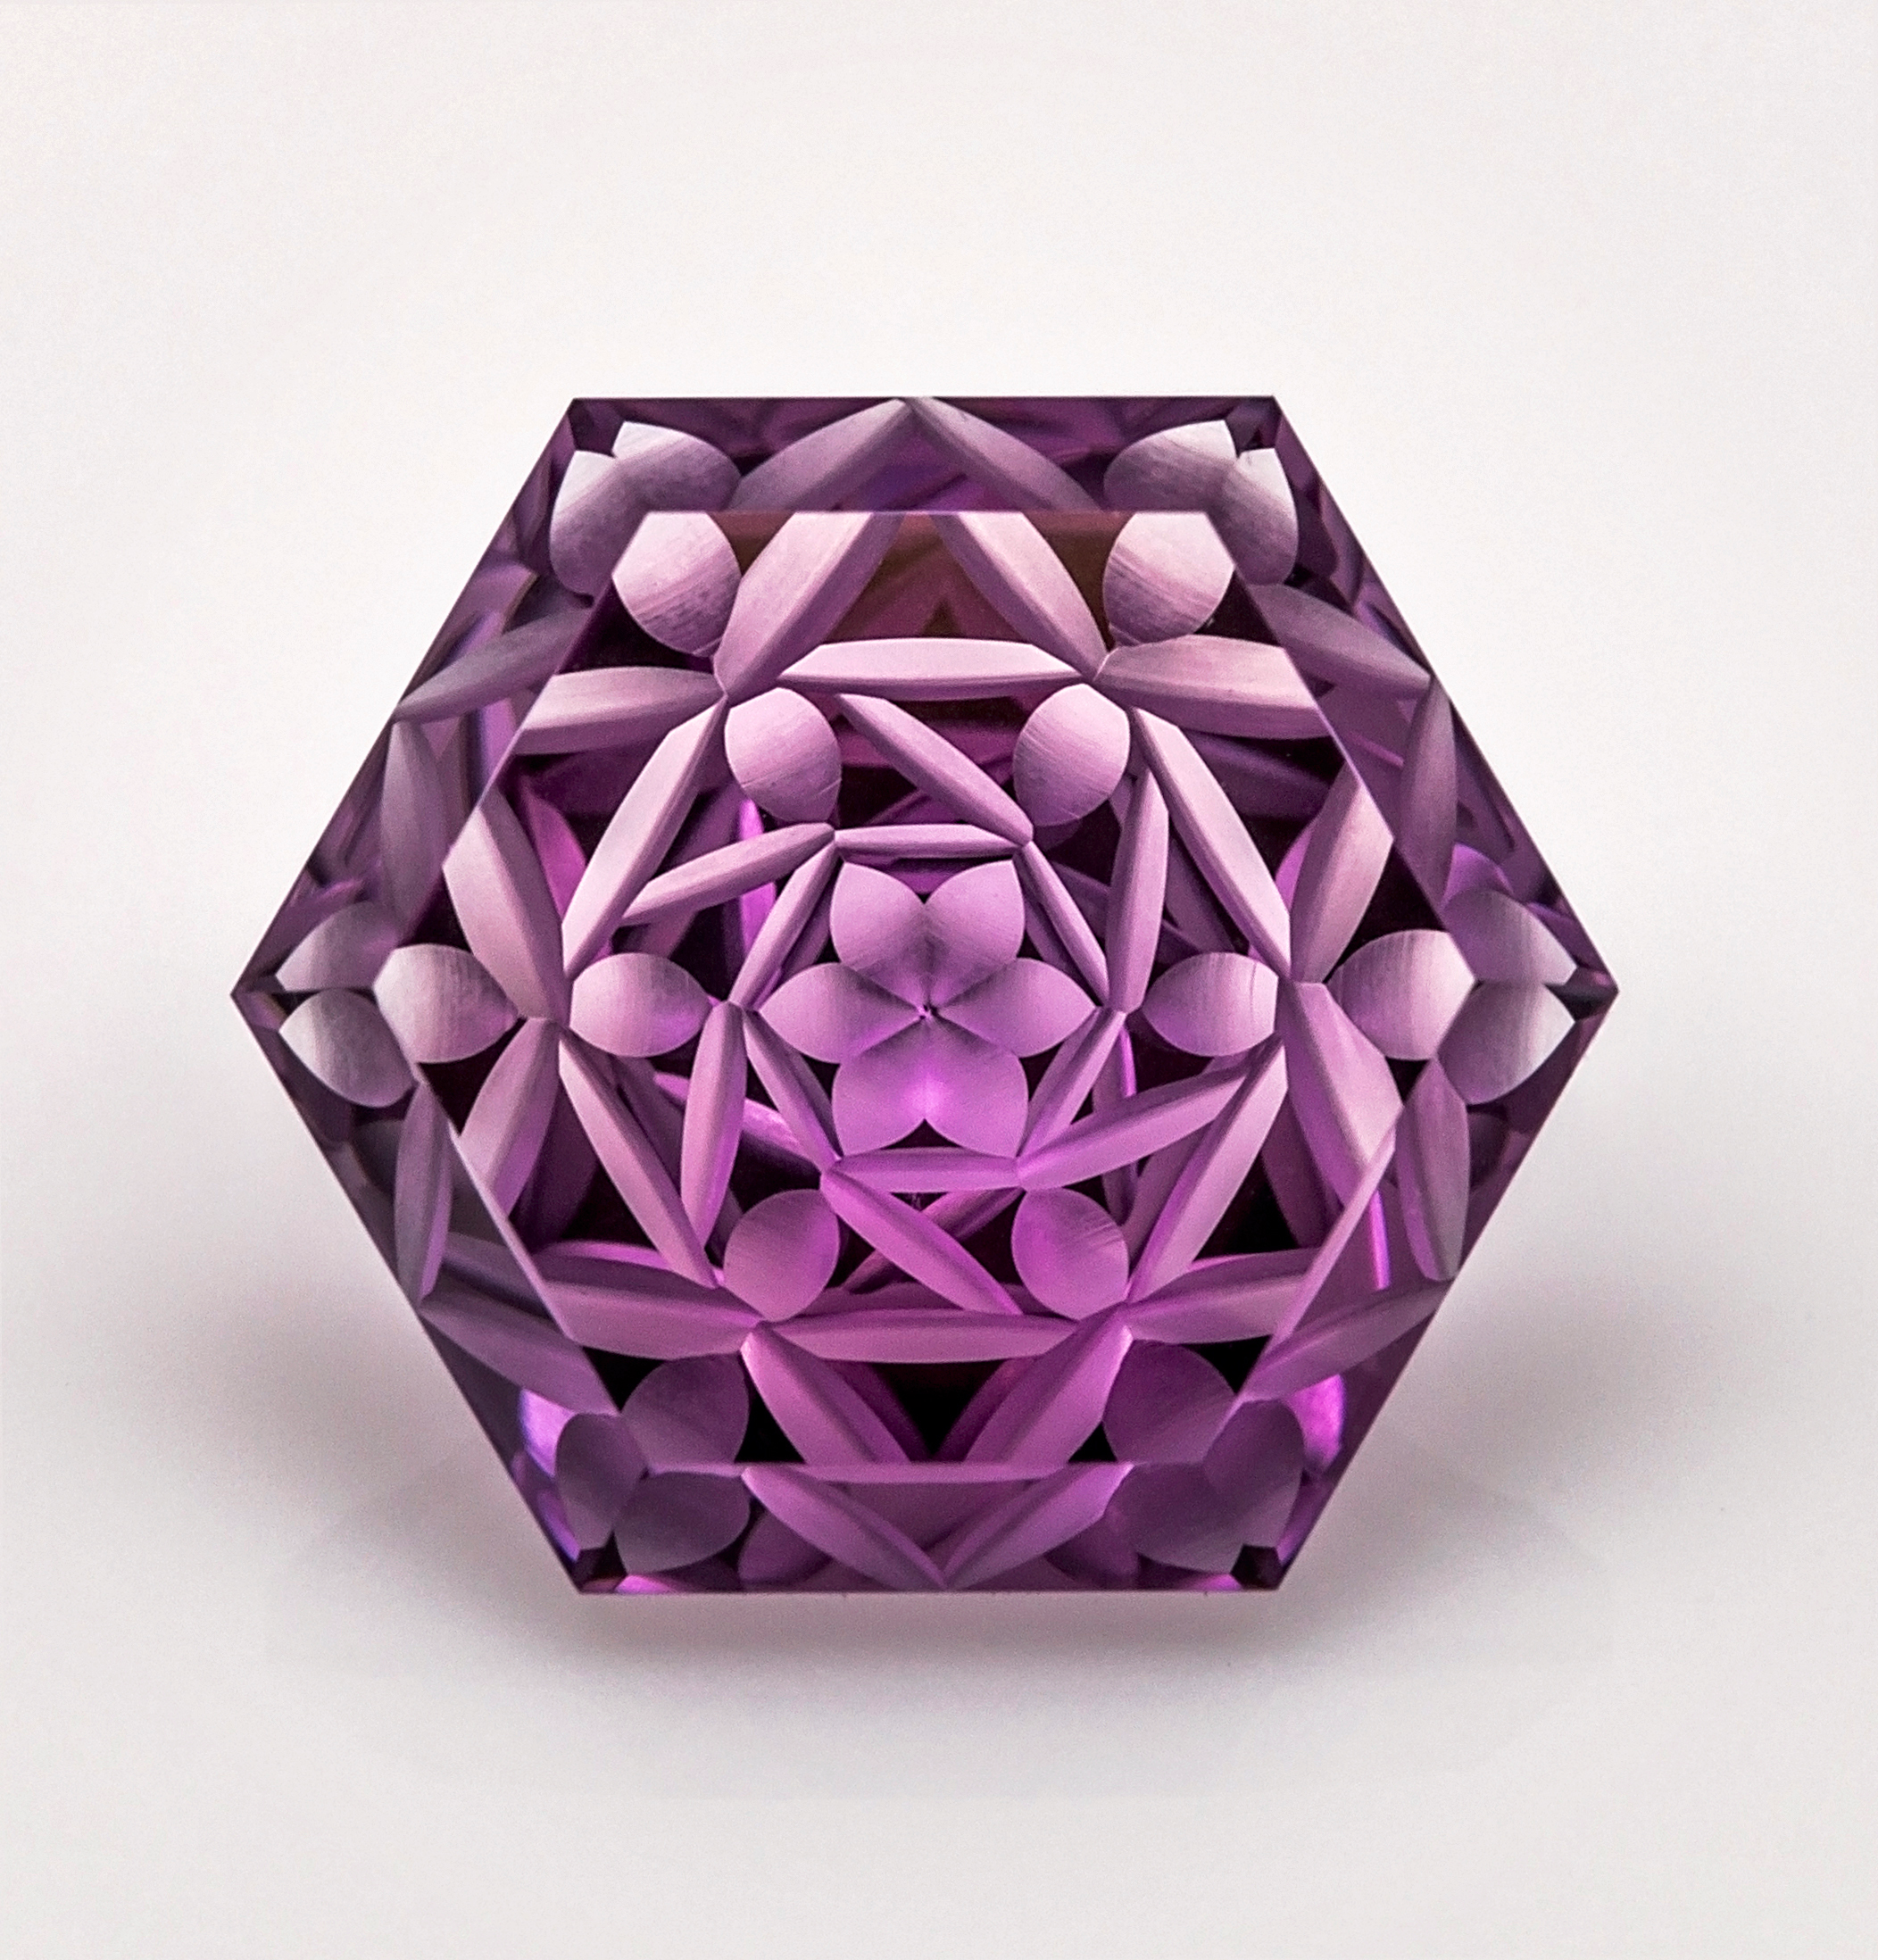
Víctor Tuzlukov
New edge of world gem faceting

Slide 7
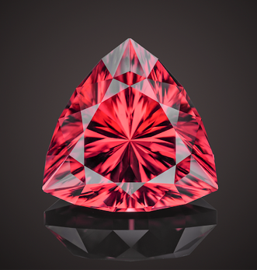
Víctor Tuzlukov
New edge of world gem faceting

Slide 8
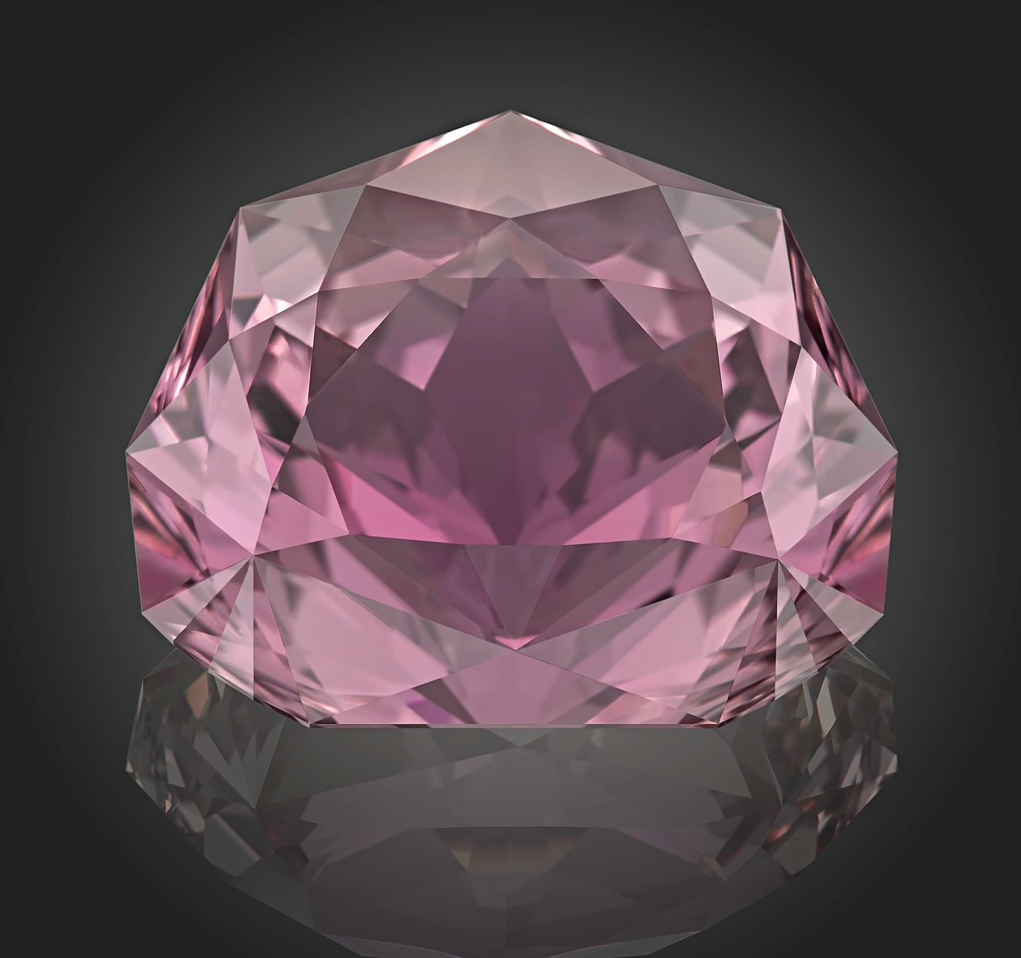
Víctor Tuzlukov
New edge of world gem faceting
Photo:
Arjuna Irsutti

Slide 9
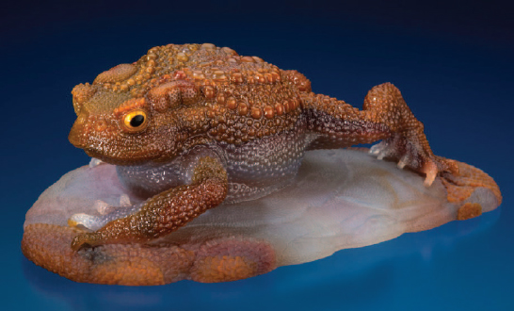
Víctor Tuzlukov
New edge of world gem faceting
Gerd and Patrick Dreher - FROG

Slide 10
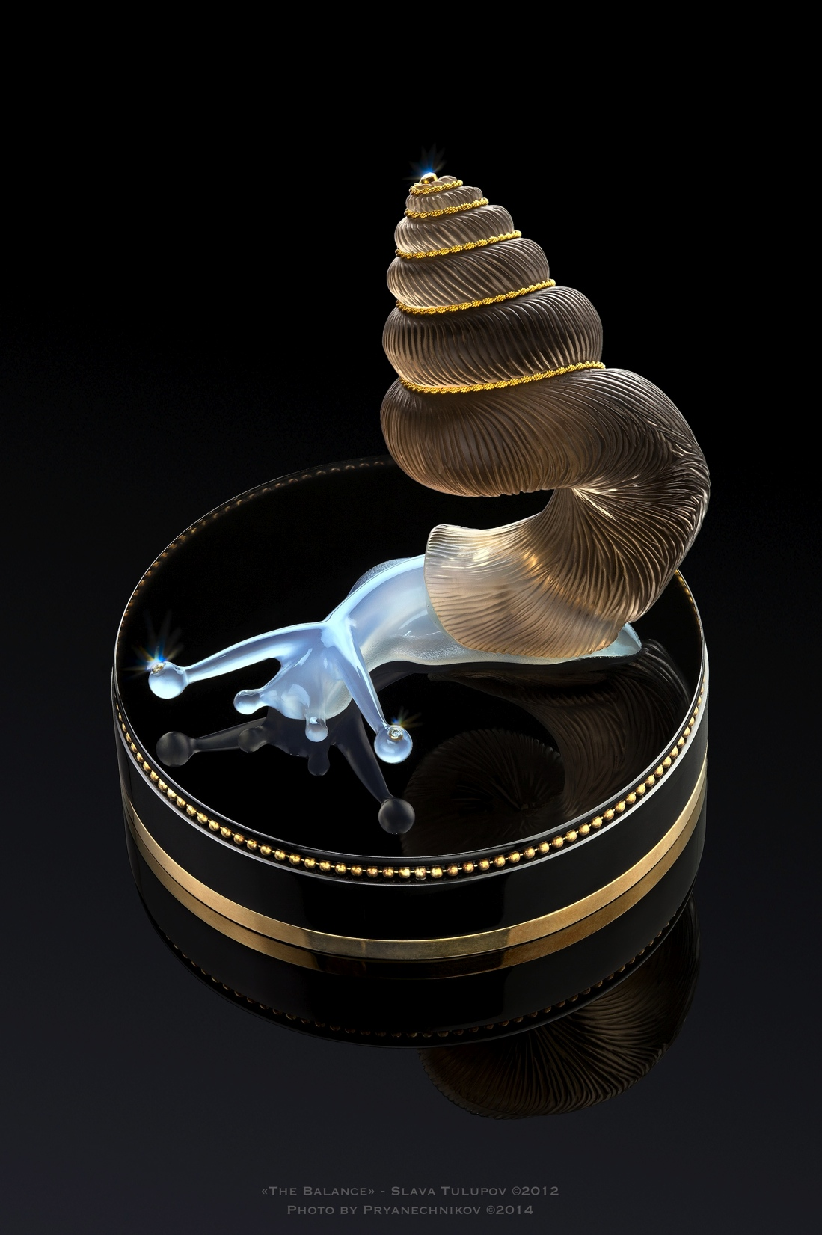
Víctor Tuzlukov
New edge of world gem faceting
Slava Tulupov
“BALANCE”
Photo by
Sergey Pryanechnikov

Slide 11
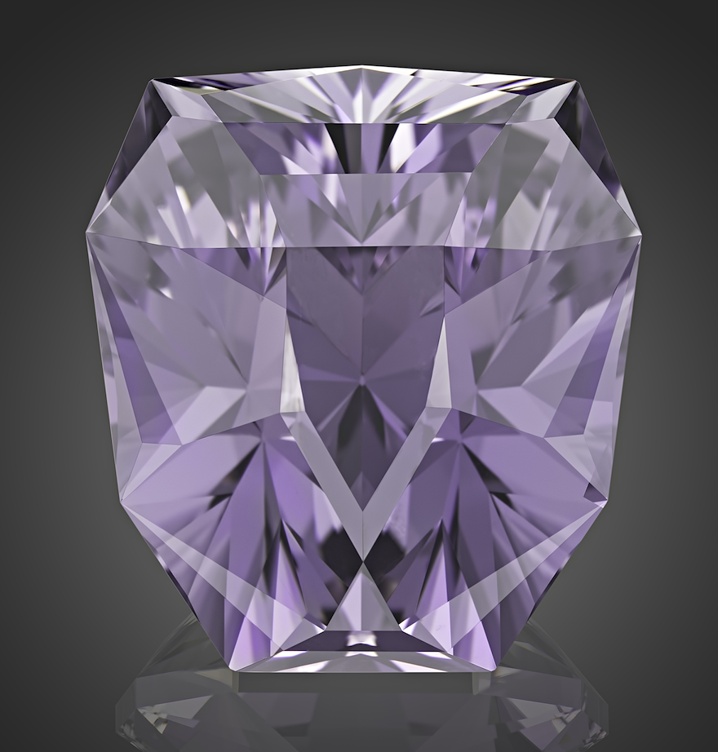
Víctor Tuzlukov
New edge of world gem faceting
“WINNER”
Kunzite, 200 ct
(“Philosophical Stone”
collection)
Photo by
Arjuna Irsutti

Slide 12
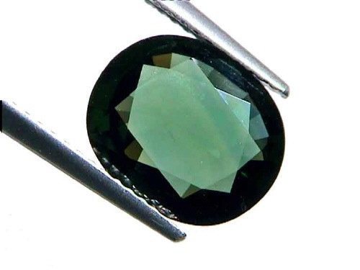
Víctor Tuzlukov
New edge of world gem faceting
Cutting with
wrong proportion
to maximize weight

Slide 13
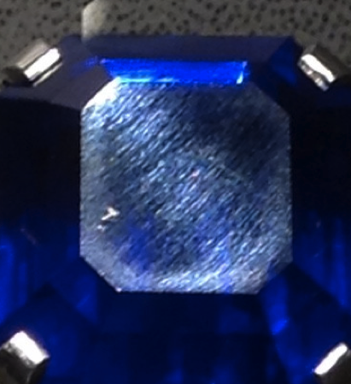
Víctor Tuzlukov
New edge of world gem faceting
Commercial
polishing on
Kashmir sapphire

Slide 14
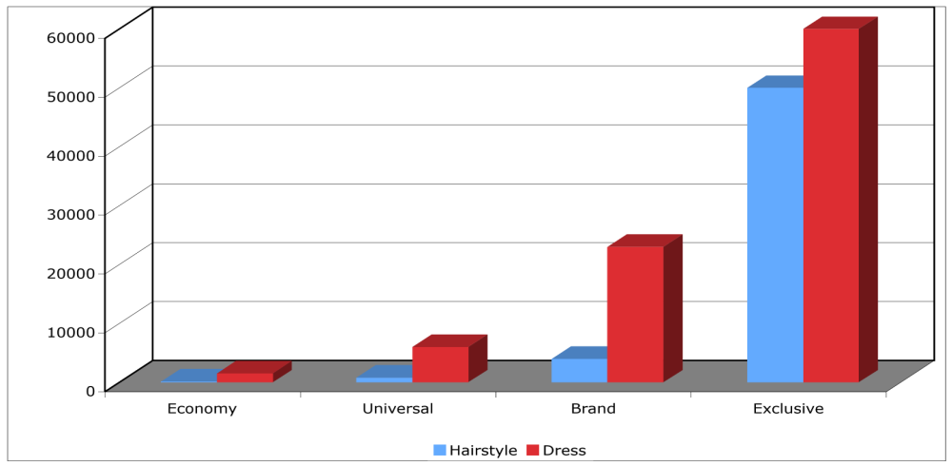
Víctor Tuzlukov
New edge of world gem faceting
Price categories in some image-making products

Slide 15
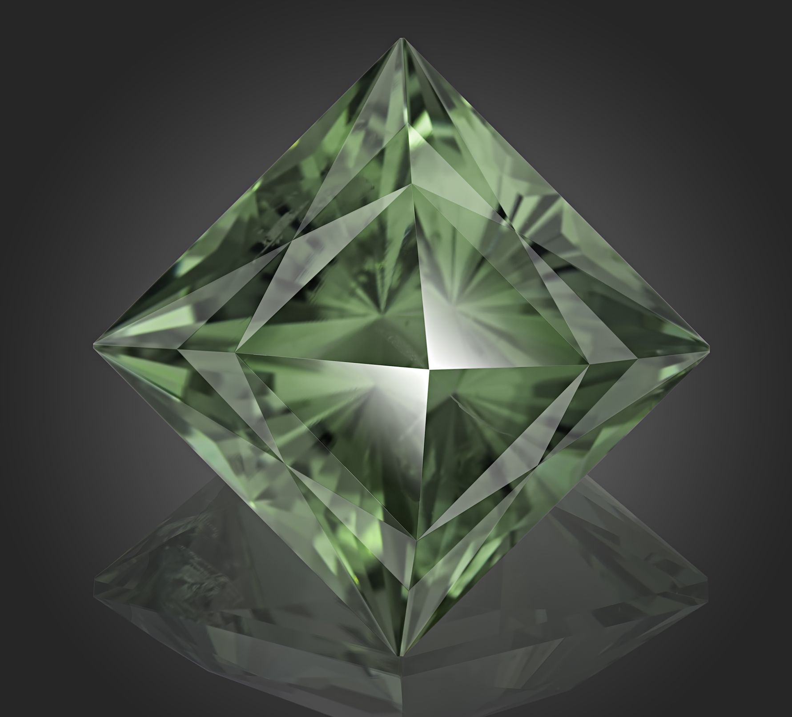
Víctor Tuzlukov
New edge of world gem faceting
“TOUCHING
of HURRICANE”
Green Quartz,
73.71 ct
(“Elements” collection)
Photo by
Arjuna Irsutti

Slide 16
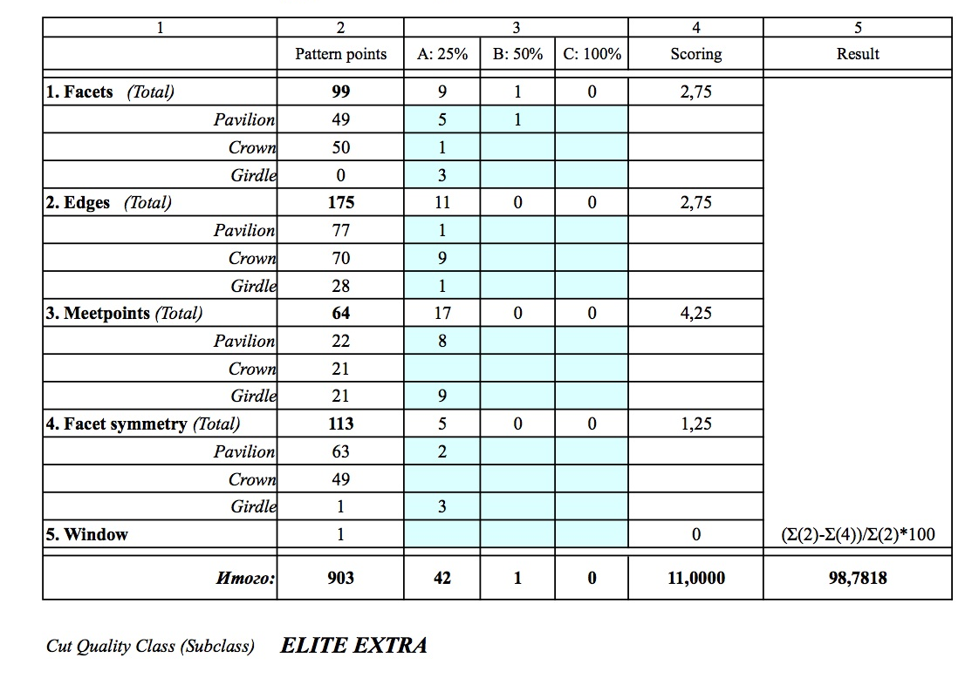
Víctor Tuzlukov
New edge of world gem faceting

Slide 17
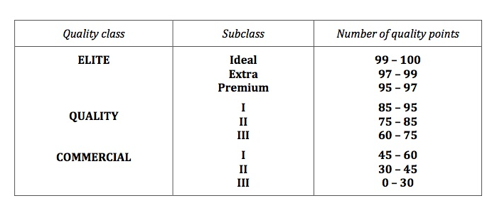
Víctor Tuzlukov
New edge of world gem faceting
Cut Grading System: Quality Classes

Slide 18
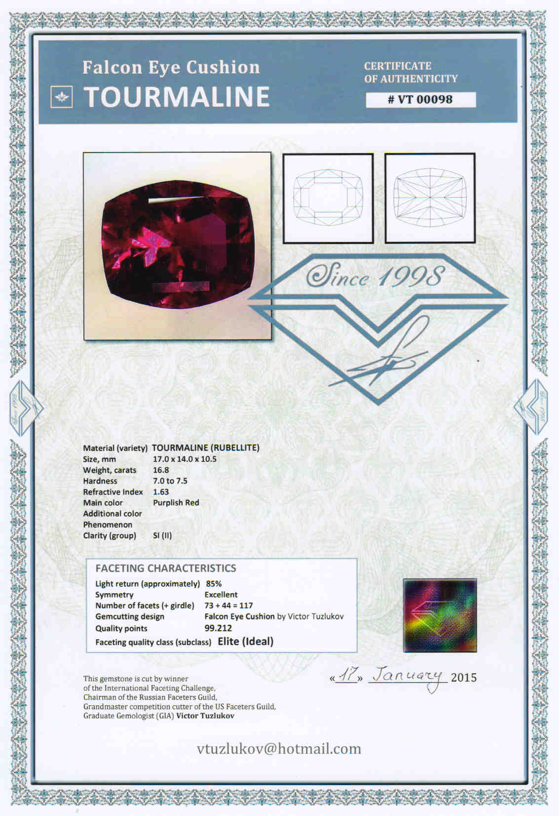
Víctor Tuzlukov
Cut Grading System:
Author’s certificate
with cut quality
evaluation

Slide 19
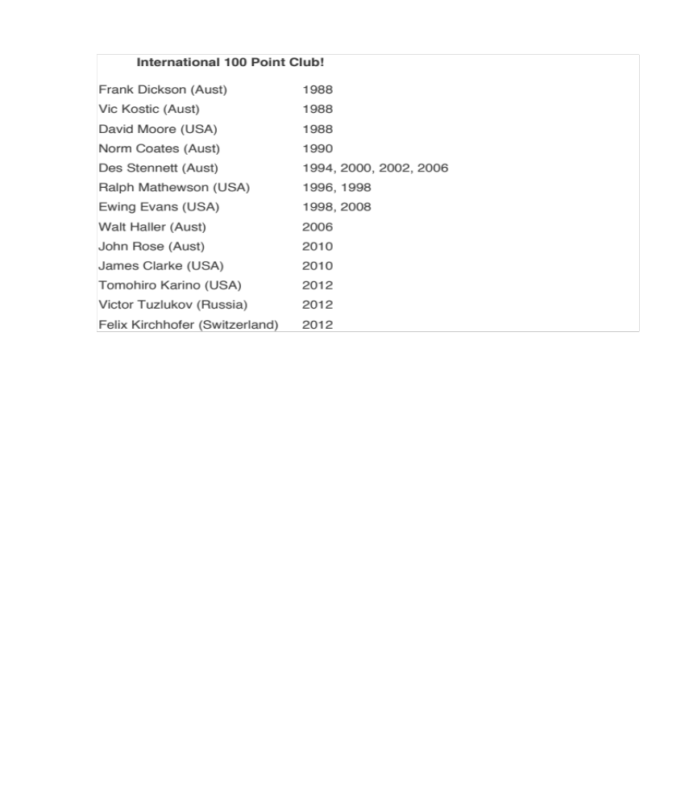
Víctor Tuzlukov
New edge of world gem faceting
International 100-point club
(based on results of International Faceting Challenges)

Slide 20
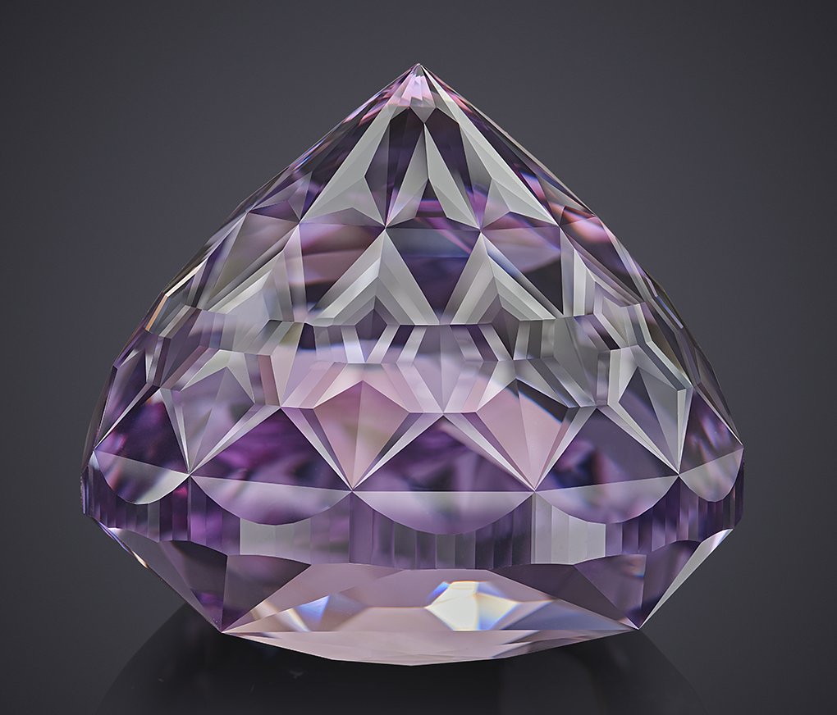
Víctor Tuzlukov
New edge of world gem faceting
Mail to:
vtuzlukov@hotmail.com
Facebook:
Victor.Tuzlukov
Thanks for your attention!

