Slide 1
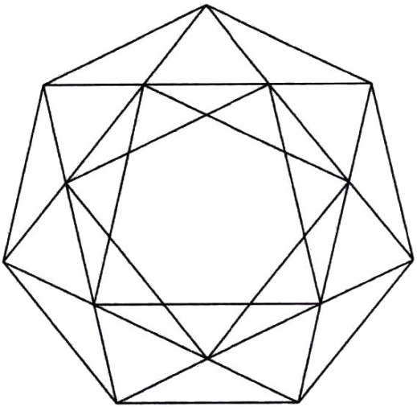
GEMCUTTING: what’s new?
Part I
Precision cut

Slide 2
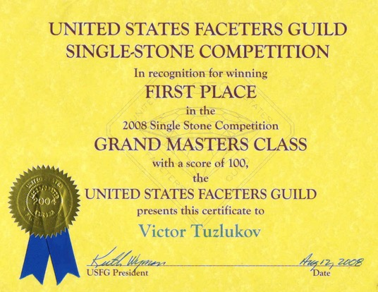
USFG: Single Stone Competition
Part I. Precision cut

Slide 3
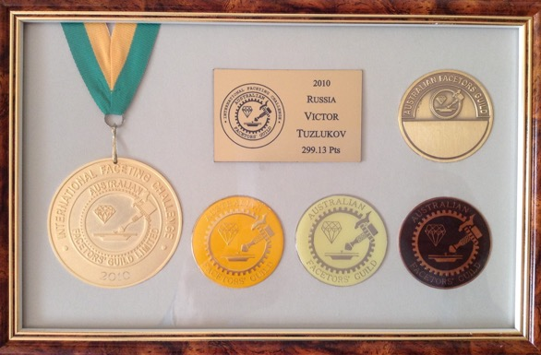
AFG: International Faceting Challenge
Part I. Precision cut

Slide 4
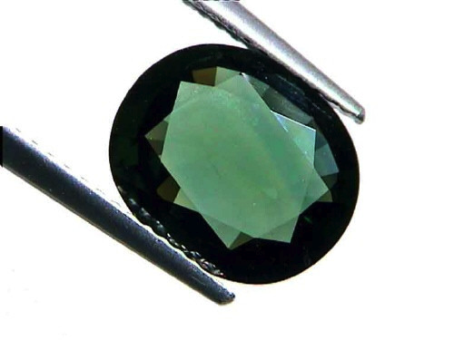
Developing of gemcutting
Part I. Precision cut

Slide 5
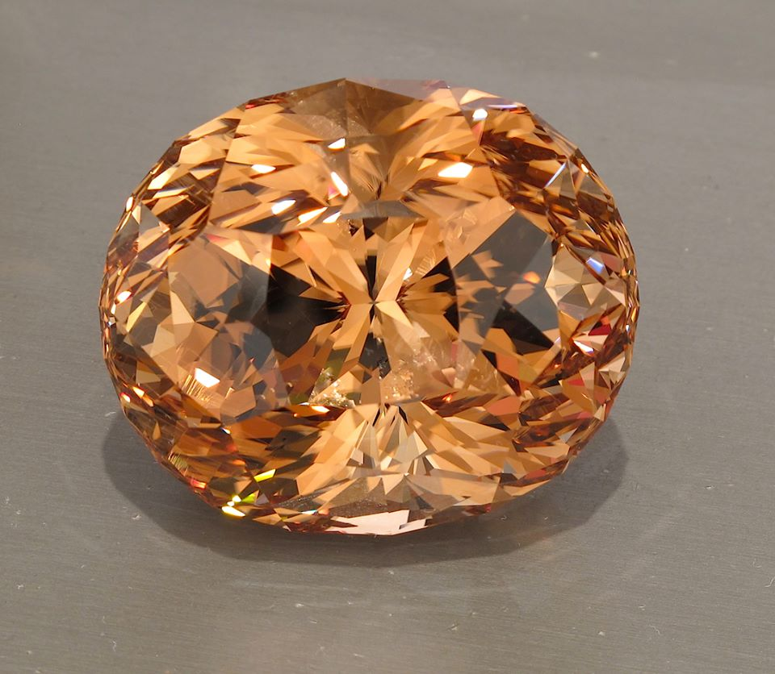
Developing of gemcutting
Part I. Precision cut

Slide 6
Developing of gemcutting
Part I. Precision cut

Slide 7
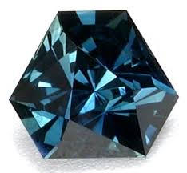
New directions in gemcutting
Part I. Precision cut

Slide 8
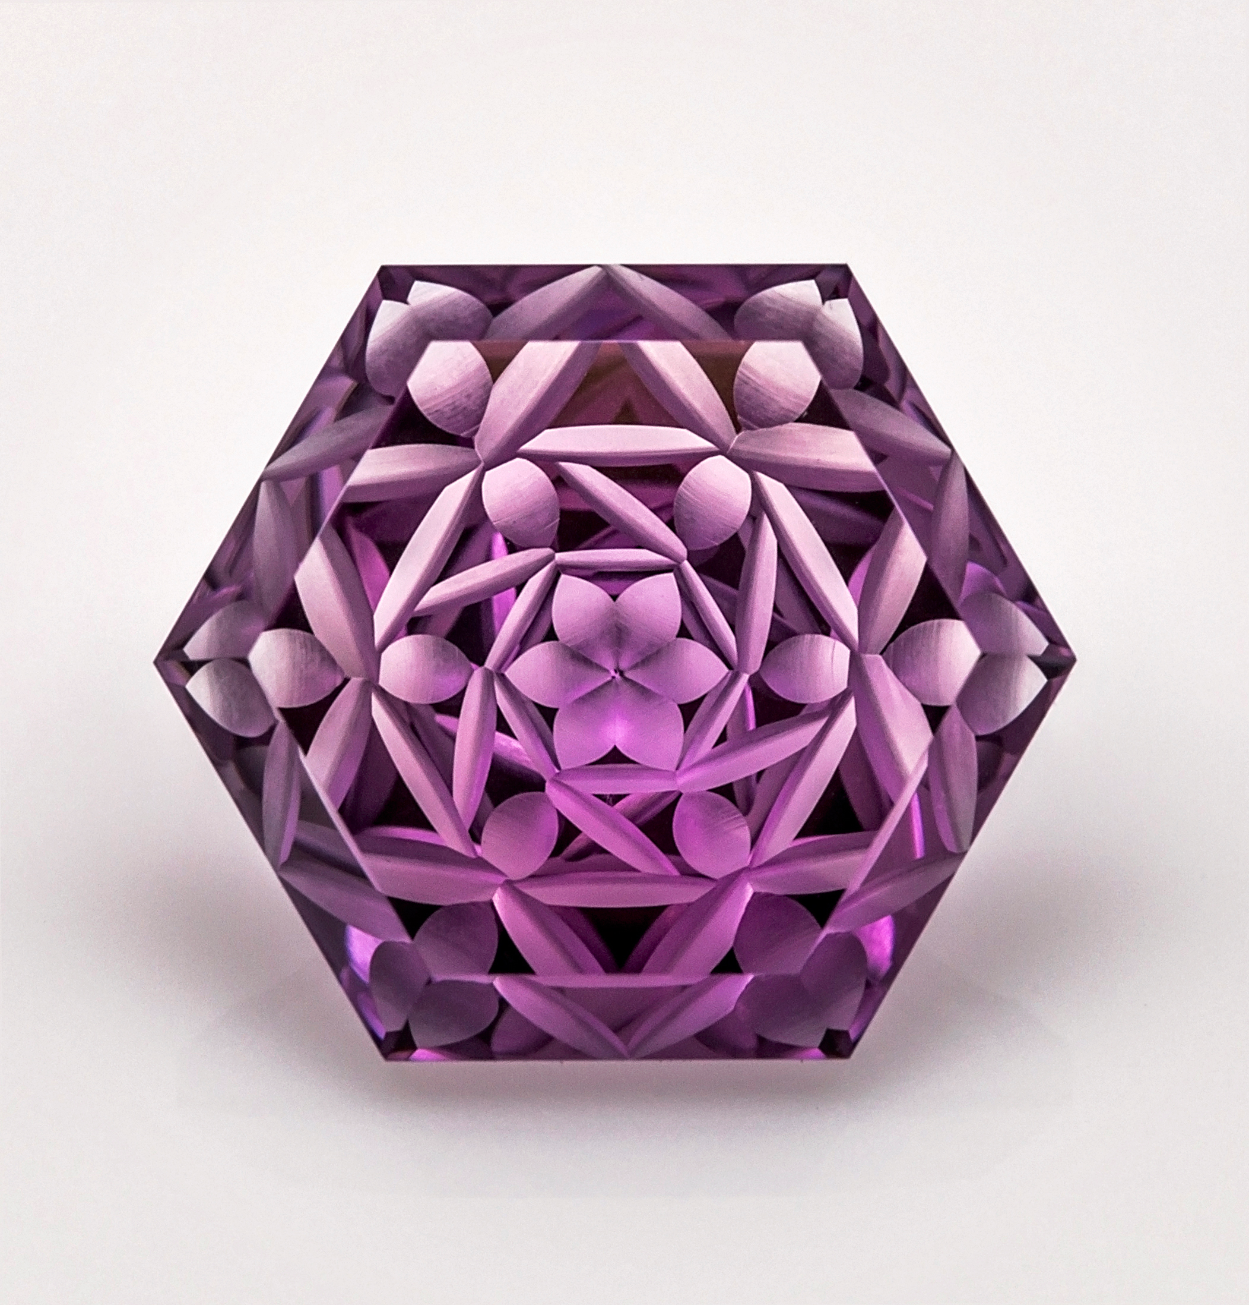
New directions in gemcutting
Part I. Precision cut

Slide 9
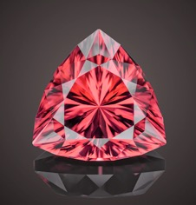
New directions in gemcutting
Part I. Precision cut

Slide 10
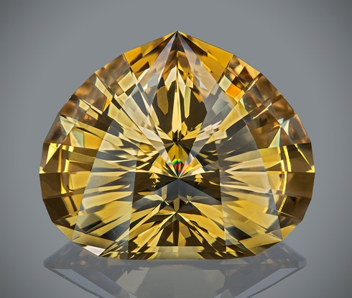
Example: “Drop of Life”
Part I. Precision cut

Slide 11
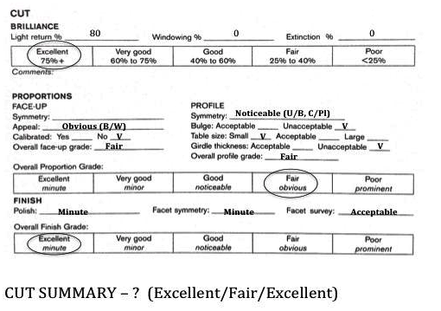
Example: GIA cut grading worksheet
Part I. Precision cut

Slide 12
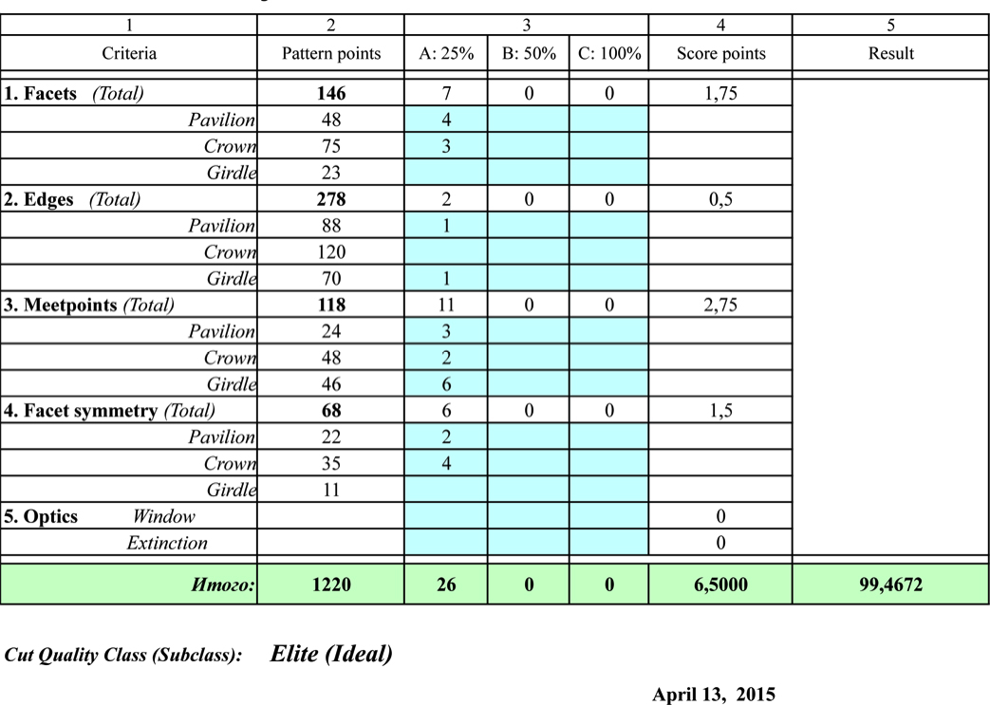
Example: VT cut grading worksheet
Part I. Precision cut

Slide 13
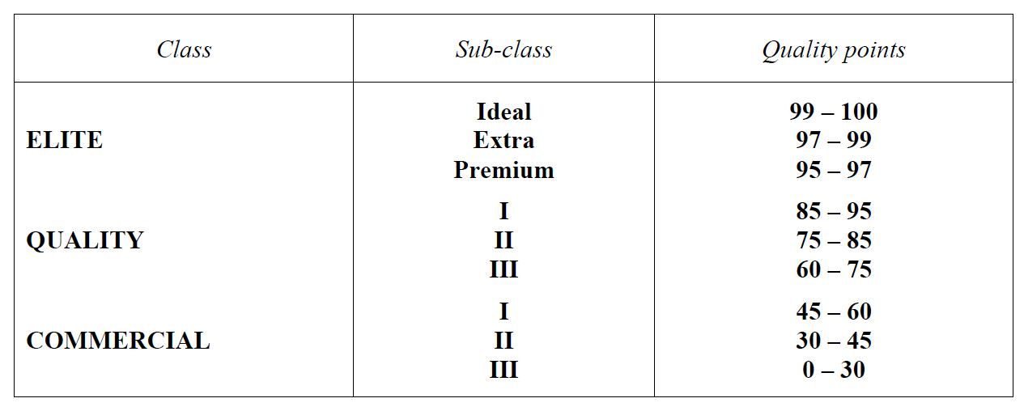
Classification by cut quality
Part I. Precision cut

Slide 14
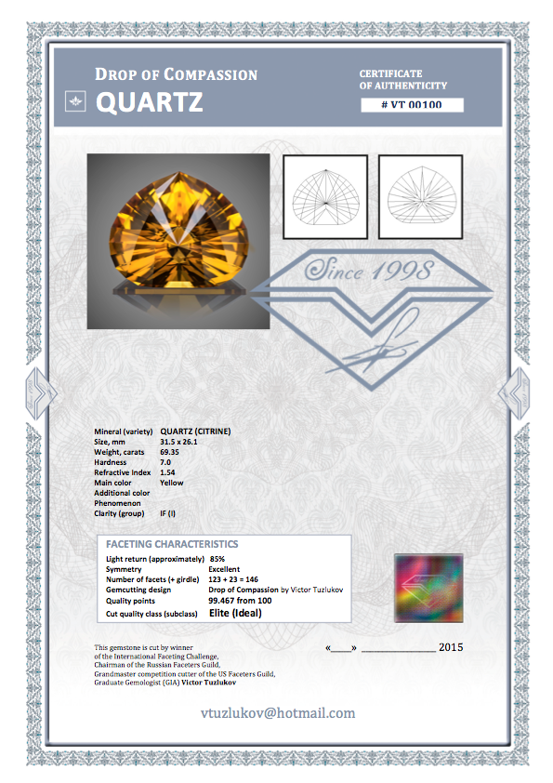
Sample of certificate with cut evaluation
Part I. Precision cut

Slide 15
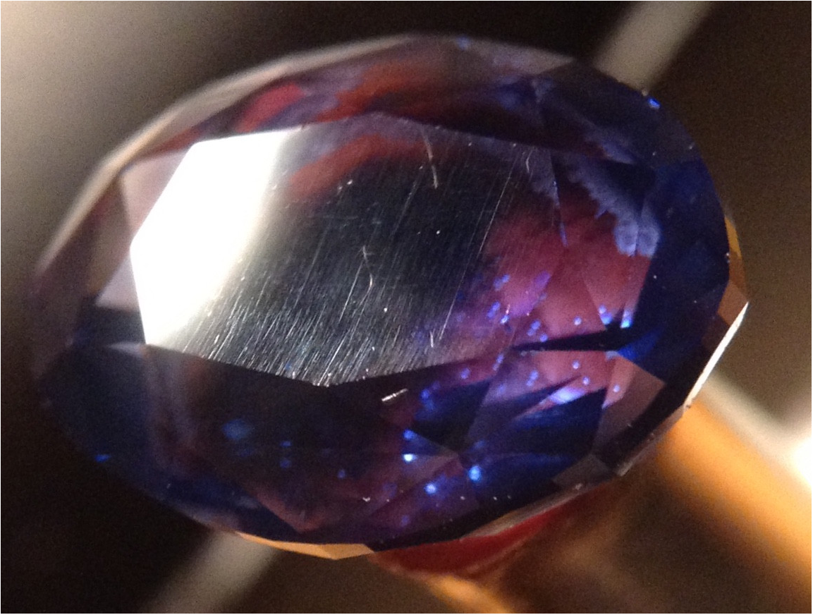
Commercial “polishing”
Part I. Precision cut

Slide 16
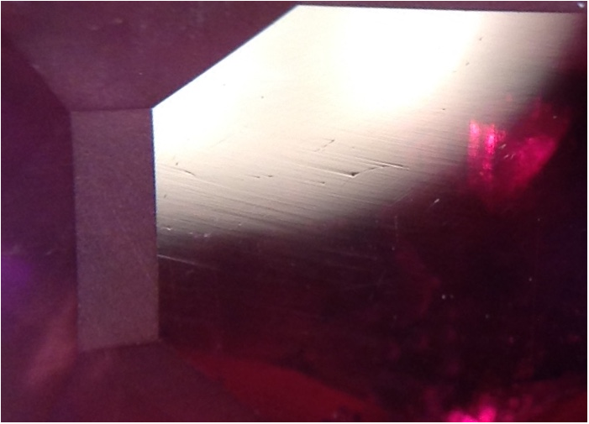
Commercial “polishing”
Part I. Precision cut

Slide 17
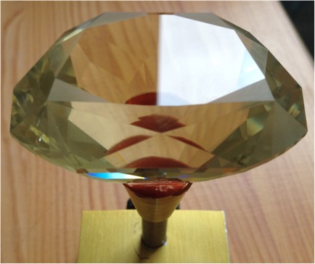
Perfect polishing
Part I. Precision cut

Slide 18
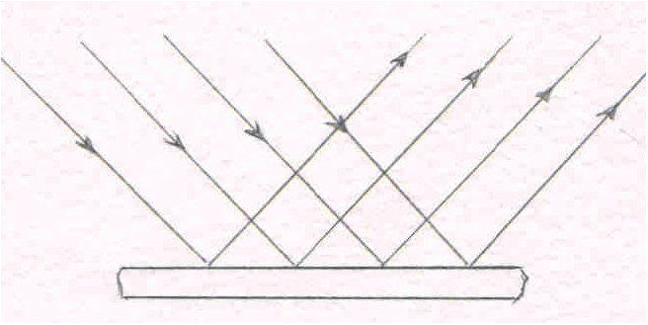
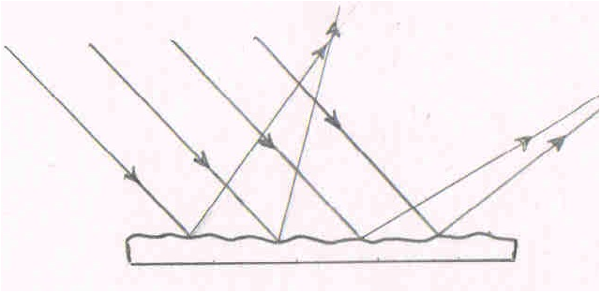
Light reflection depending on surface
Part I. Precision cut
Even surface
Uneven surface

Slide 19
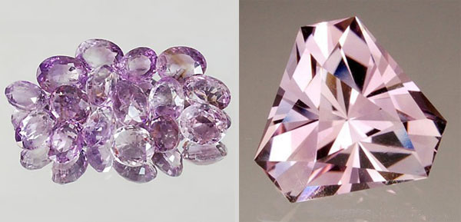
Commercial cut vs precision cut
Part I. Precision cut

Slide 20
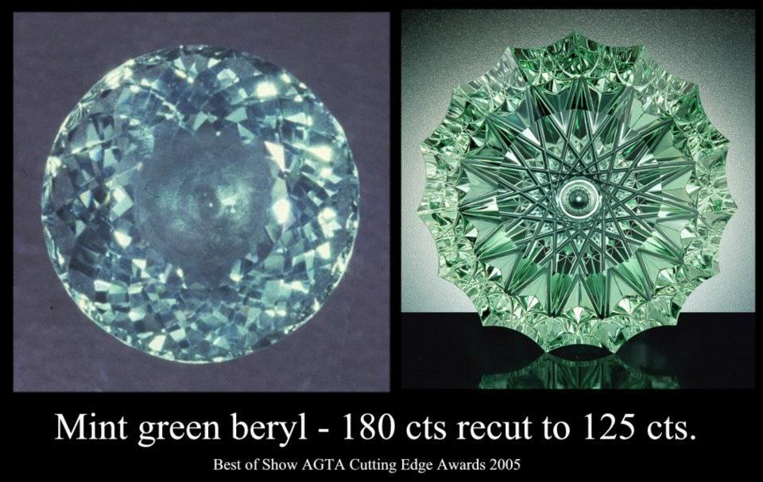
Sample of recutting
Part I. Precision cut

Slide 21
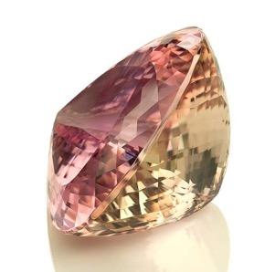
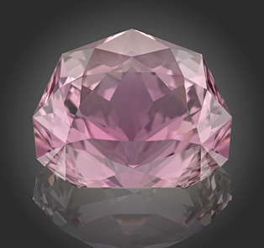
Sample of recutting
Part I. Precision cut
Kunzite
254.2 carats before
“Touching to the Perfection”
161.7 carats after recut

Slide 22
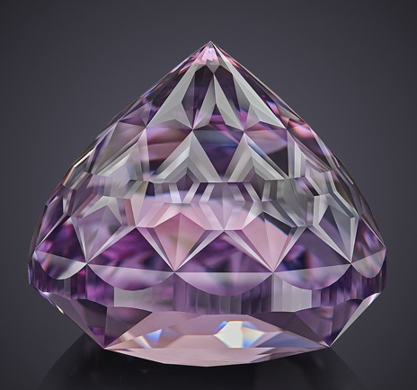
Example: Amethyst, 705 facets
Part I. Precision cut

Slide 23



Thanks for your attention!
vtuzlukov@hotmail.com

