Slide 1
Precision cut: what and how
by Victor Tuzlukov ©

Slide 2
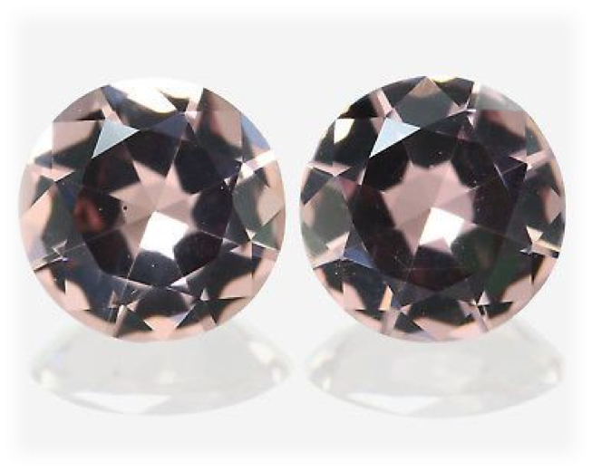
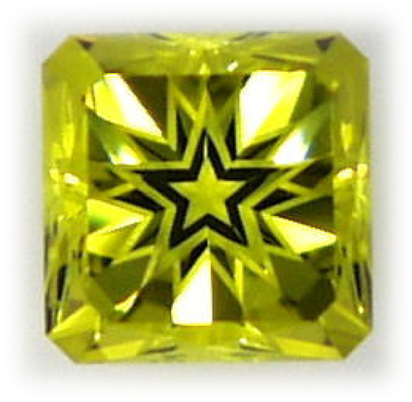
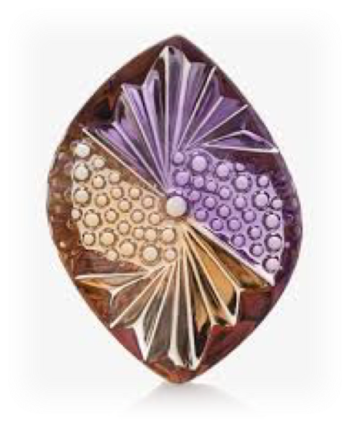
Precision cut ?

Slide 3
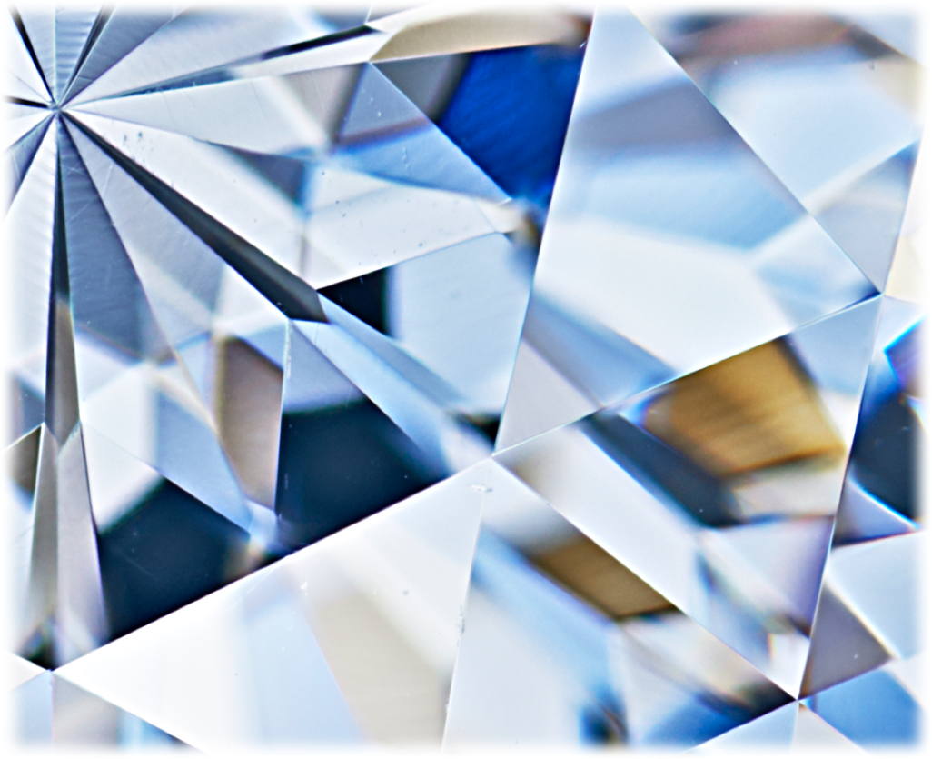
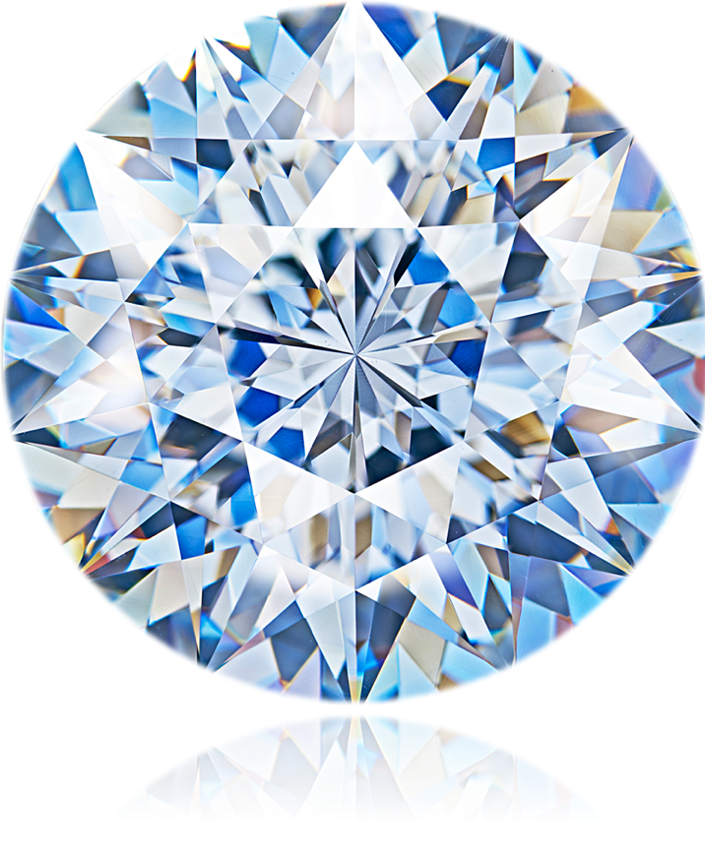
Precision cut !

Slide 4
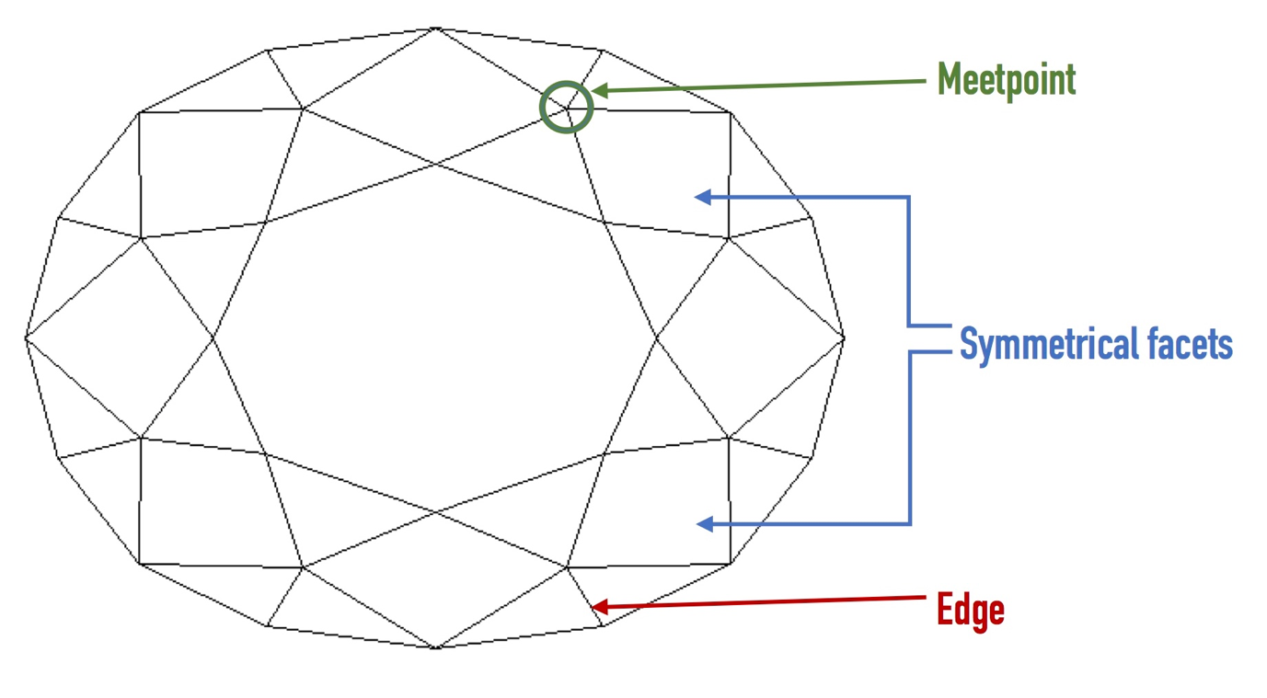
Pattern points

Slide 5
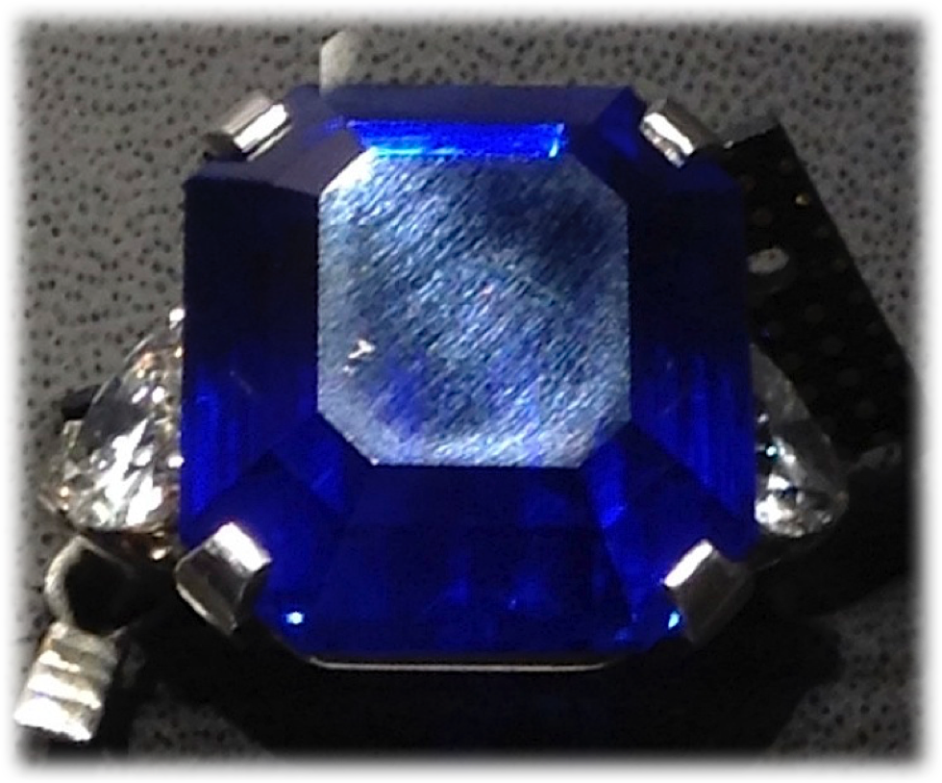
Example
Poor polish should be considered as faceting defect.

Slide 6
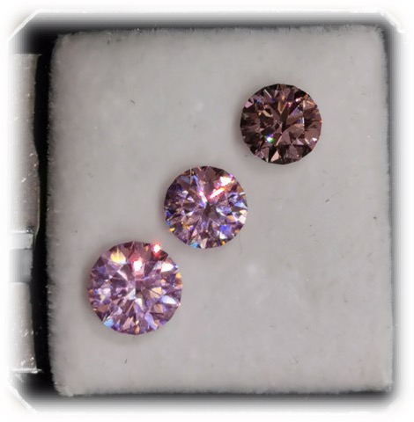
How perfect polish can improve the gem color
Same material, same design, same angles – should be the same color.
Difference is only in polish.

Slide 7
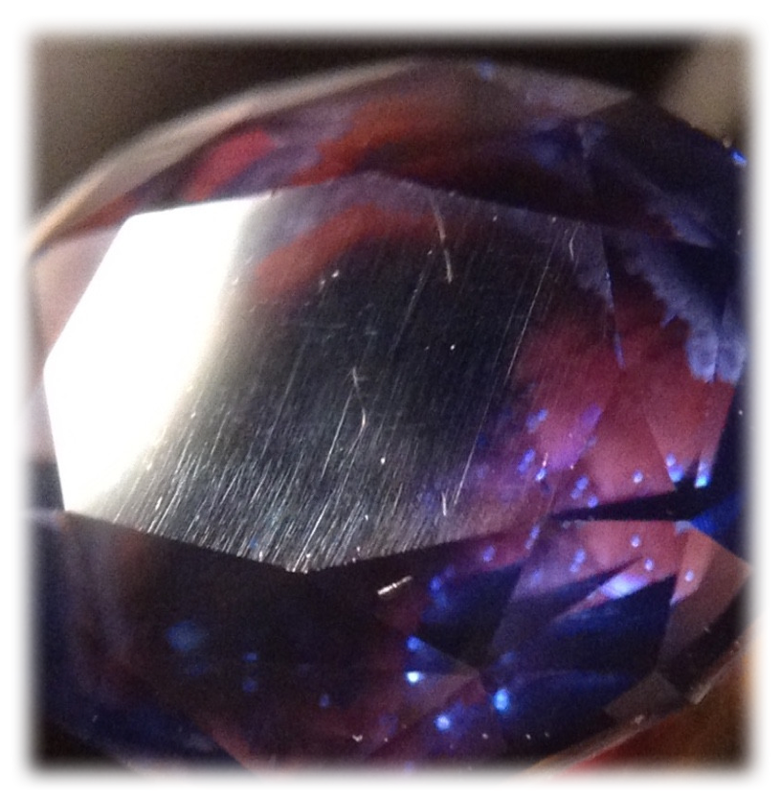
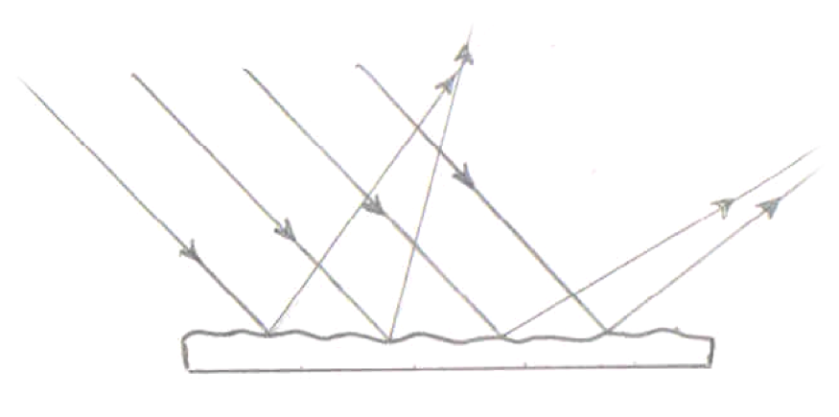
Commercial polish
Light diffusion on uneven surface

Slide 8
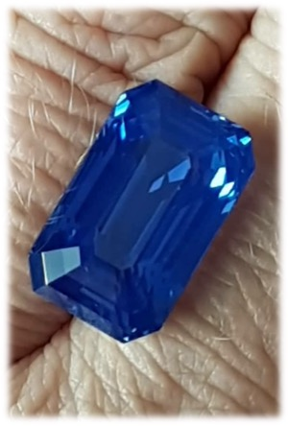
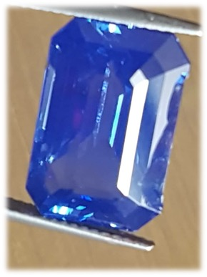
Difference in color
(example 2)
How perfect polish can improve the gem color
(sapphire before and after)

Slide 9
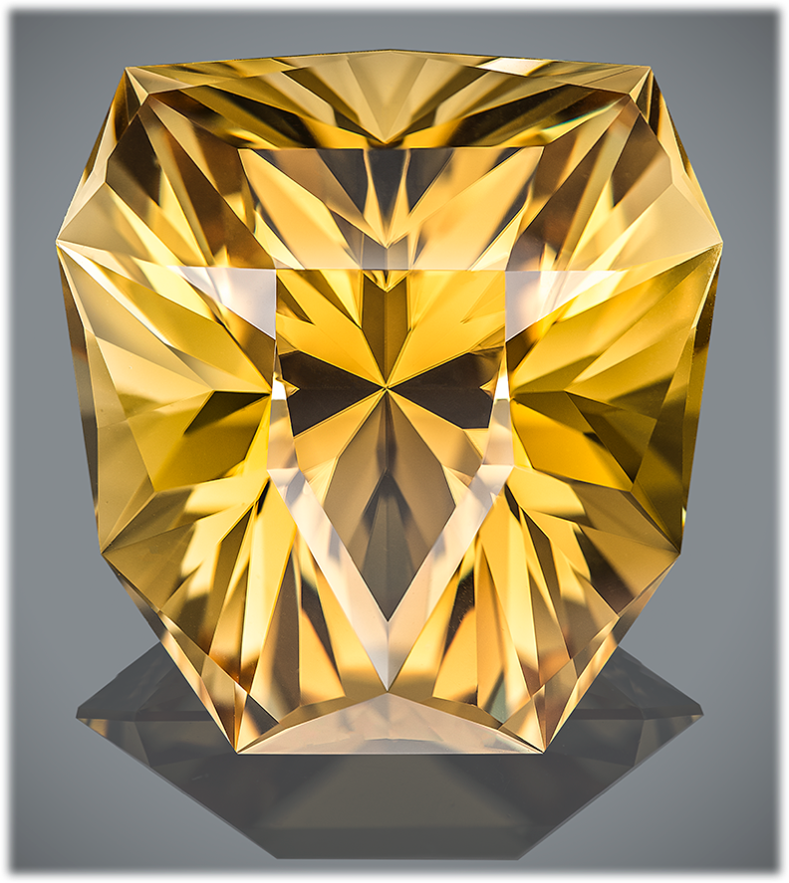
Example of
Artistic cut
“Look of the King”
…He stood looking at me – gracious and wise – and oceans of power and dignity splashed in his eyes, captivating me, dissolving me and taking away somewhere behind the limits of human self-actualization…
One time, at minute of weakness and discouragement, this look will flash before me again. Look of the KING.
Scapolite,
68.08 carats

Slide 10
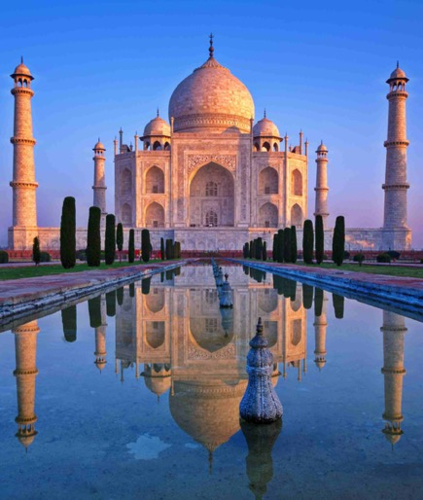
New project.
World heritage
“Don’t ask me how many stones will be included to this collection. This is project of my life, because it is more than my life. Because the world cultural heritage is really inexhaustible…”

Slide 11
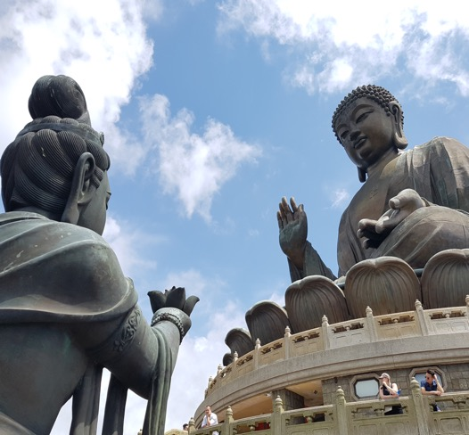
World heritage
Introduction
Initially my goal was to show grains of Wisdom kept in the world cultural heritage…

Slide 12
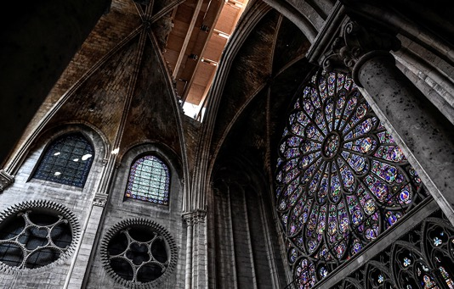
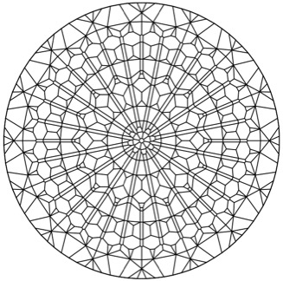
World heritage
Introduction
I feel grateful to my French colleague Lionel Bailey, who gave me the idea to show the stain glass of the cathedral in the faceting diagram.

Slide 13
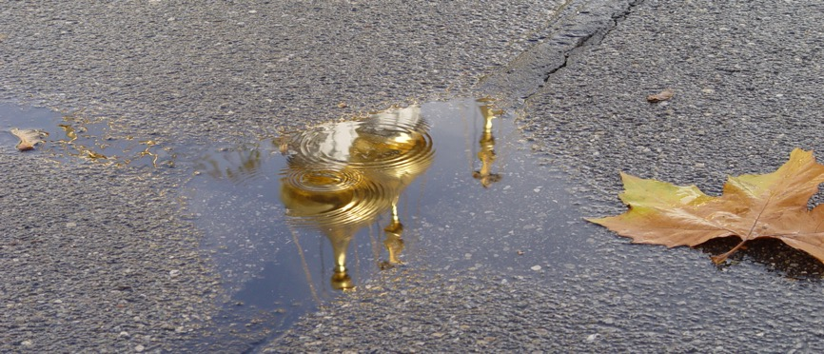
World heritage
Introduction
How do different peoples express Wisdom, Love, Beauty and Harmony? What is the contribution of this or that country to the world cultural treasury?

Slide 14
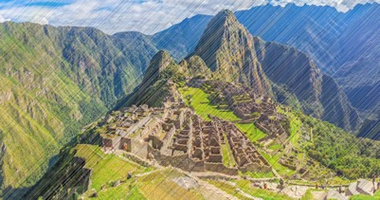
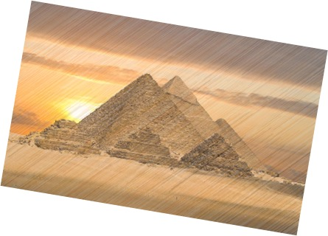
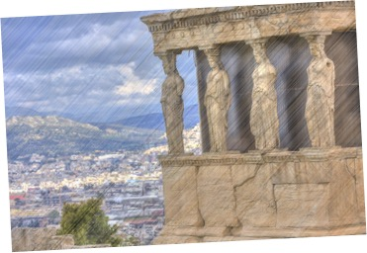
World heritage
Introduction
I want to cover gone civilizations as well, which are the same bricks in the wall of the world heritage.

Slide 15
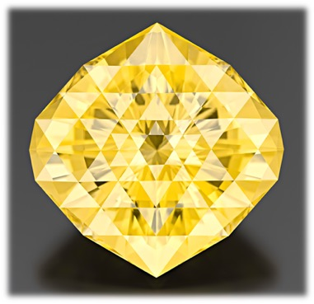
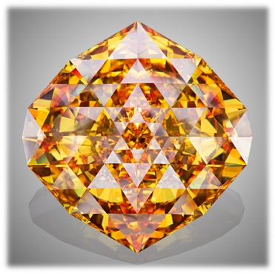
World heritage
Introduction
Sometimes the synthetic rough with its high optical characteristics gives the opportunity to reveal the author's idea more completely.

Slide 16
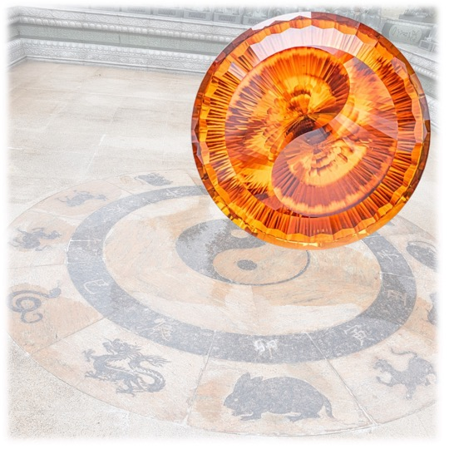
World heritage
1. China
“FROM THE EMPTINESS”
«Ever-dozing Dragon of the Eternity reveals his dual essence from the great Emptiness, forming the Universe. Like a precious flower, the Single Life twinkles inside…»

Slide 17
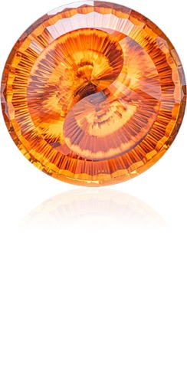
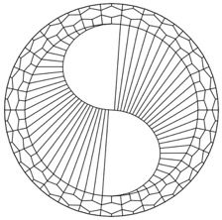
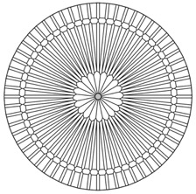
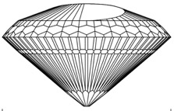
World heritage
1. China
“FROM THE EMPTINESS”
Photo: Dmitry Stolyarevich
Fire Citrine
186.40 carats
712 facets

Slide 18
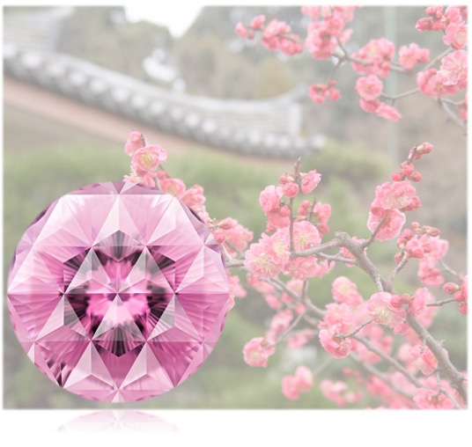
World heritage
2. japan
“FACES OF PERFECTION”
«Sakura finishes blossoming quite fast, and flight of arrow is swift. But the beauty of flower is immortal, as well as the power of flying arrow. Power and Beauty are two faces of the single Perfection… »

Slide 19
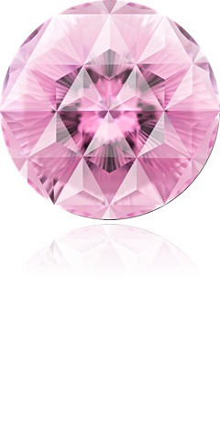
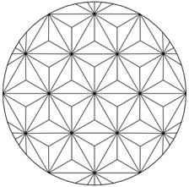
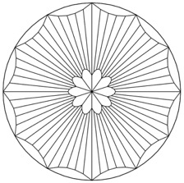
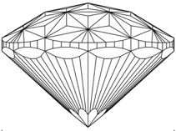
World heritage
2. JAPAN
“FACES OF PERFECTION”
Photo: Arjuna Irsutti
Kunzite
112.85 carats
250 facets

Slide 20
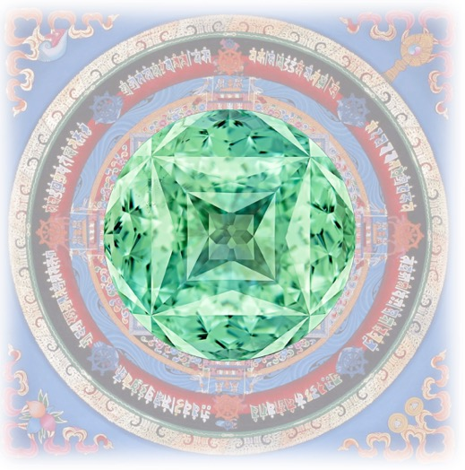
World heritage
3. TIBET
“REFLECTION OF THE GREAT”
«The Great Mandala is shining in the small gemstone. A small man is realizing the great teachings. The tiny may contain the Grand, being the beginning, the end and the evolution itself… »

Slide 21
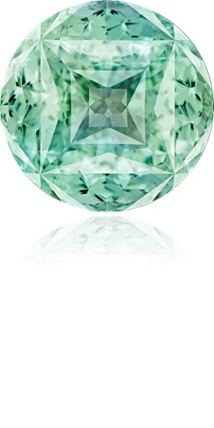
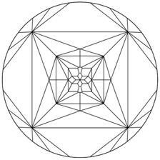
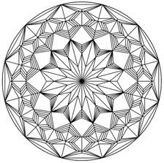
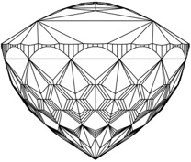
World heritage
3. TIBET
“REFLECTION OF THE GREAT”
Photo: Arjuna Irsutti
Topaz
160.94 carats
722 facets

Slide 22
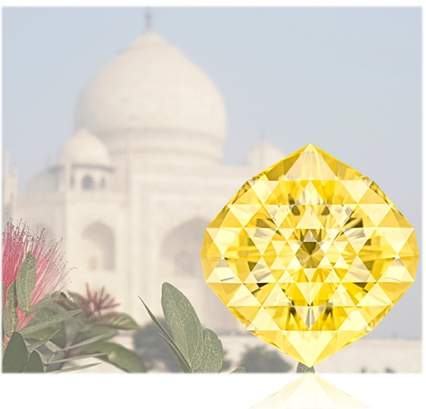
World heritage
4. INDIA
“HEART AND ESSENCE”
«Beauty is the goal and means; Ray of the Middle Way – Ray of Saving – is shining like a treasure in the Lotus flower between the ways of Destroying and Creation, similar to spirit of three-tongued flame, being the heart and the essence of our Universe… »

Slide 23
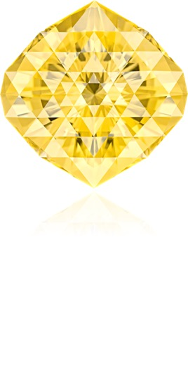
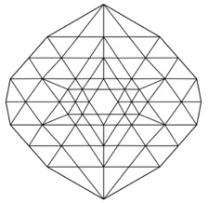
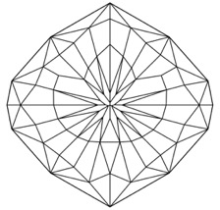
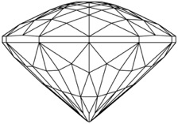
World heritage
4. INDIA
“HEART AND ESSENCE”
Photo: Arjuna Irsutti
Scapolite
199.84 carats
205 facets

Slide 24
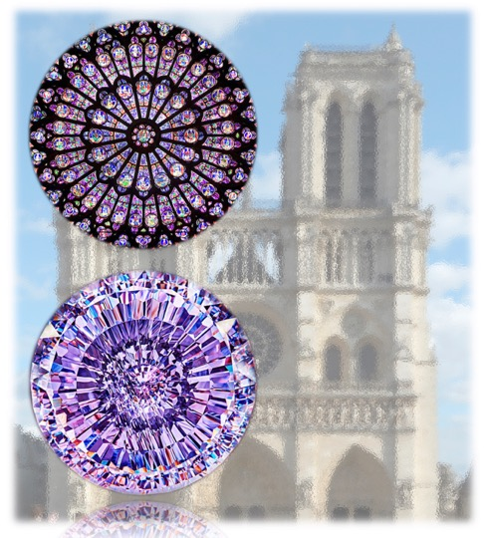
World heritage
5. FRANCE
“FRAGILITY OF THE ETERNAL”
«History teaches us how fragile our heritage could be: what had been created and kept by centuries might be damaged or even destroyed in a matter of hours…»

Slide 25
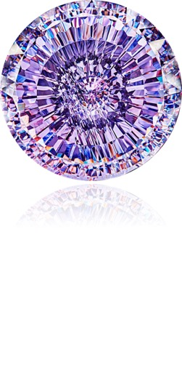
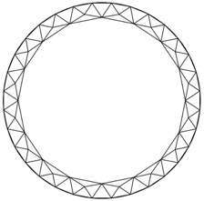
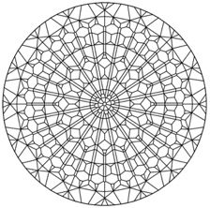
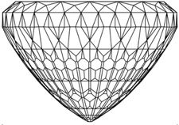
World heritage
5. FRANCE
“FRAGILITY OF THE ETERNAL”
Photo: Dmitry Stolyarevich
Cubic Zirconia (synthetic)
424.19 carats
860 facets

Slide 26
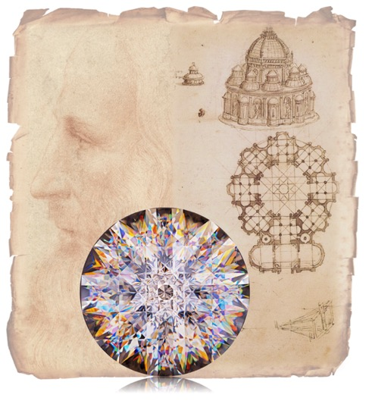
World heritage
6. ITALY
“VERSATILITY OF GENIUS”
«When beauty of artistic images and precision of geometric drawings merge in the great Harmony, they reflect the multidimensional nature of Genius.»

Slide 27
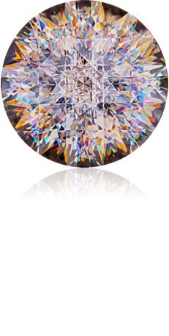



World heritage
6. ITALY
“VERSATILITY OF GENIUS”
«When beauty of artistic images and precision of geometric drawings merge in the great Harmony, they reflect the multidimensional nature of Genius.»

Slide 28
Thanks for your attention!
E-mail: vtuzlukov@hotmail.com
Whatsapp: +7 926 732 0799

